Slide 1
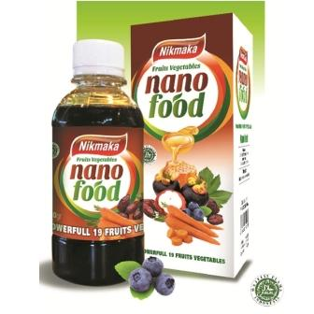


Notification of Ministry of Public Health
(No.376) B.E. 2559 (2016)
Re: Novel Food
1

Slide 2
Topic
Background and current issue
Introduction of Notification of Ministry of Public Health (MoPH) for novel food
  Definition of novel food
  Main requirements for novel food
  Examples of novel food
Examples of Novel food
2

Slide 3


“Food” under Food Act B.E. 2522 (1979)
Edible items and those which sustain life including:
(1) Substances can be eaten drunk, sucked or gotten into the body either by mouth or by other means, no matter in what form;
(2) Substances intended for use as ingredients in the food production including food additives, coloring, flavoring agents
Medicine, psychotropic substances, narcotic under relevant laws
3

Slide 4



Example food category: Food Supplement
“Products taken for consume other than conventional foods which contain nutrients or other substances as ingredients, are in forms of tablets, capsules, powders, flakes, liquids or others ; which are not conventional foods for consumers who expect for benefit of health promotion”
Clear statement on label:
“should regularly eat different varieties of full 5 categories of food, in an appropriate proportion” and
“No effect for prevention or cure diseases”
4

Slide 5




Example of food category: Special Purposed Foods
“processed, formulated, or specific ingredient foods, for special purpose fit to physical, physiology, or irregular body, by characteristics, appearances, or categories and quantities of ingredients which are clearly different from the same of normal foods”
1
Diabetic
Foods for specific patients or physically irregular figure.
Weight control
2
Elderly
Foods for persons which require
special purpose in food consumption
Pregnant women
5

Slide 6
Current food trend
- Consumers are becoming more health-conscious leading to increasing variety of new products with health-related benefits such as herbal food supplements
- Development of new or innovative process may give rise to significant changes in the composition or structure of such food which affect their nutritional value, metabolism or level of undesirable substances
Novel food
- No history of human consumption as food
- Any production process not currently used leading affect their nutritional value or level of undesirable substances
This may present a risk to public health
6

Slide 7
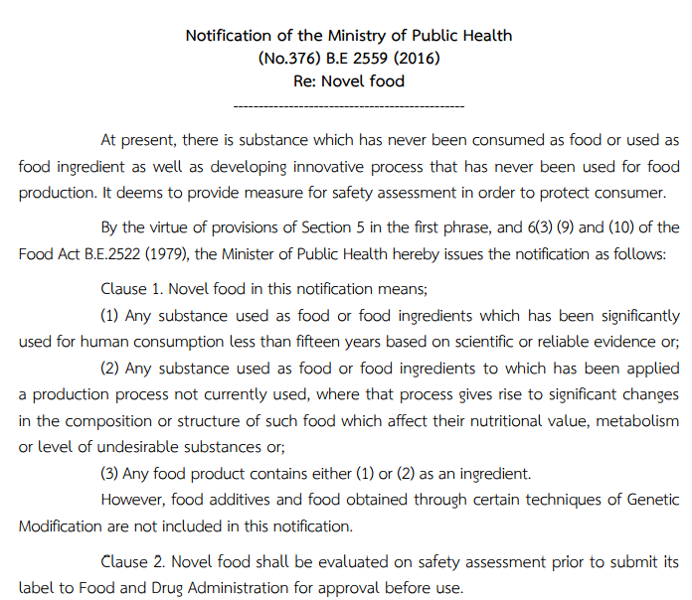

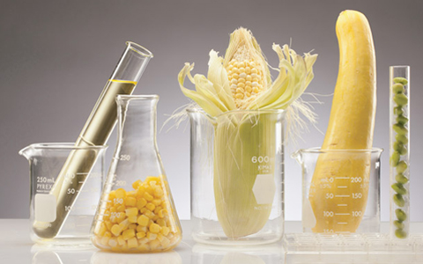

Notification of Ministry of Public Health (No.376) B.E. 2559 (2016) Re: Novel food
Link: http://food.fda.moph.go.th/law/announ_moph351-400.php
7

Slide 8
Notification of MoPH (No.376) B.E. 2559 (2016) Re: Novel food
Main points
1. Definition: “Novel food” mean
(1) Any substance used as food or food ingredients which has been significantly used for human consumption less than fifteen years based on scientific or reliable evidence or;
(2) Any substance used as food or food ingredients to which has been applied a production process not currently used, where that process gives rise to significant changes in the composition or structure of such food which affect their nutritional value, metabolism or level of undesirable substances or;
(3) Any food product contains either (1) or (2) as an ingredient.
Exclude: food additives, and
food obtained through certain techniques of Genetic Modification.
8

Slide 9
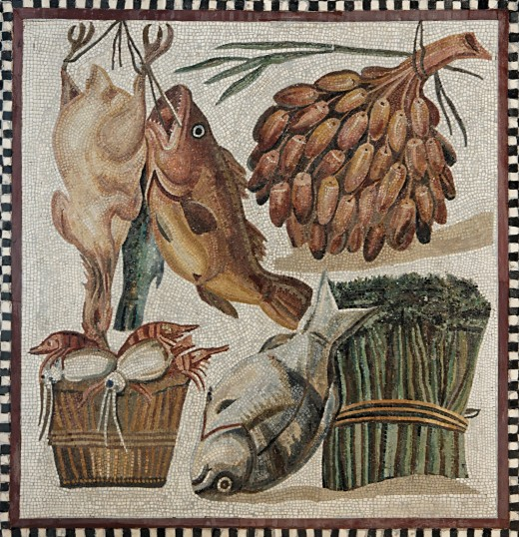
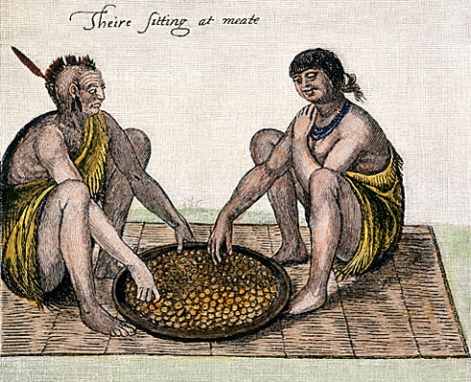
History of use as food
>>> Food which has been confirmed on its safety from experience of continued use in the customary diet of a large part of the population for generations in community or regions or countries leading to be generally regarded as safe to eat <<<
Preparation method
Instruction or recommendation for consumption
Daily recommended dose
Purpose for consumption
Any adverse effect report associated with such food.
9

Slide 10
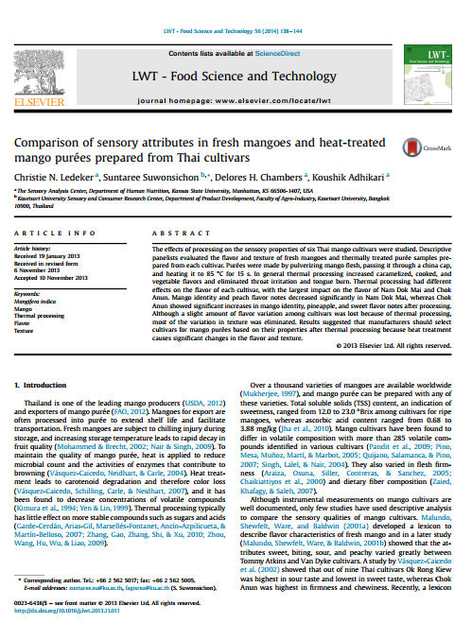
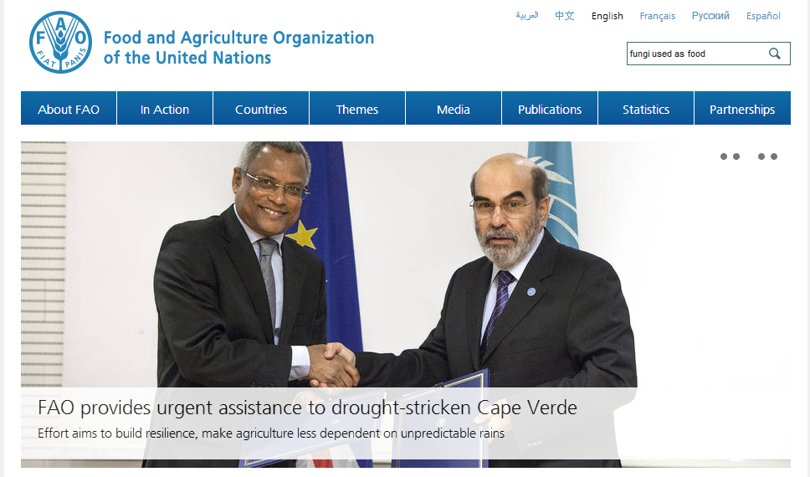
Source of reliable information for history of use as food
Technical textbooks or published articles in relevant and reliable technical journal
Technical database of government agencies or international organizations such as FAO, WHO
Reliable databases related to scientific journals such as Elsevier, TOXLINE, Pubmed, BIOSIS, TOXNET, NAPRALERT
An official letter or certificate of free sale from competent authorities or agencies or bodies assigned by competent authorities
10

Slide 11


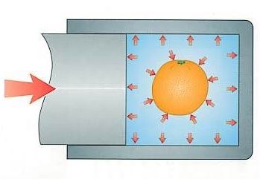
“a production process not currently used” includes any process which may lead to a significantly different product with significant changes in the composition or structure of such food which affect their nutritional value (such as increase nutrients , etc.), metabolism and/or also undesirable properties (such as contaminants from environment, mycotoxins, allergens,or pathogens, etc.)
Examples of new technologies in food production:
- Nanotechnology
- Non-thermal food pasteurization process
- High hydrostatic pressure process
11

Slide 12
Notification of MoPH (No.376) B.E. 2559 (2016) Re: Novel food
2. Scope
By provision of section 5 in the first phrase, and 6(3) (9) and (10) of the Food Act 1979
Any substance used in food, food ingredient, or food product
Which is defined as “Novel food”
Novel food shall be evaluated on safety assessment
prior to submit its label to Food and Drug Administration for approval before use
3. Safety assessment
Apply relevant information described in the annex of this notification to the risk assessment center recognized by Food and Drug Administration
12

Slide 13
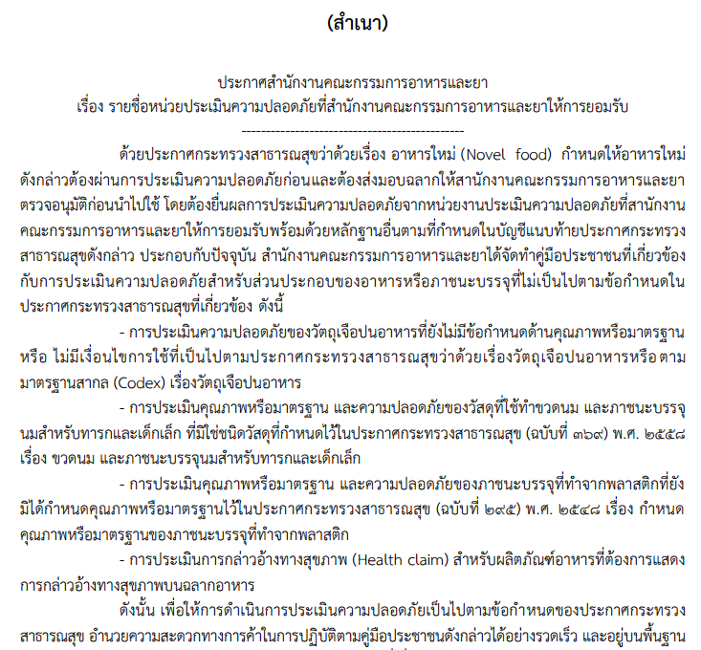
Notification of MoPH (No.376) B.E. 2559 (2016) Re: Novel food
Safety assessment centers recognized by Food and Drug Administration
Announcement of Food and Drug Administration
Re: List of risk assessment centers recognized by Food and Drug Administration
3 Centers for Novel safety assessment
1) Bureau of Quality and Safety of Food
Department of Medical Sciences
Ministry of Public Health
2) The National Food Institute
Ministry of Industry
3) THAILAND Risk Assessment Center
(TRAC), Mahidol University
(Link: http://food.fda.moph.go.th/law/announ_fda.php)
13

Slide 14
Notification of MoPH (No.376) B.E. 2559 (2016) Re: Novel food
relevant information described in the annex of this notification
Type of Information
Reliability of information
Relevant information with ingredient and
Product including
- Specification
- Process
Safety (Toxicity studies, Clinical test)
- Nutrition/ Efficacy
Criteria for usage (Amount/Type of food)
Purpose for consumption/ Targeted Consumer
Result of safety assessment from international
risk assessment agency or other recognized
countries
1. Certified by applicant such as
Specification, Process
2. Certified by competent agencies such as
- Report/Certificate of analysis
- Result of safety assessment by
international organization or reliable
agencies such as JECFA, EFSA, FCC, etc.
3. Published in technical journal/textbook
such as textbook, scientific journals,
Official Monograph, etc.
14

Slide 15
Notification of MoPH (No.376) B.E. 2559 (2016) Re: Novel food
4. Requirements of quality, safety, and labeling for novel food
Quality and safety shall be complied with relevant Notifications of MoPH
Example: pasteurized milk
- Quality and standard complied with Notification of MoPH (No. 352) B.E. 2556 Re: Other milk products;
- its production shall follow Notification of MoPH (No. 298) B.E. 2549 Re: Production Processes, Production Equipments, and storage of ready-to-consume milk products in liquid form which passed through pasteurization heat treatment.
Labeling shall be complied with Notification of MoPH (No.367) B.E. 2557 Re: Labeling of Prepackaged Foods, except clause 4(9) to display both production and expiration for consumption. Additional information shall also be expressed on its label;
(1) Name of active ingredients (if any);
(2) Instruction of use, or condition of use such as type or category of food
and maximum permitted level of use
15

Slide 16

Notification of MoPH (No.376) B.E. 2559 (2016) Re: Novel food
5. Enforcement
Come into force as of 16 July 2016
Exception for enforcement in case of
(1) Novel food produced for export or;
(2) Novel food that producer or importer has been permitted for sale prior to the date of this notification come into force.
16

Slide 17

Summary of safety assessment and Pre-market approval procedure
1. Safety assessment
1. Applicant submit relevant information to safety assessment center
2. Safety assessment center by 3-5 experts provide safety assessment and their opinions
3. Safety assessment provide a safety assessment report based on experts’ opinion
4. Applicant receive the safety assessment report and relevant information required as annex of the notification
17

Slide 18

Summary of safety assessment and Pre-market approval procedure
(cont’d)
1. Applicant submit the safety assessment report and relevant information to FDA
1. Safety assessment
2. Pre-market approval
2. FDA by a sub-committee on safety consider for approval based on the report and relevant information
3. If no any enquiry, the sub-committee endorse the safety of novel food and provide condition of use (if any).
If additional information is required, FDA should inform the applicant to submit with timeline
4. FDA provide an official letter on approval of novel food for further pre-market registration
18

Slide 19
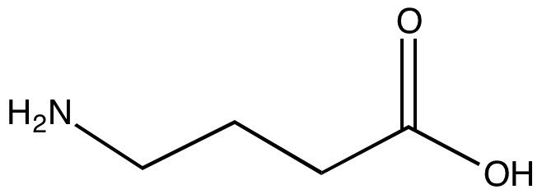

Example of novel food
Gamma-aminobutyric acid (GABA)
Produced by specific process to significantly increase concentration level
>> To apply in food supplements and beverage<<
Submitted information for safety assessment includes
Sub-chronic study in animal test, clinical study, history of use as food ingredients in
other countries
Result of Sub-committee consideration
GABA with permitted specification and specific process is approved for safe use as food
Specify type of food allowed to have GABA as ingredient and Maximum limit
19

Slide 20
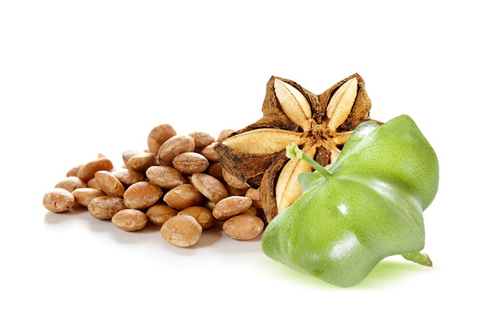
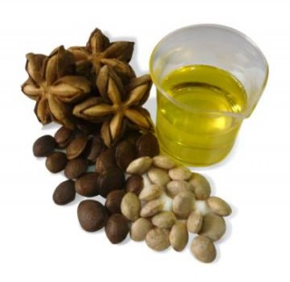
Example of non-novel food
Sacha Inchi oil
(Sacha Inchi, Plukenetia volubilis L.)
Main fatty acid >>>> Omega-3
Long history of use for human consumption
Reliable scientific data on safety and efficacy in human are available
20

Slide 21
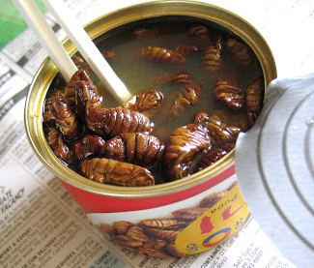
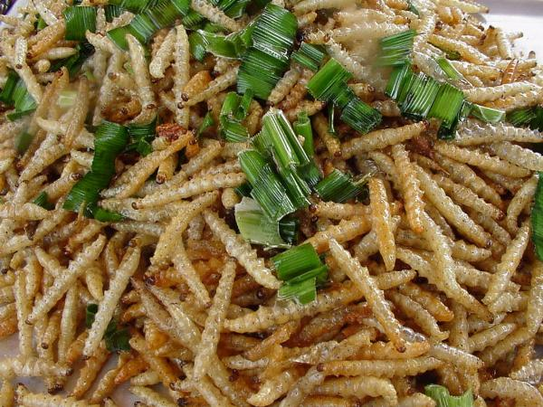
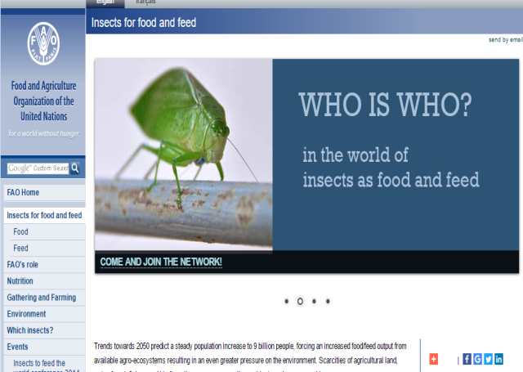
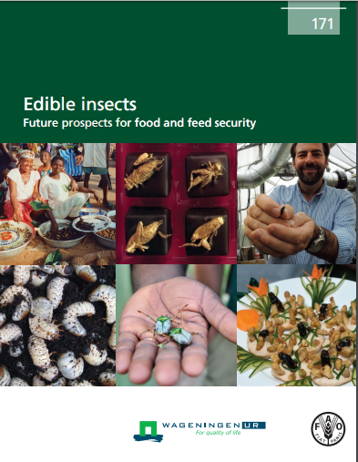
Example of non-novel food
Edible insects
Ready-to-eat products such as
canned silkworm pupae, fried bamboo worms
Long history of use for human consumption
with high protein contents
Reliable scientific information on nutritional benefits Is available
21

Slide 22
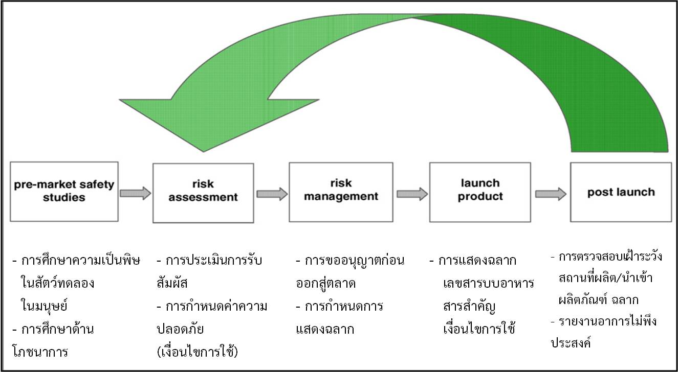
Summary of control system for novel food
Modified from P. Hepburn et al., 2008
22

Slide 23


23

