Slide 1

Institute of Nutrition
New Development on
Thailand Risk Assessment Center – TRAC
Songsak Srianujata, Ph.D., R.Ph.
Pharrunrat Tanaviyutpakdee, Ph.D.
Thai Society of Toxicology
Institute of Nutrition, Mahidol University
And Thailand Risk Assessment and Srvailance Center (TRAC)
Bangkok, Thailand

Slide 2
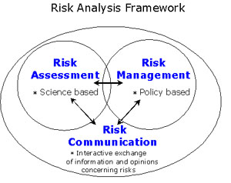
Introduction Risk Analysis

Slide 3
Risk Assessment
Hazard Identification
Hazard Characterization
Exposure Assessment
Risk Characterization
Science
based

Slide 4
Food Chain
Contamination
-Chemicals
-fertilizer
Contamination
-microbial
-other chemicals
Food additives
Hygiene
Production
Transport
Storage
Processing
Agriculture
-plants
-livestock
-fishery
Additives
Carcinogens
Cooking
Selling
Human health
Hazard
Consumption

Slide 5
Principle of Risk Assessment Organization
Preferably independent from risk management
Could be completed in the organization, but unnecessary
Can be an organization with sufficient expertise in the form of networking
The organization can function as national or regional risk assessment coordinator
The organization should collect data base on experts in risk assessment of various field

Slide 6

Establishment of National
Risk Assessment Organization
Thailand Risk Assessment and Survailance Center (TRAC)

Slide 7
Strategic Framework of Food Management in Thailand
A Cabinet Resolution on “Thailand Food Strategy”
Approved
The Strategic Framework of Food Management
on 25 November 2010
by the Cabinet

Slide 8

Thailand National Food Committee Act of 2008
Food
Security
Food
Quality
Food
Education
Food
Safety
11 related ministries, 30 national agencies, 30 relevant Acts
Ministry of
Defense
Ministry of
Finance
Ministry of
Foreign Affairs
Ministry of Social
Development
and Human Security
Ministry of
Industry
Ministry of
Public Health
Ministry of
Commerce
Ministry of
Interior
Ministry of
Science
Ministry of
Education
Ministry of
Agriculture
The National
Security Council
The National
Economic and Social
Development board
The Consumer
Protection Board
The national Health
committee

Slide 9
The National Food Committee Component
Chairman : Prime Minister
(or designated Deputy-Prime Minister)
Secretary
: FDA, Ministry of Public Health
Co-secretary
: ACFS, Ministry of Agriculture
7 Resource persons in :
-Food Security (2) -Food Safety (1)
-Food Quality (1) -Law (1)
-Economic and Trade (1)
-Food Innovation (1)
Committee members
11 related ministries, 4 executive administrators
Ministry of
Defense
Ministry of
Finance
Ministry of
Foreign Affairs
Ministry of Social
development
and human security
Ministry of
Industry
Ministry of
Public Health
Ministry of
Commerce
Ministry of
Interior
Ministry of
Science
Ministry of
Education
Ministry of
Agriculture and Commodity
The National
Security Council
The National
Economic and Social
Development board
The Consumer
Protection board
The national health
committee
Committee / Sub-Committee
FS BMA - Songsak S.

Slide 10
Sub-committee on Risk Assessment
Taskforces to Implement Strategic Theme 2 on
Food Quality and Safety
Standardization of food quality/safety standards
Promotion of food Q/S standards at all levels with capacity development activities
Strengthening food service outlets for consumer protection, tourism and food culture
Strengthening food import control system
Strengthening management and control system of chemical substances used in agriculture
Promotion of food Q/S logos for consumer confidence in both domestic and international markets
7. Strengthening inspection and certification throughout the food chain
Risk assessment for food safety (chair by Dr. Songsak)
Integrated food safety control system at provincial and community levels
Consumer awareness and protection

Slide 11
Establishment of Thailand Risk Assessment Center (TRAC)
Approved by the Committee on Food Safety and Quality
The sub-committee on risk assessment is responsible for the establishment of TRAC, stationed at Mahidol University
Appointed working groups to draft the guidelines for risk assessment of
Chemicals including additive, contaminant, veterinary drug
Pesticide
Nutrient
Genetically modified food
Microbial agent
General
Collecting of expert rosters
Process of capacity building

Slide 12
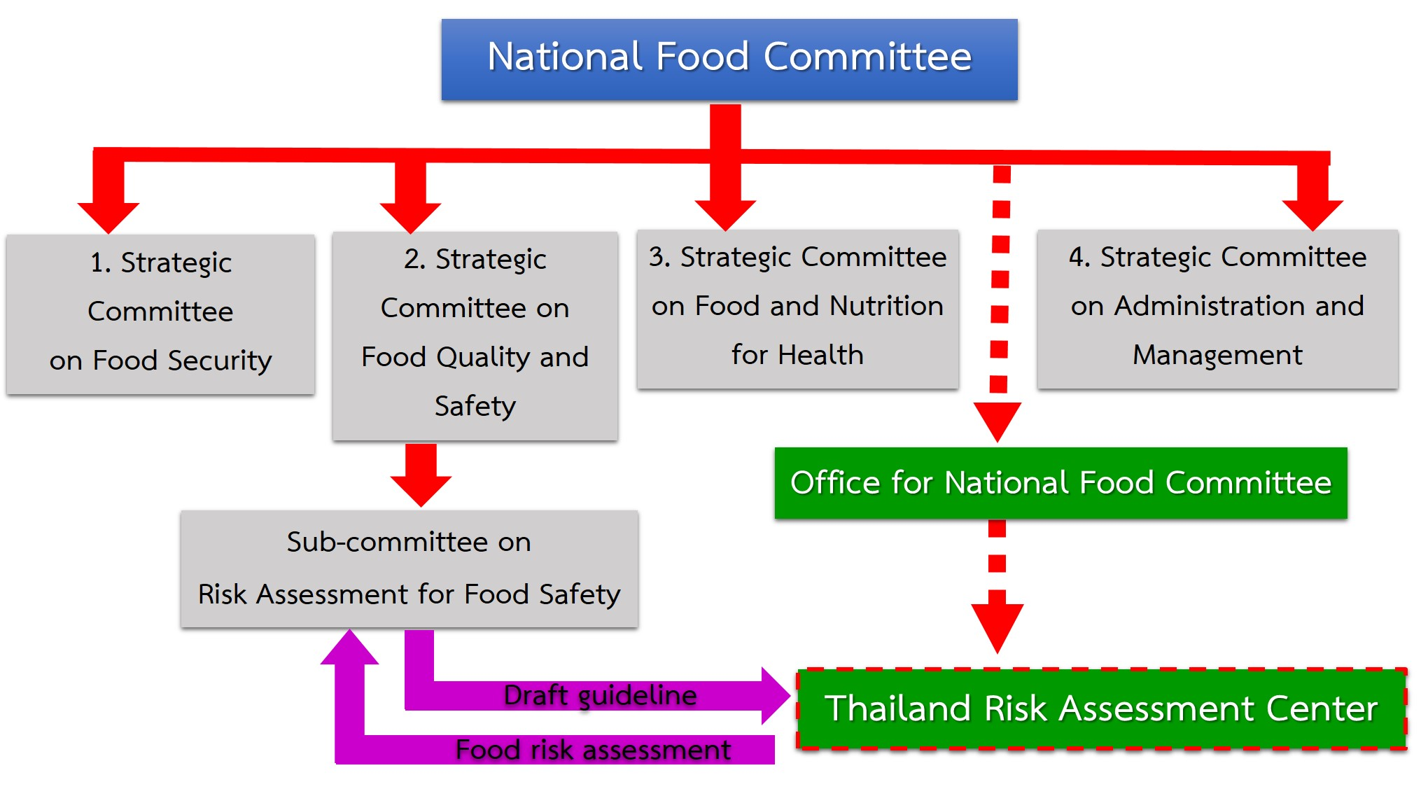
Tempolary Location
Mahidol University, Institute of Nutrition

Slide 13
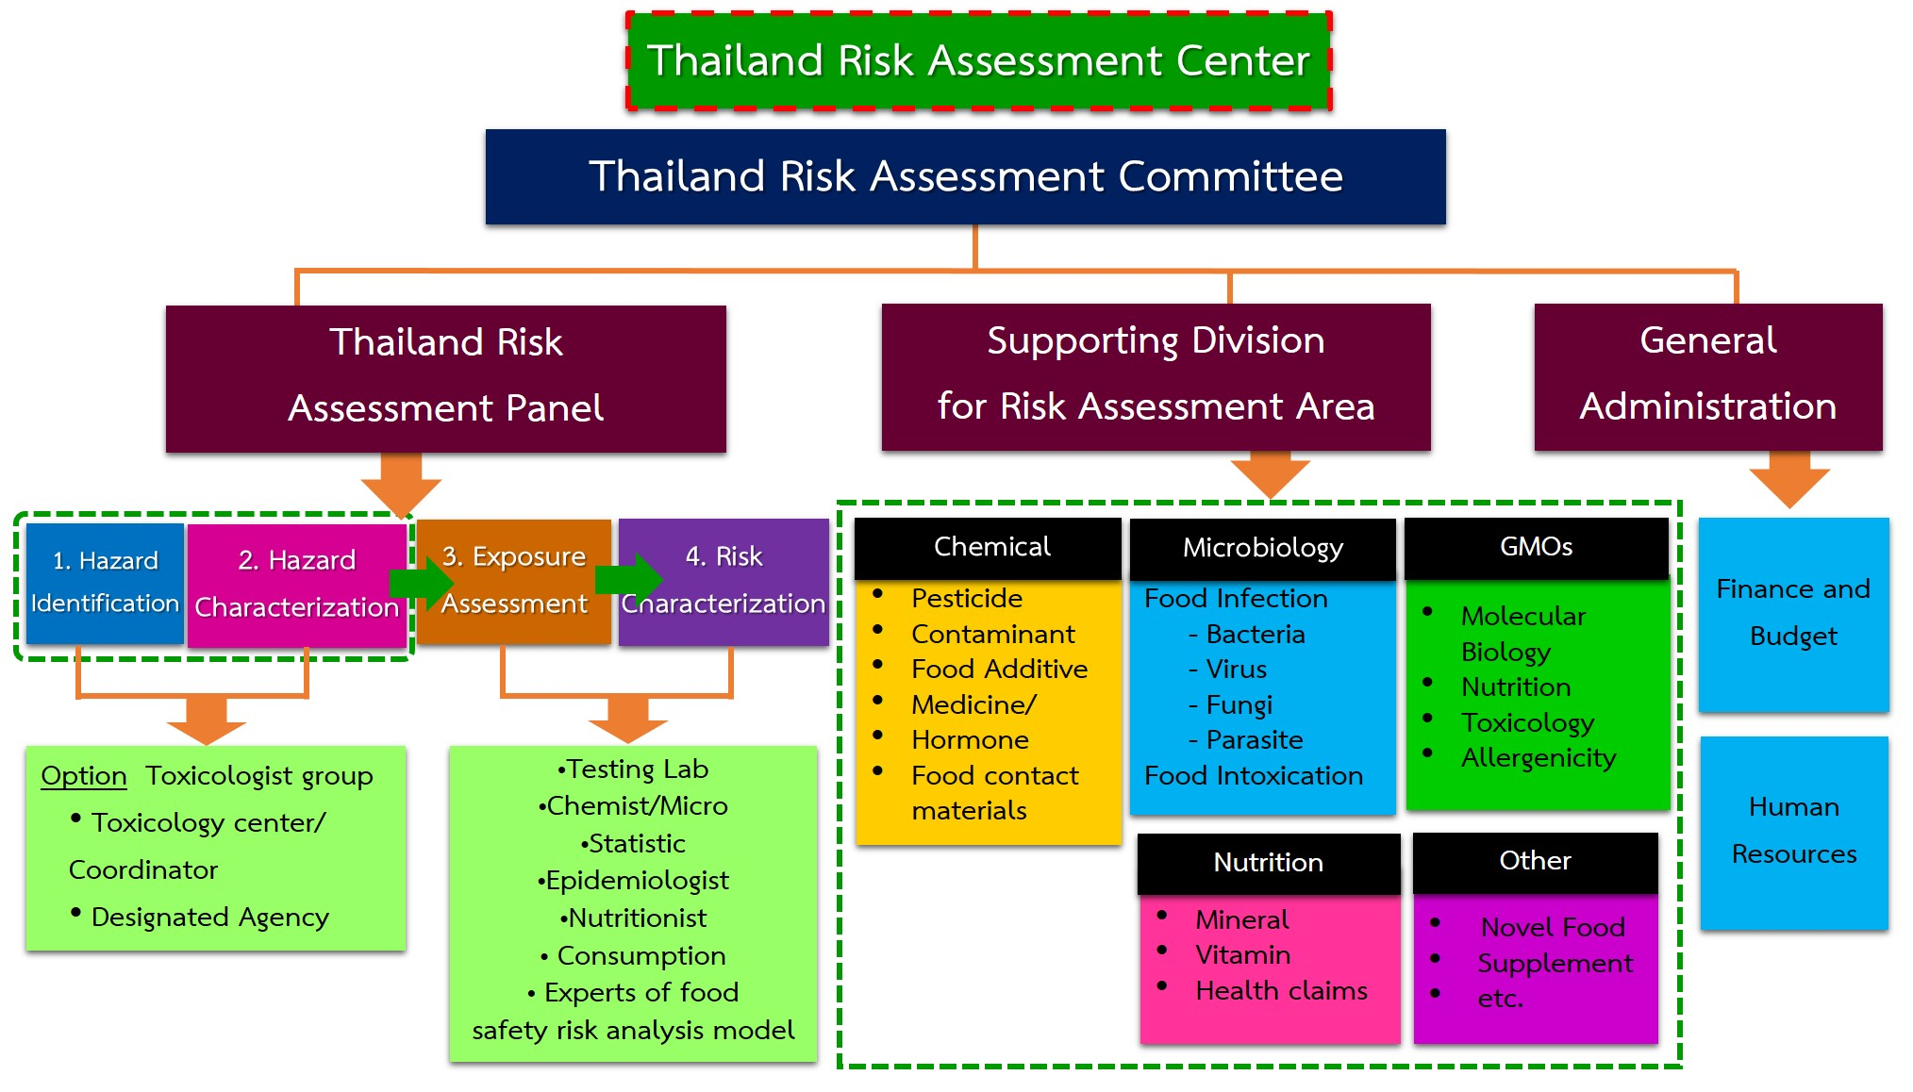

Slide 14





COLLABORATIONS AND ACTIVITIES
COLLABORATIONS
Universities
Departments / Institutes
Department of Medical Sciences
The National Center for Genetic Engineering and Biotechnology(BIOTEC)
Etc.
Mahidol University
Naresuan University
Etc.

Slide 15
8 STEPS OF TRAC’S RISK ASSESSMENT PROCESS
1
Make an appointment for an appeal request via the telephone
2
Submit all documents required for
TRAC’s risk assessment
Get all documents back and correct before resubmitting
3
TRAC officers check all documents
(1 workday)
1
workday
TRAC officers elucidate the
fault or defect information
Documents
 unacceptable
*The decision will be notified via the telephone only
☑ Acceptable
4
TRAC officers prepare the documents
to TRAC expert panel

Slide 16
4
TRAC officers prepare the documents
to TRAC expert panel
2
workdays
5
Assessment will be conducted by
TRAC expert panel
No later than 80 workdays
TRAC officers ask for
more evidences*
Documents
Insufficient
evidence
*The decision will be notified via the telephone only
☑ Sufficient evidence
(exclude duration for
submitting more evidence)
6
TRAC expert panel
make a conclusion
7
TRAC committee make a
consensus decision
1
workday
8
TRAC officers notify and officially
submit result to company
3
workdays

Slide 17
Current development in safety assessment of Novel Food: Thailand Case

Slide 18
What is Novel Food?
In the context of Thailand Notification of Novel Food (notification no. 376, B.E. 2559)
Item 1 Novel Food means
Material used as food or food component with the history of use not more than 15 years with reliable source of evidence, or
The material as 1. derived from the process which is not the normal process for production of such material, that may significantly alter the components structure and form of the food that leads to nutritional value and metabolism, or the level of undesirable substances, of the food

Slide 19
Products that contain materials as 1. and 2.
However, it does not include food additive and food derived from genetically modified.

Slide 20
Item 2 It is stated that: The novel food must pass the process of safety assessment and submit the label to Thai FDA for evaluation and approved before it can be marketed.
Item 3 The result of safety assessment of such novel food must be assessed by the safety assessment organization accepted by Thai FDA, and submitted to Thai FDA together with the documents listed.

Slide 21
The information to be supplied with the application for approval.
General information for safety assessment
Documented evidences used for safety assessment of novel food
The list of documented evidences are as:
General information of food components
General information on the product
Information on consumption history
Quality and Standard of the food component

Slide 22
Quality and Standard of the food product
Analysis result
Method of storage
Process of production, synthesis, extract
Primary information on the chemicals used in processing
Form and recommendation for consumption
Safety information
Biochemical process
Fate of transportation (absorption, distribution and elimination

Slide 23
Biotransformation
Effects on enzymes and other parameters
Reaction and fate of the food
Toxicological studies in animals
Acute toxicity
Sub-chronic toxicity
Chronic toxicity (Clinical study in normal subjects may be used)
Safety study of microbial used (if any)

Slide 24
Specific toxicity
Clinical study in human or epidemiological study
Other studies (if any)
Information on nutrition
Safety assessment result from
Notes of the detail information on some items are listed in the notification

Slide 25
Thailand Risk Assessment Center – TRAC
is one of the risk or safety assessment organizations designated by Thai FDA

Slide 26

ขอบคุณครับ
Thank You for Your Attention

