Slide 1
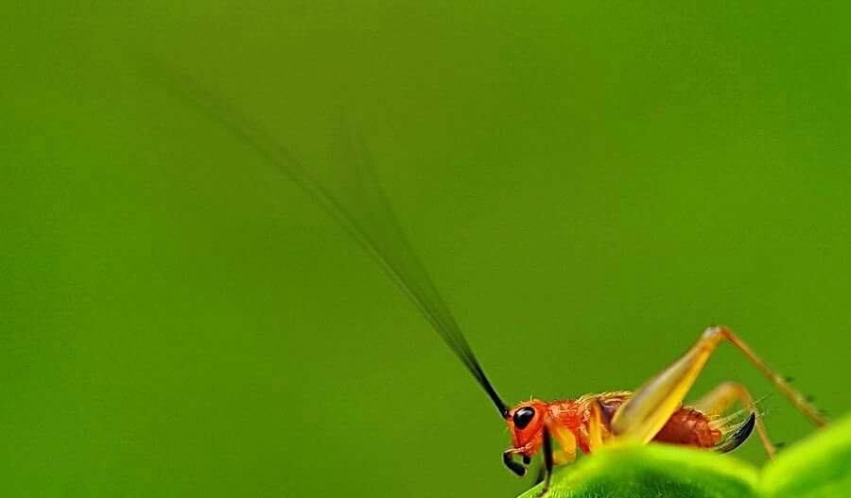

GAP on Cricket Farming and Market access to the EU
Mr. Pisan Pongsapitch
Deputy Secretary General
National Bureau of Agricultural Commodity and Food Standard (ACFS)

Slide 2
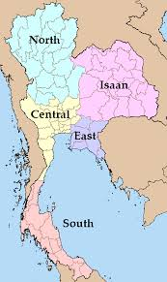

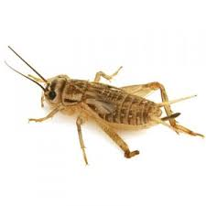

Production of Cricket
Phrae, Chiang Rai, Chiang Mai, Nan
Khon Kaen, Roi Et,
Udon Thanin, Kalasin
Chanthaburi, Sakaew

Slide 3
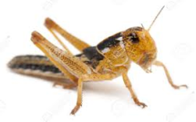
Production of Cricket

Slide 4
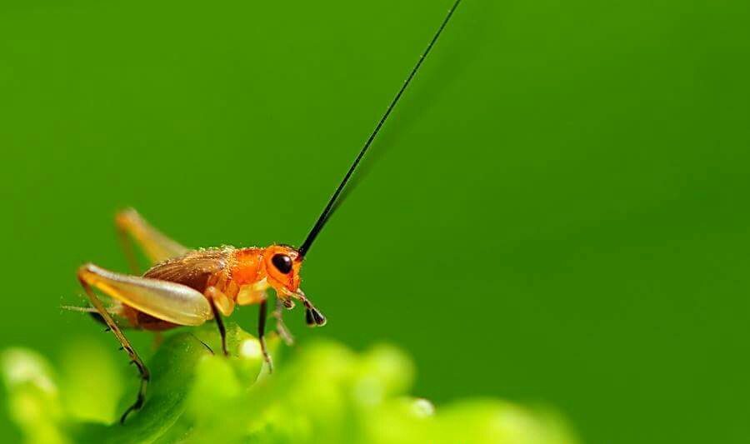
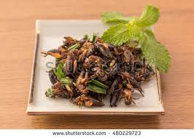
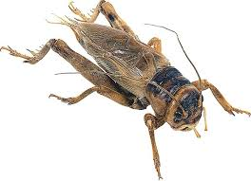
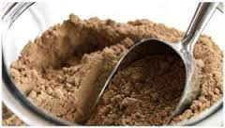
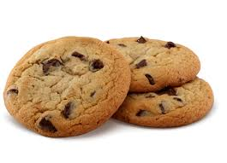
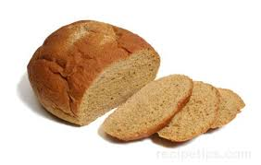
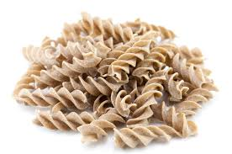
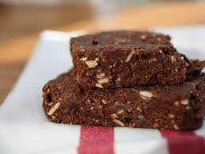
Production of Cricket
PRODUCE
PRODUCT

Slide 5

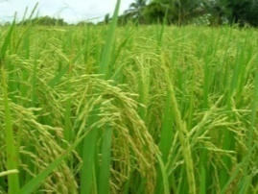
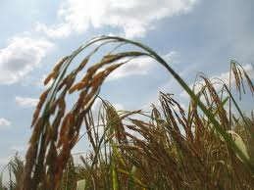
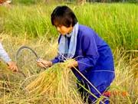
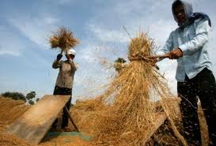
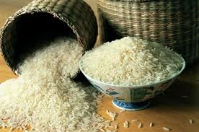
ROAD MAP OF FOOD SAFETY
Cabinet on 4 March 2003 announced the year 2004 as a Food safety year and approved “Road Map of
Food Safety” to be implemented from 2004
I
II
III
IV
V
From - Farm - to - Table

Slide 6

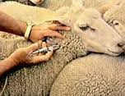

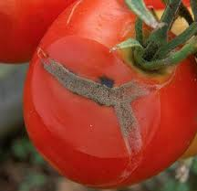
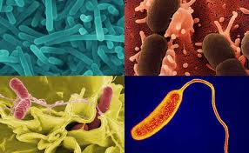
Food Control System in Thailand
Consumer food safety (domestic) and trading of
food (export).
⬇ Single food safety standard for both domestic
and export.
⬇ Ensure the safety of food products.
⬇ Single standard for safety but may be
multiple standards for quality.

Slide 7
MOAC : Roles on Food Safety Standardization
ACFS
Fruits/Veg.
Livestock
Fisheries
Standard setting
Promotion of standard compliance
Accreditation of certification bodies
Certification
Dept. Agri. Extension / Rice Dept.
Dept. Livestock
Dept. Fisheries
Dept. Agriculture / Rice Dept.
Dept. Livestock
Dept. Fisheries
ACFS

Slide 8
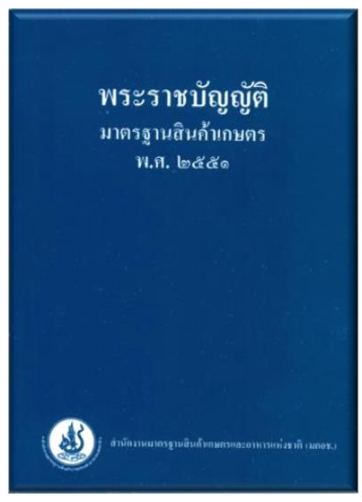
Agricultural Standards Act 2008
The Agricultural Standards Act B.E. 2551 (2008)
The enforcement of the Agricultural Standards Act B.E. 2551 (2008)
from 20 August 2008
The Act will benefit all relevant sectors to upgrade the standards of
Thai agricultural qualities to be recognized by both local and
international consumers.
It involves mainly food safety through the registration of products
and standard inspection and certification

Slide 9
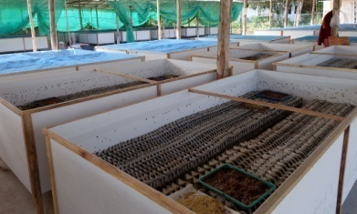
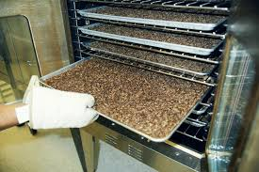
Standards for food chain
Product (Export)
Farm
Industry
Product (Domestic)
GAP
GMP
HACCP
Product standard (Safety & Quality)

Slide 10
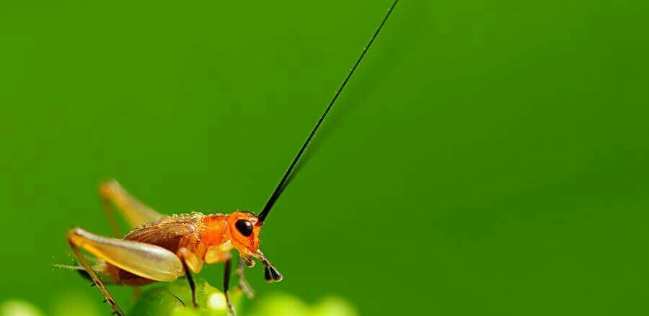
Standard Setting
ACFS
Farmers
Processors
Scientists
Consumers
Focal Points
(Codex, OIE, IPPC)
8 Steps
Standard Elaboration
Commodity Standard
National Standards
System standard
General Standard
Products
Consumers

Slide 11
Standard elaboration steps
Prioritize issues or items of which a standard should be set up
Appoint a technical committee to consider draft
Set up the draft standard
Propose the draft standard to the committee for consideration and to decide whether the standard be voluntary or mandatory
Voluntary standard
Mandatory standard
Public hearing
Public hearing
Submit to a proofreading committee, then ACFS Board
Submit to a proofreading committee, then ACFS Board
Notify a novel mandatory standard to WTO
The final draft standard to be endorsed by the Minister of Agriculture and Cooperatives and to be declared in the Royal Gazette
Review after 5 years or if changed

Slide 12

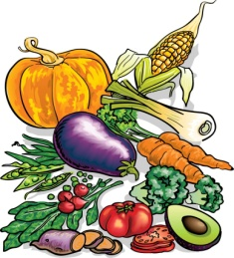


ACFS : National standard setting
1. Prioritization of a standard
2. Establishment of Technical Committee;
all stakeholders including
* scientists, experts
* government officers
* farmers
* private sectors

Slide 13
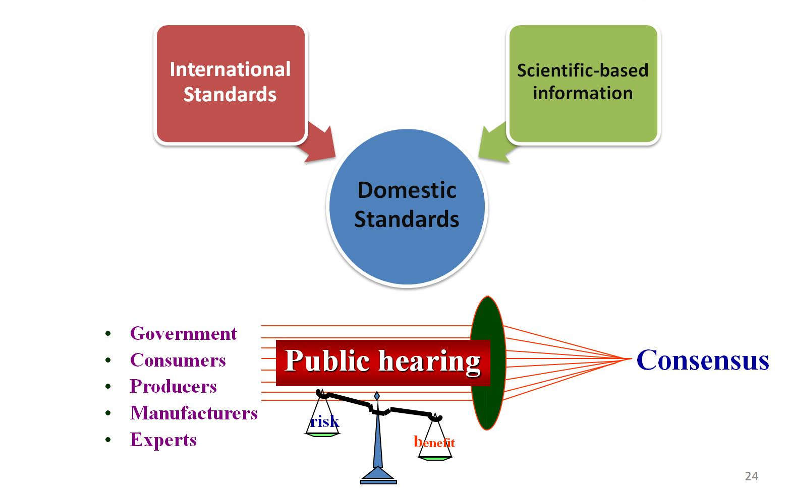
ACFS : National standard setting
3. Standard drafting
4. Draft standard considered by the Technical Committee
5. Public hearing/Requesting comments from all stakeholders

Slide 14






ACFS : National standard setting
6. Draft standard is submitted to
the National Committee on
Agricultural Standards
7. WTO Notification
(for mandatory standard)
8. Standard Approval and Notified
in the Royal Gazette
(for voluntary standard)

Slide 15

Agricultural Standards Act 2008
2 Types of Standards
1) Mandatory standards :
license required for production, export or import
require inspection/certification by approved CB
2) Voluntary standards :
license not required
inspection/certification on voluntary basis

Slide 16
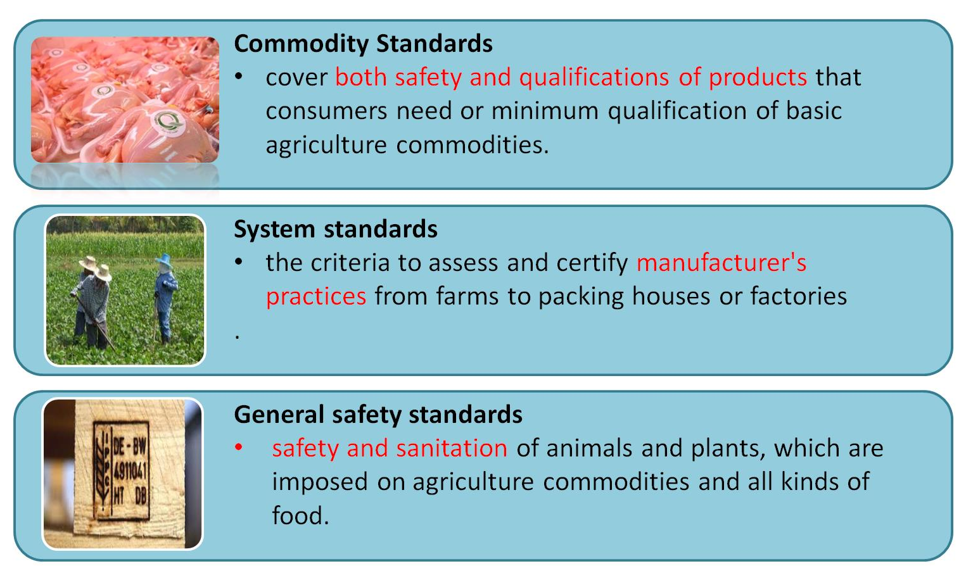
Thai Agricultural Standards

Slide 17
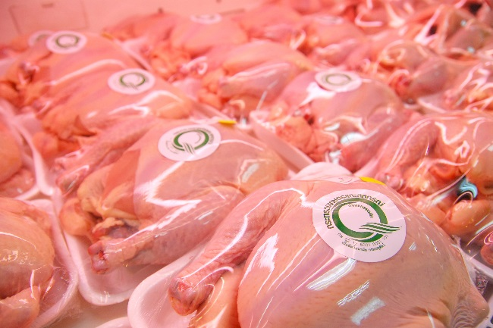
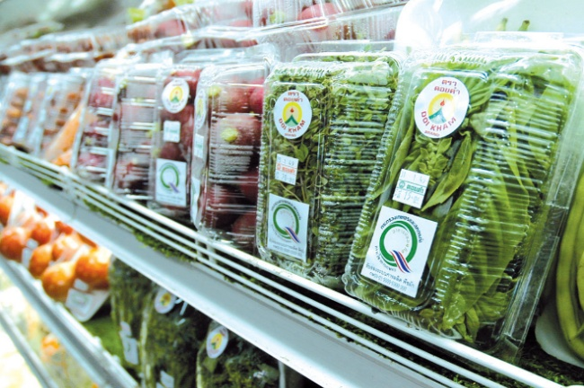
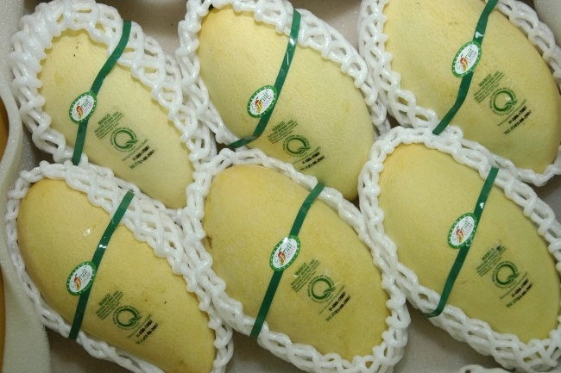
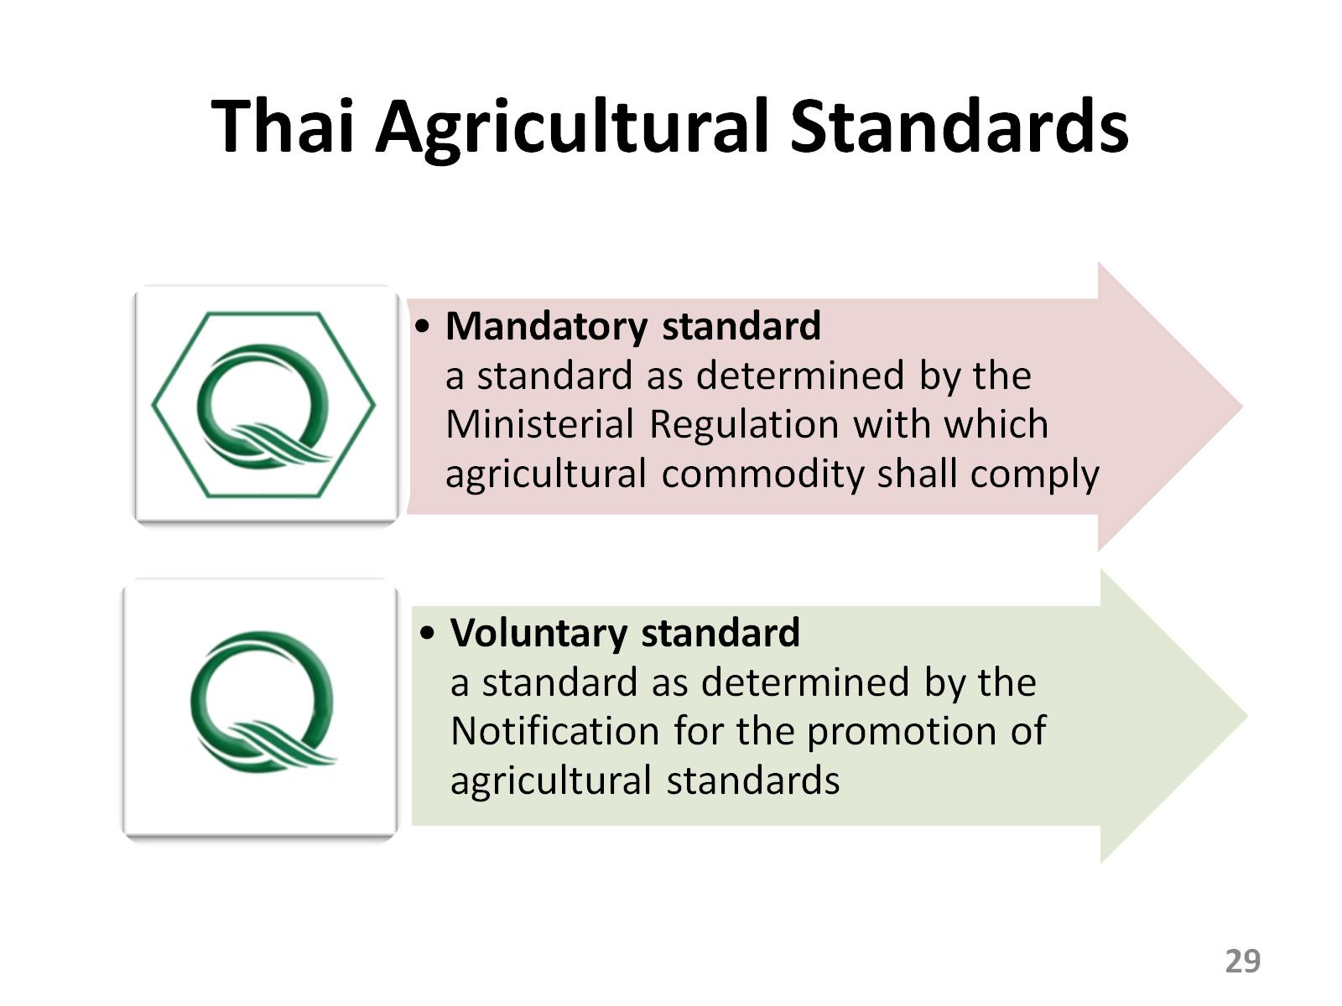


Certification Marks

Slide 18
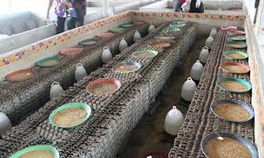
Standards for Cricket Product
Good Agricultural Practice (GAP) for Cricket Farm
FARM
Code of Practice : General Principles of Food Hygiene (TAS 9023-2007)
MANUFACTURER

Slide 19
Standards for Cricket Product
FARM
PRODUCE
MANUFACTURER
PRODUCTS

Slide 20

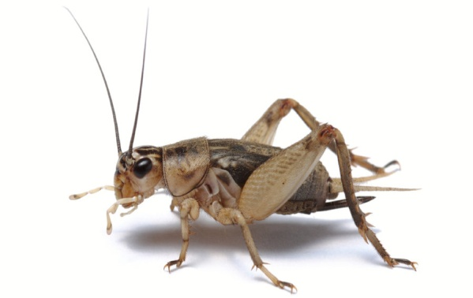
GAP-Cricket Farm
Location
Feed
Water
Farm Management
Sanitation
Animal Health Management
Personal hygiene
Document and Records

Slide 21
Other Activity
Risk Assessment of cricket production for consumption
Objective
1. To conduct risk assessment on chemical and biological hazard
2. To gather information for establishing the Guideline on cricket
production

Slide 22
Method
- All relevant information are gathered
(Production, CCPs, and Chemical and biological risks)
- Crickets (Acheta domesticus,Gryllus bimaculatus) were collected
Analysis of crickets
- Chemical analysis ex. Heavy metal
- Biological analysis ex. E.coli, Samonella spp.
- Conclusion and Recommendation on Risk Management

Slide 23


