Slide 1
On Women & Entrepreneurship Across Africa
Dr Ola Orekunrin
Founder, Flying Doctors Nigeria
Twitter: @naijaflyingdr

Slide 2
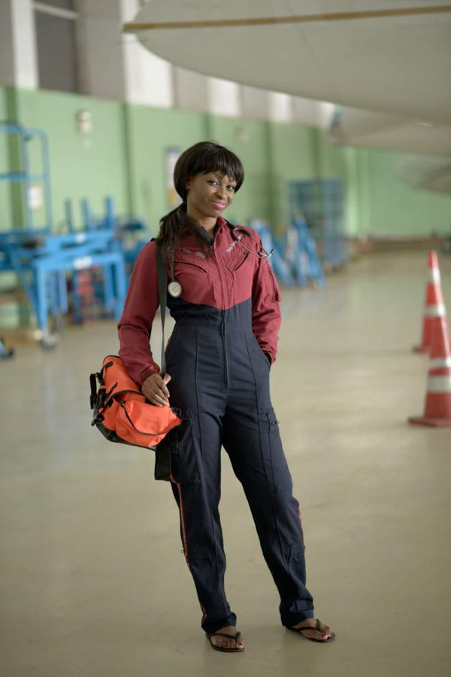
My Entrepreneurial Journey
Family tragedy
Started air ambulance, x10 growth, multi-million dollar enterprise, saves lives across West/Central Africa
Started investing in other businesses whilst scaling up

Slide 3
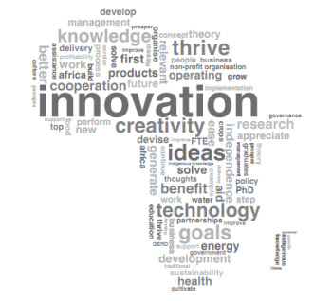
Entrepreneurship in Africa
400 African companies with annual revenues exceeding $1 billon
African companies grow faster and are more profitable
? African companies in the Fortune 500
7 in India, 7 in Brazil and 98 in China

Slide 4
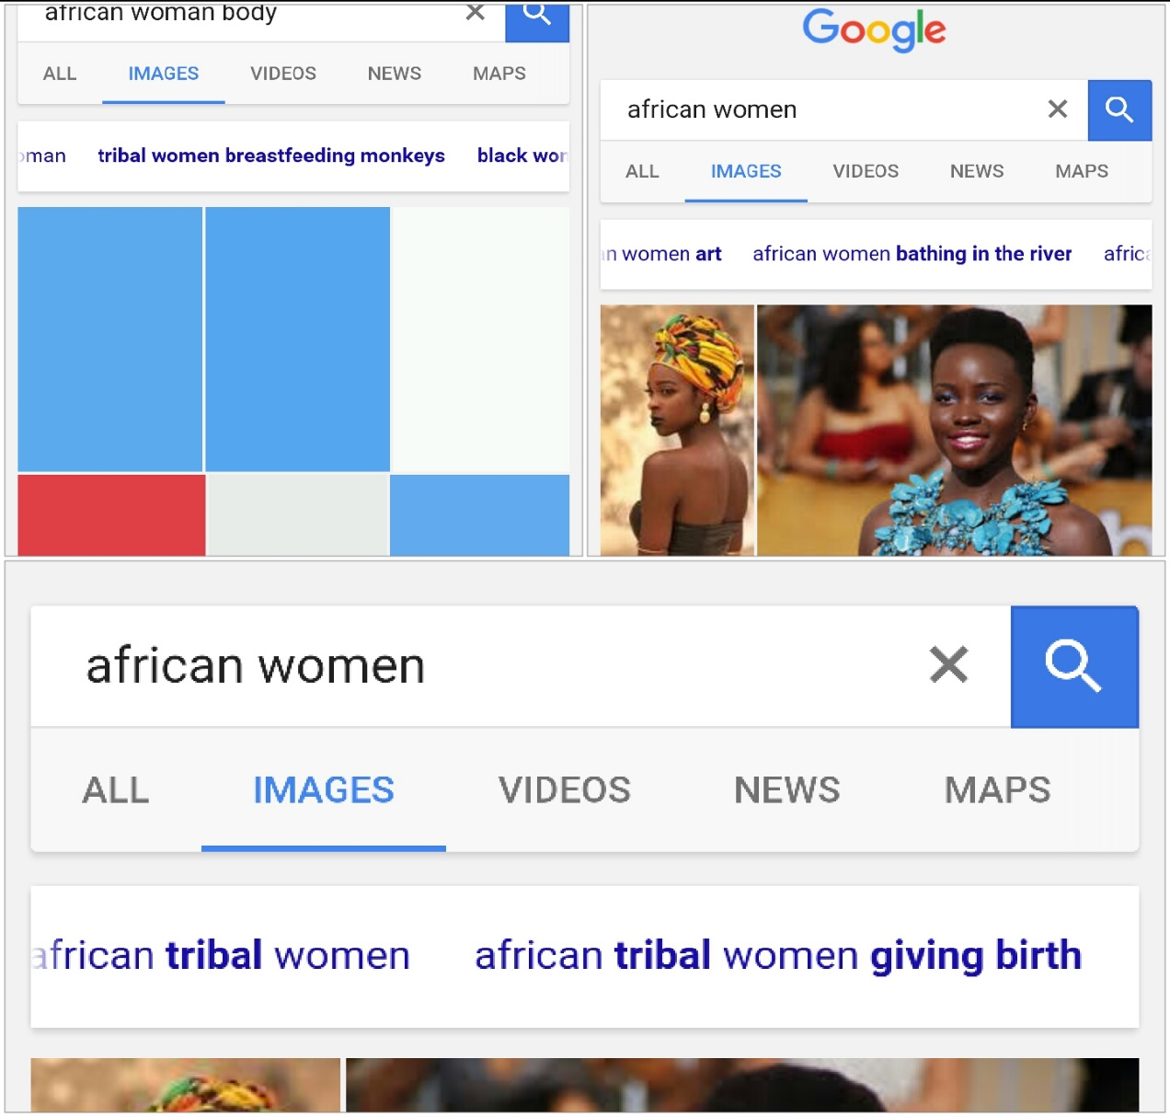
Female Entrepreneurship in Africa
What results do you get when you type ‘African woman’, African women’ or’ African woman body’ in Google?
Tribal women breastfeeding monkeys
African women circumcision
African woman gives birth to a horse
African women bathing in river
Significance of undressing African women

Slide 5
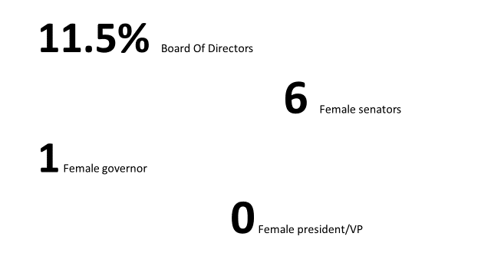

Slide 6
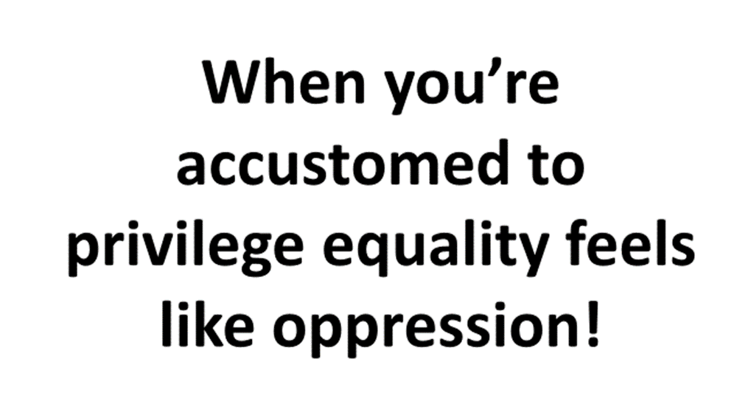

Slide 7
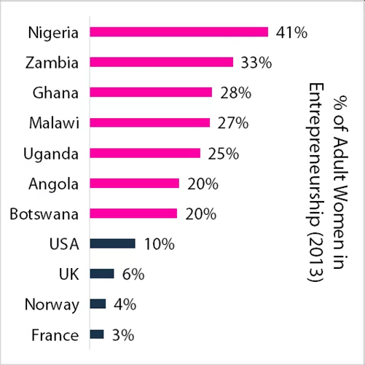

Slide 8
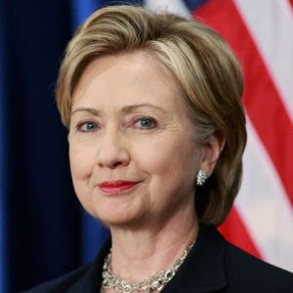
Female Entrepreneurship In Africa II
Sectors of the economy that are most critical for economic growth rely on women. Highest number of female entrepreneurs sub-Saharan Africa
Cultural/Religious/Likeability barriers
‘On every measure women are more economically excluded than men’
Unmet financial needs of $320bn; biggest barrier to growth Greater challenges than men accessing credit.
Stronger repayment track record, x5 faster business growth

Slide 9
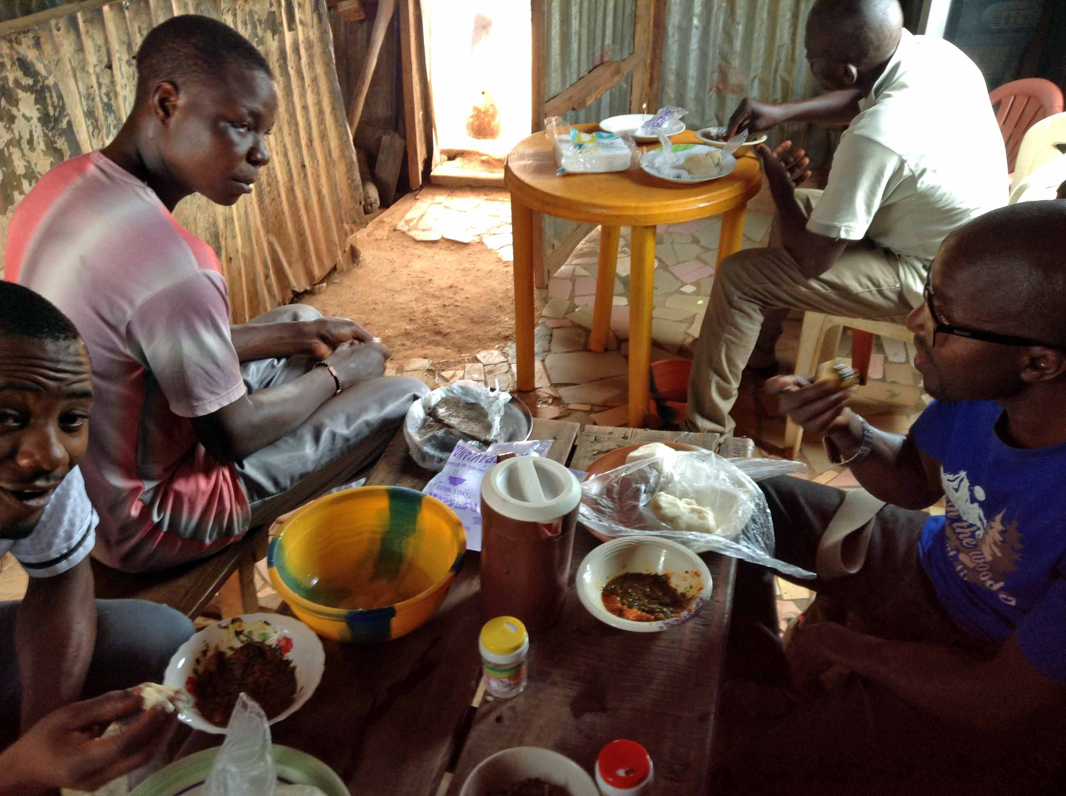
Learning So Far…..
We start lots of businesses, but they remain small
We have difficulties accessing finance, scaling and growing held back by culture, bias, roles and banks
Crippling our economies and our continent
Imperative to move from ‘bukka’ to board room

Slide 10


Slide 11
The thing women have yet to learn is that nobody gives you power. You just take it
-Roseanne Barr

Slide 12
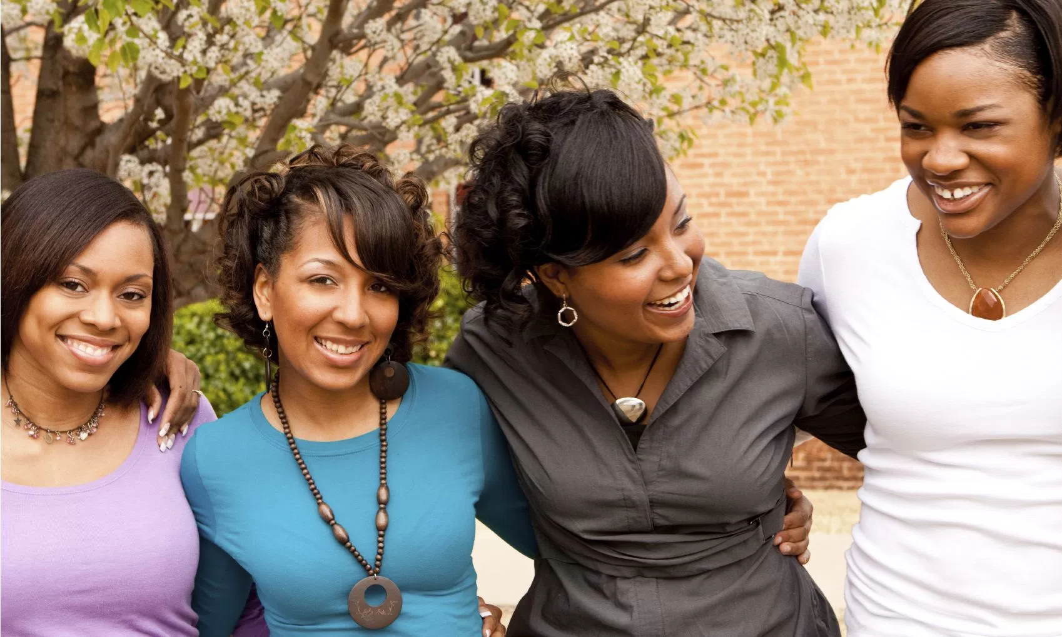
Solutions
Crucial to economic growth in Africa, not just the right thing, but the smart thing
Banks/Other sources of finance with focus on female entrepreneurs, better returns fewer NPL’S
Mentorship and education programs aimed at female entrepreneurs. Experiential and well as intellectual.
Tear down those walls! Speak up and speak out

Slide 13
Here’s to those who will change the narrative of the ‘African Woman’
May we know them
May we be them
May we raise them

