Slide 1


 |  | Information session EU Delegation to Uganda CSO in-country call for proposals for Uganda 2024 CFP EuropeAid/180807/DD/ACT/UG
 |  | April 9, 2024
XJPXTY6TA6Y2-1408595408-2533

Slide 2
Introduction

Slide 3

Applicants are responsible for checking all details and complying with all procedures.
Please refer carefully to the Guidelines for Applicants and other documents related to this Call for Proposals, as well as other reference documents on the EU website.

Slide 4
Overall goal: to strengthen CSOs as independent actors of good governance and development in their own right.
Thematic programme Civil Society Organisations
The only thematic programme with a
actor-based mandate
Comprehensiveness and worldwide coverage
Act independently from the consent of government
Notes:
The only thematic programme with a clear actor-based mandate under NDICI-Global Europe
Comprehensiveness and worldwide coverage
Ability to act independently from the consent of government and other public authorities
Support for service delivery under the thematic programme should notably be the exception rather than the norm, and should always include efforts to strengthen organisational capacities and/or links to advocacy efforts, in order to contribute to long-term positive and transformative effects

Slide 5
Grant contract
Principles
Equal Treatment > award process must be impartial
Non-Retroactivity > EU will only cover costs for activities after signature of contract
Co-Financing > EU does not finance the entire operation, only up to 95% of eligible costs
Non-Profit > non-commercial: actions may not have the purpose of generating profit
Notes:
EU grants have to respect the principle of:
Equal Treatment > award process must be impartial
Co-Financing > EU does not finance the entire operation, only up to 95% of eligible costs
Non-Profit > non-commercial: actions may not have the purpose of generating profit in particular in the FSTP scheme
Non- Retroactivity > EU will only cover costs for activities after signature of contract

Slide 6


Actors involved and responsibilities
Who is who?
Grant beneficiaries are normally different from the target groups of the action
Grant contract
Coordinator and beneficiary of the grant contract
EU
Lead applicant
Contracting Authority
Operational responsibility
Co-beneficiary of a grant contract
Co-applicant
Affiliated entities
Notes:
When we talk about grants, it is important to have in mind some basic terminology.
First of all:
What is a GRANT?
Grant is a financial donation – non-commercial payment (Grant may not give rise to profits).
When we talk about the Contracting Authority ( we mean the EU) – The EU signs a contract with Grant beneficiary(ies).
We also have a specific terminology for the different actors:
LEAD APPLICANT (Beneficiary)
the coordinator - main interlocutor – who acts on behalf of the co-beneficiary(ies)
Co-applicant(s)
the other co-beneficiary(ies)
Affiliated entity(ies) (if any)
Others :
associates, contractors and third parties benefitting from financial support

Slide 7
Guidelines of the call

Slide 8

Objectives
Overall objective:
To enable local civil CSOs to engage as actors of governance and development in their own right.
Specific objective:
To promote youth’s empowerment opportunities and participation in policy and development processes and
To prevent and respond to teenage pregnancies.

Slide 9


The Call is organised into 2 lots aligned with the 2 specific objectives:
Proposed actions can target only one specific objective
Lot 1:
Youth empowerment opportunities and participation in policy and development processes
Lot 2:
Prevention and response to teenage pregnancies

Slide 10
Location of Actions

Slide 11
West Nile
Acholi
Lango
Karamoja

Slide 12
How does the call work?
Two phases:
  First you submit a CONCEPT NOTE
  ONLY if you pass that stage, will you be invited to submit a FULL APPLICATION, BUDGET & full LOGICAL FRAMEWORK
Submission of concept notes:
  Deadline: 14 May 2024 at 13:00 Uganda Time / 12.00hrs Brussels time
  Submission is via online platform PROSPECT: https://webgate.ec.europa.eu/europeaid/prospect
  Hand delivery is only allowed in exceptional cases

Slide 13
Parameters for actions (projects)
Duration:
  Minimum: 24 months
  Maximum: 36 months
Amount to be requested from EU :
  Minimum: €400,000
  Maximum: €600,000
Percentage of total for EU contribution (as laid down in 2.1.3):
  Minimum: 50% (of total eligible costs)
  Maximum: 80% (of total eligible costs)
  Maximum: 95% (of total eligible costs) ONLY For UG organisations

Slide 14
Eligibility

Slide 15
Eligibility criteria
Applicants and co-applicants
Must be:
a legal person,
non-profit-making,
be a civil society organisation (CSO)
be established in Uganda and/or in one of the countries eligible under Regulation (EU) 2021/947 of the European Parliament and of the Council, of 9 June 2021 establishing the Neighbourhood, Development and International Cooperation Instrument – Global Europe.
Lead applicant
Co-applicant
The lead applicant may act individually (only if Ugandan) or with a co-applicant(s). Lead applicants that are not established in Uganda must act with at least one co-applicant established in Uganda.

Slide 16
Number of applications allowed
Lead applicant
The lead applicant may submit only one application under this call for proposals.
May not be awarded more than one grant.
The lead applicant may not be a co-applicant or an affiliated entity in another application at the same time.
May not be co-applicant/ affiliated entity in more than one application under this call for proposals.
But may not be awarded more than one grant under this call for proposals
Co-applicant
Affiliated entities

Slide 17
How to fill and submit your application

Slide 18

Registration in PADOR
To participate lead applicants, co-applicants and affiliated entities must register with PADOR and receive a unique EuropeAid identifier.
Make sure that the PADOR profiles of potential candidates/co-applicants and affiliates are up to date.
It is recommended to register with PADOR well in advance.
User 's guidelines, FAQ, e-training are available here
Notes:
With the application the lead applicant also has to submit completed PADOR registration form (Annex
F) for the lead applicant, each co-applicants(if any) and each affiliated entities(if any).
WHAT IS PADOR?
Potential Applicant Data Online Registration
PADOR is an on-line database in which organisations register and update their data
It serves to evaluate the operational and financial capacity of the organisations and their eligibility to participate in calls for proposals
PADOR website: https://webgate.ec.europa.eu/pador
NOTE: before registering, double check to make sure that your organisation is not already registered
Once registered in PADOR, you will get a EuropeAid ID
Helpdesk for questions related to the functioning of PADOR:
INTPA-SUPPORT-SERVICES@ec.europa.eu

Slide 19
Registration in PADOR
Also remember to upload:
Statutes or articles of association of the applicant, of each co-applicant and each affiliated entity
A copy of the applicant's latest accounts (Not required for co-applicants or affiliated entities)
Legal entity sheet
Financial identification form
Notes:
With the application the lead applicant also has to submit completed PADOR registration form (Annex
F) for the lead applicant, each co-applicants(if any) and each affiliated entities(if any).
WHAT IS PADOR?
Potential Applicant Data Online Registration
PADOR is an on-line database in which organisations register and update their data
It serves to evaluate the operational and financial capacity of the organisations and their eligibility to participate in calls for proposals
PADOR website: https://webgate.ec.europa.eu/pador
NOTE: before registering, double check to make sure that your organisation is not already registered
Once registered in PADOR, you will get a EuropeAid ID
Helpdesk for questions related to the functioning of PADOR:
INTPA-SUPPORT-SERVICES@ec.europa.eu

Slide 20
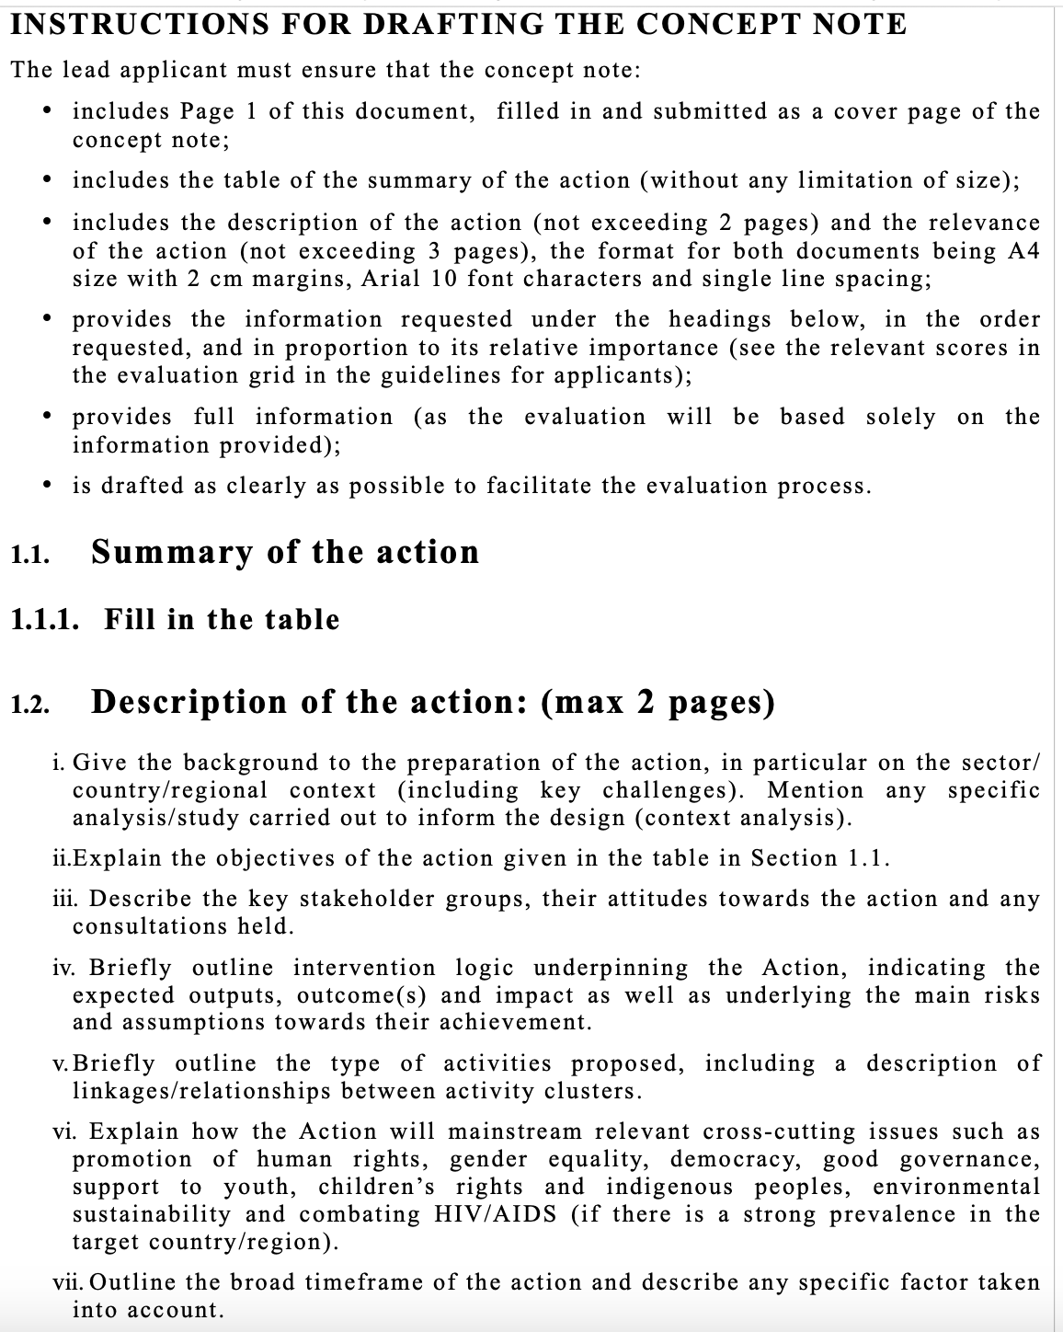
Concept note form
Instructions for drafting the Concept Note
READ THE GUIDELINES!
And follow the instructions in the grant application form - Annex A1

Slide 21
Concept note format
Ref. to the template in Annex A. 1 and follow the instructions
Remember to indicate your Lot of interest
Cannot exceed 5 pages (A4 size) of Arial 10 characters with 2cm margins, single line spacing.
Must be written in English
Follow in order the points indicated in Annex A.1 of the Grant Application Form-
Carefully review the concept note checklist for self- guidance purposes before submission

Slide 22
Concept note content
Description of the Action (max 2 pages): objectives, background, location, target groups, final beneficiaries, estimated results, main activities
Relevance (max 3 pages): to the objectives and priorities of the call and to the particular needs and constraints of the target regions/sectors; particular added-value elements
Information about the applicant (via PROSPECT):
Basic project details (via PROSPECT): Title; duration; requested EU contribution(amount) – pay attention to guidelines section 1.3 on minimum and maximum amounts.
Also refer to section 2.3 – Step 1

Slide 23


Build your narrative
Ensuring coherence
Identify risks and explain how you will mitigate them.
Human rights-based approach and gender equality: show how your action addresses these issues.
Description of the action
Explain the role and added-value of your consortium / application.
Identify well your target groups and their needs
Consult with stakeholders
Use the Logical Framework as a planning tool
Notes:
Here are some general recommendations to keep in mind when designing your proposal
Structure your proposal in a logical and coherent manner.
The project title should be short and engaging to facilitate communicating about the project.
Use the Logical Framework as a planning tool. Draft a Logical Framework before writing the application form and use it to provide information for the Description of the action.
The preparation of your proposal should be a collaborative effort (participatory approach) and be built on stakeholders consultations. Be clear in identifying the target groups and their needs. Demonstrate that you know your target group well, that they have been involved in the design of the proposal. Be specific, rather than choosing overly broad and ambitious target groups (e.g. ”Youth groups" without quantifying or identifying selection criteria).
Don’t just declare commitment to human rights-based approach and gender equality: show how your action focuses on relevant issues and has a relevant implementation strategy.
Identify potential risks and clearly explain your mitigation strategies to increase the viability of your proposal. PLEASE NOTE that the form does not ask you to elaborate on external factors in any section, but the evaluation grid has a specific question on the subject. The evaluator will search for the answer in your proposal.
Explain the role, experience, reputation and relationships of the consortium members.
The evaluator will only read the Concept note, they will not research your organisation or work. It is important to explain your added value as a potential EU partner.

Slide 24
Concept note Administrative checklist evaluation
Before sending your concept note check that each of the criteria below have been met in full
1.The correct grant application form has been used
2. The instructions for the concept note have been followed.
3. The proposal is typed and is written in an eligible language for this call.
4. An electronic version of the concept note (CD-ROM) is enclosed (Please write ‘Not applicable’ (N/A) if you are applying via PROSPECT).
5. One original and the number of copy(ies) foreseen in section 2.2 of the guidelines are included (Please write ‘Not applicable’ (N/A) if you are applying via PROSPECT)
6. The Declaration by the applicant has been filled in and has been signed.

Slide 25
Concept note Administrative check
Before sending your concept note check that each of the criteria below have been met in full
7. The action will be implemented in an eligible country(ies)
8. The action will be implemented in the minimum number of countries required (If a minimum number of countries is not mandatory: Please write ‘Not applicable’ (N/A))
9. The duration of the action is equal to or higher than the minimum allowed in section 2.1.3 of the guidelines..
10. The duration of the action is equal to or lower than the maximum allowed in section 2.1.3 of the guidelines.
11. The requested EU contribution (amount) is equal to or higher than the minimum allowed in section 1.3 of the guidelines
12. The requested EU contribution (amount) is equal to or lower than the maximum allowed in section 1.3 of the guidelines

Slide 26
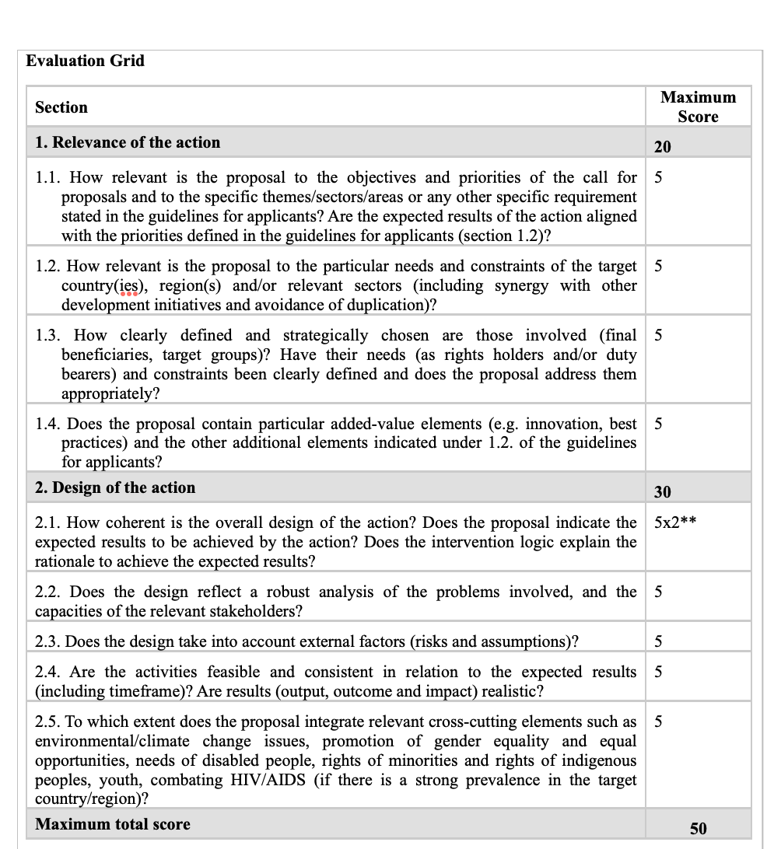




Evaluation and selection of Concept notes
CONCEPT NOTE Evaluation grid
Compare it with your proposal
Notes:
Familiarise yourself with the evaluation grid provided in the Guidelines.
Conduct a comprehensive review of your Concept Note, comparing it to the evaluation grid, to ensure that all the questions in the grid are effectively addressed.
- All elements of the grid will be scored

Slide 27
Evaluation and selection of Concept notes
ALL elements of the grid will be scored
Value for money (costs, efficiency and effectiveness) – and not just consumption of funds
Successful lead applicants will receive a letter in their PROSPECT profile; requesting them to submit a full application
Notes:
Once all concept notes have been assessed, a list will be drawn up with the proposed actions ranked according to their total score.
Firstly, only the concept notes with a score of at least 30 will be considered for pre-selection.
Secondly, the number of concept notes will be reduced, taking account of the ranking, to the number of concept notes whose total aggregate amount of requested contributions is equal to at least 200% of the available budget for this call for proposals. The amount of requested contributions of each concept note will be based on the indicative financial envelopes for each lot, where relevant.
Lead applicants will receive a letter indicating the reference number of their application and the respective results. This letter will automatically appear online in the PROSPECT profile of the lead applicant.
The pre-selected lead applicants will subsequently be invited to submit full applications.

Slide 28


Evaluation and selection of Concept notes
CONCEPT NOTE Evaluation grid: 2 criteria
RELEVANCE OF THE ACTION
DESIGN OF THE ACTION
To the objectives of the call?
To the country and sector?
To the target groups and beneficiaries?
Added-value?
Is it coherent?
Reflects a robust problem analysis?
Considers external factors?
Activities are feasible?
Integrates cross-cutting elements?
Notes:
The Concept note will be evaluated based on two criteria:
RELEVANCE OF THE ACTION
To the objectives of the call?
To the country and sector?
To the target groups and beneficiaries?
Added-value?
DESIGN OF THE ACTION
Is it coherent?
Reflects a robust problem analysis?
Considers external factors?
Activities are feasible?
Integrates cross-cutting elements?

Slide 29
The Budget
Full budget required only at full application stage; estimated budget and EU contribution needed for concept note.
Estimates at concept note stage cannot vary more than 20% from those included in full application
Co-financing: the balance has to come from sources other than the EU budget.

Slide 30
What costs are eligible?
Section 2.1.4 of the guidelines
  Eligible and non-eligible cost costs are defined in Annex G – Art.14 of the General conditions
  Reimbursement of eligible costs may be based on Actual costs incurred by Beneficiary(ies) and affiliated entities
  ---
  Eligible costs are:
Cost of staff assigned to the action.
Travel and subsistence costs for staff and other persons taking part of the action
Equipment (new and / or used) and supplies specifically for the purposes of the Action
Depreciation, rental or leasing costs for equipment (new or used) and supplies specifically dedicated to the Action
Cost of consumables
Cost of services, supply and work contracts awarded by the beneficiaries for the purpose of the Action
Costs deriving directly from the requirements of the contract (dissemination of info, evaluation, audit, translation…)

Slide 31
What costs are eligible?
Be incurred during the implementation of the action
Be indicated in the estimated overall budget
Be necessary for the implementation of the action
Be identifiable and verifiable
Comply with the requirements of applicable tax and social security legislation
Be reasonable, justified and comply with the requirements of sound financial management
Ineligible costs – Guidelines 2.1.4
Debts and debt service charges (interest)
Provisions for losses or potential future liabilities
Costs declared by the Beneficiary(ies) and financed by another action or work programme receiving a European Union grant
Purchases of lands or buildings, except where necessary for the implementation of the action
Currency exchange losses
Credit to third parties,
Salary costs of the personnel of national administrations
Duties, taxes and charges including VAT paid and not recoverable by the beneficiaries

Slide 32
Contributions in kind
Provision of goods or services to a Beneficiary(ies) or affiliated entity(ies) free of charge by a third party.
As contributions in kind do not involve any expenditure for a Beneficiary(ies) they are not eligible costs. For purposes of this CfP, contributions in kind may not be treated as cofinancing.

Slide 33
Logical frame
Review and practical application

Slide 34
Logical Framework Approach elements in your Concept Note
Impact
(Overall Objective)
Long term change to which the action will contribute
(at country, regional or sector level)
Outcome
(Specific Objective)
Final positive change on the target areas and in the lives of the target groups and final beneficiaries by the end of implementation
under control of the target group
Outputs
Goods / services or changes directly delivered by the intervention
(under control of the intervention)
Activities
What the project does to produce the results (utilisation of resources)
Inputs
Financial / Human / Physical Resources
Notes:
The results chain will be the first column of your logical framework matrix.
Results represent the changes the intervention aims to contribute to within the given context.
The logical framework allows you to examine the causal links between the different levels (from inputs to impact).

Slide 35
Global Europe Results Framework
The EU Results Framework
Notes:
When selecting the indicators for your log frame, you should use some of the EU corporate results and indicators during preparation of the proposed actions in order to develop a robust Logframe.

Slide 36
What is a Results Framework?
  A set of indicators:
  pre-defined (collectively agreed)
  that correspond to strategic objectives (policy priorities)
  broken down into expected results (measured by indicators with data sources, baselines & targets)
  that can be aggregated (core)
  and are used for institutional reporting (collective achievement)
  Examples:
  EU/Global Europe Results Framework
Notes:
What is a Results Framework?
A set of indicators:
pre-defined (collectively agreed)
that correspond to strategic objectives (policy priorities)
broken down into expected results (measured by indicators with data sources, baselines & targets)
that can be aggregated (core)
and are used for institutional reporting (collective achievement)
Examples:
EU/Global Europe Results Framework
The EURF is essentially a list of indicators that have been used to collect and measure key results achieved at corporate level by EU interventions
The EURF was launched in 2015 and then updated in 2018 to align with the 2030 Agenda and the EU Consensus on Development.
A new revision was once again required to align with the 2021-2027 Multi-Annual Financial Framework (MFF) which includes a new instrument for EU external action – the Neighbourhood, Development and International Cooperation Instrument (NDICI – Global Europe). This updated list of indicators is called the Global Europe Results Framework (GERF).

Slide 37
Common pitfalls and recommendations

Slide 38
Common mistakes
The partnership composition does not respect the eligibility criteria;
Weak relevance of the proposal to the objectives, priorities and added value of the call (section 1.2) and to the problems in the target area/country.
Vague identification of target groups and weak analysis of their needs
Weak design of the action: the Specific Objective is over-ambitious or vague; the design includes ambitious outputs but not sufficient or appropriate activities to achieve them; too many objectives etc
Weak attention to risks and mitigation;
Confused roles and responsibilities of the applicants;
Unconvincing attention to cross-cutting issues;
Unrealistic budget, errors in budget
Forgetting to click “submit”.
Notes:
Some common mistakes to have in mind:
The partnership composition does not respect the eligibility criteria;
Weak relevance of the proposal to the objectives, priorities and added value of the call (section 1.2) and to the problems in the target area/country.
Vague identification of target groups and weak analysis of their needs
Weak design of the action: the Specific Objective is over-ambitious or vague; the design includes ambitious outputs but not sufficient or appropriate activities to achieve them;
Weak attention to risks and mitigation;
Confused roles and responsibilities of the applicants;
Unconvincing attention to cross-cutting issues;
Unrealistic budget.

Slide 39
Recommendations
Do not exceed the recommended length for each section;
Answer each section in order;
Don’t leave any question unanswered;
Check for any Q&A documents and updates to the Call.
Check eligibility of ALL co-applicants and affiliates. Check that no applicants are participating in more than one proposal.
Notes:
Do not exceed the recommended length for each section;
Answer each section in the order specified in the Guidelines;
Don’t leave any question unanswered – a low score is better than nothing;
Shorten the sub-questions into as paragraph headings (to make sure that you don’t forget anything).
Study the evaluation grid in the Guidelines (section 2.3)– your application will be assessed on the basis of these criteria. We will go there next
Assess and revise your draft proposal.
Check for any Q&A documents and updates to the Call.
Check eligibility of ALL co-applicants and affiliates. Check that no applicants are participating in more than one proposal.

Slide 40
Communications and timetable
Questions on this call can be submitted in writing to delegation-Uganda-finance@eeas.europa.eu before 18:00 Uganda time on 23 April 2024.
Questions and responses will be uploaded on DG International Partnerships and EUD websites at the latest on 3 May 2024.
Info to lead applications about opening, admin checks and concept note evaluations will be sent on 21 June 2024*
Invitations to submit full applications are expected to be sent on 21 June 2024
The indicative deadline for full applications is 6 August 2024
* = indicative dates; Please see guidelines (section 2.5.2) for full indicative timetable

Slide 41
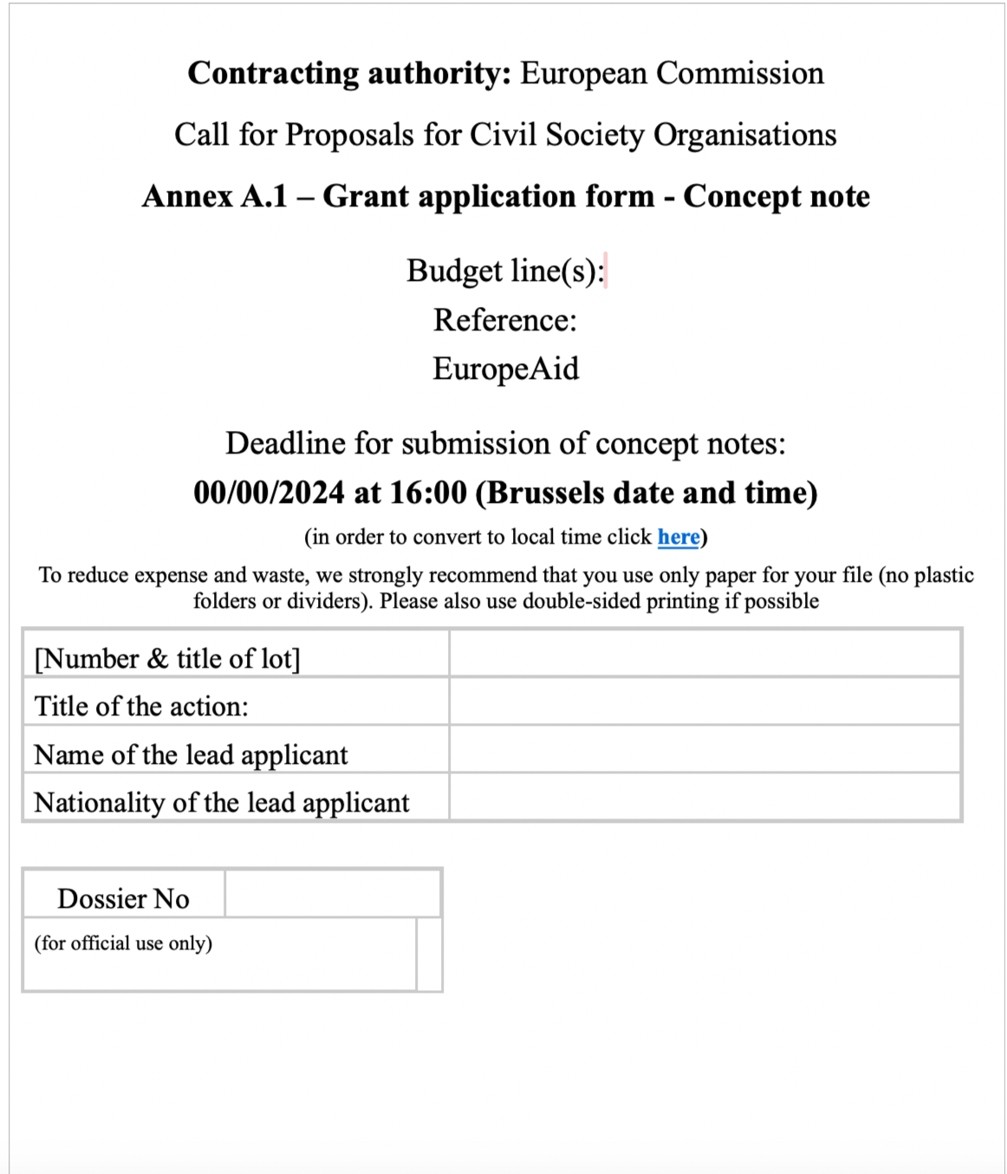
Submission of CN
Key messages
Concept notes must be submitted online via PROSPECT
Do not wait until the last day, hour, minute to submit
Use the checklist for the concept note (last page of the Annex A.1)
Incomplete concept notes may be rejected
Notes:
Submission of concept notes and full applications is via mandatory via PROSPECT; found on https://webgate.ec.europa.eu/europeaid/prospect
Check PROSPECT user manual for more info & how to track status of your application
Upon submission, the lead applicant receives an automatic confirmation of receipt in its PROSPECT profile
Signed and completed declaration by the lead applicant (p.5 of the grant application form – Annex A.1)
This is to be uploaded in PROSEPCT in addition to uploading the filled in concept note itself

Slide 42

Submission of CN
Deadline for concept note submission:
14 May 2024
12:00 Brussels time
1 minute late is late enough!
Notes:
14 May 2024
12:00 Brussels time

Slide 43
Thank you!

