Slide 1


WORKING WITH SOMALI PEOPLE TO BUILD PEACE AND PROSPERITY
ECONOMIC GROWTH AND JOB CREATION
Supporting Productive and Private Sectors Development
THE SECTORS
Somalia is still emerging from the effects of a long civil war, political-social conflicts and extended drought. Despite this, the economy, mainly based on traditional primary productive sectors, is growing. Through the National Development Plan, the New Partnership Agreement and the Economic Recovery Plan, the Federal Government of Somalia (FGS) has set out an ambitious agenda of reforms needed to support the economy.
Somalia has diverse livelihood systems: pastoralists, agro-pastoralists, fishing and coastal communities. Agriculture provides 60% of the country's GDP, 80% of its employment and 90% of its exports. The livestock and crop sectors remain the main sources of current economic activity and employment. Live animal export and cereals are critical to consolidate and improve the quality of the high number of existing jobs in some regions. Meat production and hide and skin also have some potential to create jobs along the chain if investments are made for small-medium industries in urban areas with big demand. There is a high potential to increase cereal productivity with Good Agricultural Practices (GAP), better inputs and post-harvest management. Horticulture (mainly fruit and vegetables) has the biggest potential to create new jobs especially to supply urban areas. Banana production potential remains large, as Somalia used to be the largest banana exporter in East Africa before the start of the civil war.
With the longest coastline in Africa (3,330 km) and a large Economic Exclusive Zone (EEZ) the fishing industry has a high potential for growth and job creation in Somalia. However, fishery remains artisanal, virtually unmanaged, and subject to commercial exploitation by foreign and mostly illegal fleets.
The lifting of state constraints on private enterprise led to improved economic performance and to the provision by the private sector of many services previously provided inefficiently by the public sector (telecommunications, air transport, money transfer, and, though inadequately so, urban water, electricity, and social services). Contributing to the improved economic performance is the large emigration of skilled Somalis. The booming informal trade with neighbouring countries provided a new source of income.
OUR APPROACH AND SUPPORT
The support of the Productive and Private Sectors development in Somalia is critical. The EU has historically been one of the main donors in the livestock sector, actively supporting agriculture and recently engaged in fisheries. The main EU interventions combine institutional capacity building for main line ministries (policies, regulations, information, competences) with farmers/pastoralists direct support.
Private sector engagement is key to support and boost value chain development and job creation. Local private investments are an opportunity in the short term, but strategies need to be adapted. The EU strategy to address inclusive economic growth and job creation will combine direct support to selected value chains with policy and regulatory frameworks for business environment and private sector development. Since the establishment of the Public Private Dialogue and the involvement of the private sector in the National Development Plan the EU has maintained constant dialogue with the Chambers of Commerce at regional and national level both through informal meetings and the participation into the private sector fora organised in the framework of the work of IFC/WB supporting private sector development. As a result a stronger emphasis on partnerships with the private sector has been given in ongoing projects as well as in the design of new programmes, especially related to economic development and job creation. The EU contribution to the IFC Trust Fund for Private Sector Development, will be specifically targeted to strengthen the capacity and representativeness of the private sector organisations and increase their participation in policy dialogue and development strategies.

Slide 2
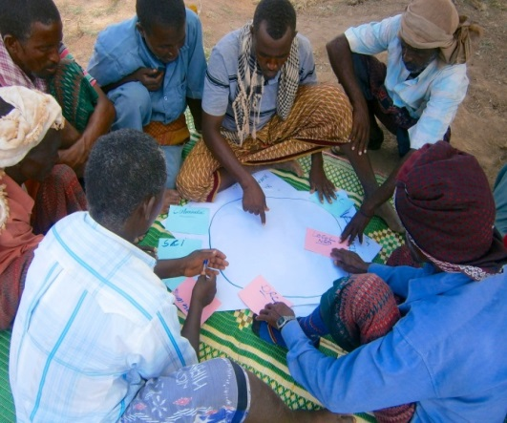
OUR RESULTS
Amongst most relevant results achieved in 2017 thanks to EU support in these sectors:
Productive sector:
More than 6,500 farmers, pastoralists, agro-pastoralists and fishermen have benefited from improved access to services, inputs and market
67 small business associations and cooperatives supported
More than 9 regulatory frameworks have been supported, including: the Dairy Act, the Veterinary Code, the Livestock Policy, the SME Policy, the Company Laws, etc.
At least 89 critical infrastructures have been built or rehabilitated in order to facilitate the access of farmers, pastoralists, agro-pastoralists and fishermen to services, inputs, natural resources and market, out of which 74 involved cash for work
At least 500 fishermen in Somaliland were trained and have benefited from better access to cold storage, ice production and processing facilities
20 tons of certified cereal seeds were distributed to small farmers to increase their productivity
Private sector:
Thanks to the EU contribution to the World Bank Multi-Partners Trust Fund (MPTF), progress has been made to strengthen the regulatory framework for the Money Transfer Operator (MTO) sector
100 enterprises have been supported through World Bank Multi-Partners Trust Fund (MPTF)
OUR ON-GOING SUPPORT IN FIGURES
Project | Amount in EUR | Main objectives | Implementing partner
Enhancing Somali Livestock Trade (ESOLT) | 3 000 000 | To improve livelihoods and resilience of livestock dependent households To enhance market access of Somali livestock and livestock products | African Union
Reviving Spate Irrigation In Somaliland | 2 000 000 | Increase the resilience of livelihoods to threats and crises | FAO
Somaseeds - Improving the genetic quality of seeds in Somalia | 2 500 000 |  | FAO
Income, livelihood and nutrition through a fishery-based economy | 2 999 427 | To strengthen livelihoods, improve food security and nutrition to Somaliland and Puntland populations through small-scale fisheries production, processing and trade | Somali Fair Fishing
No Piracy: Alternatives for Youth Living in Coastal Communities of Puntland, Galmudug and Mogadishu | 5 300 000 |  | FAO
Technical Assistance for Institutional Capacity Building on Agriculture Value Chain and Public-Private Partnership Development in South-Central Somalia | 1 922 283.55 |  | Adam Smith International
OUR CONTACTS
Susanne Martin – Head of Section Susanne.Martin@eeas.europa.eu
Martino Vinci – Programme Manager Productive Sectors Martino.Vinci@eeas.europa.eu
Abdi Abdikadir– Press and Information Officer abdikadir.abdi@eas.europa.eu

