Slide 1


Navigating Cultural and Social Norms
Ndidi Okonkwo Nwuneli
June 15th 2017

Slide 2
AGENDA
What are some social & cultural norms that exist in the Nigerian context?
Sharing Experiences
Q & A

Slide 3
Social Norms
Some popular myths/beliefs!
You cannot have it all!!!
You have to change your name
You are not a complete woman until you are married and not treated with respect until you have children
You have to prioritize marriage over career
You have to be baby friendly
You cannot earn more than your husband
Your business cannot be bigger than your husband’s
Small is beautiful
Others???

Slide 4
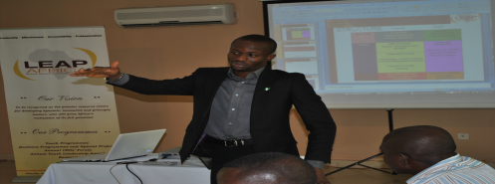



Cultural Norms
WHAT ABOUT RELIGIOUS NORMS???
HOW DO THEY ENCOURAGE US OR LIMIT US?
Who is your father?
Are you under pressure to maintain a certain lifestyle?
Do you have a son?
As a single woman can I live by myself?
Some ethnic groups support strong women, others are threatened by them!
Is it a sign of weakness to ask for help?
How many relatives are you supporting?
I can be successful but not too successful?
What are the expectations of my inlaws, parents?

Slide 5
…It is still a Great Time to be a Nigerian Woman Entrepreneur!!!
Training opportunities abound
Ample number of role models
Funding opportunities exist – more money chasing opportunities
More industry and women’s networks to support women
More women on boards
3

Slide 6
AGENDA
What are some social & cultural norms that exist in the Nigerian context?
Sharing Experiences
Q & A

Slide 7
Tips for Navigating the Social & Cultural Dimensions
Develop a clear personal mission and vision
Identify mentors, critics and role models
Create a support network – ask for help – it takes a village
Invest in a Board of Directors
Surround yourself with individuals who share your vision and values
Invest in building a strong network
Invest in life long learning
Stay humble and focused - stay in your lane!
Find opportunities to serve!!!

Slide 8
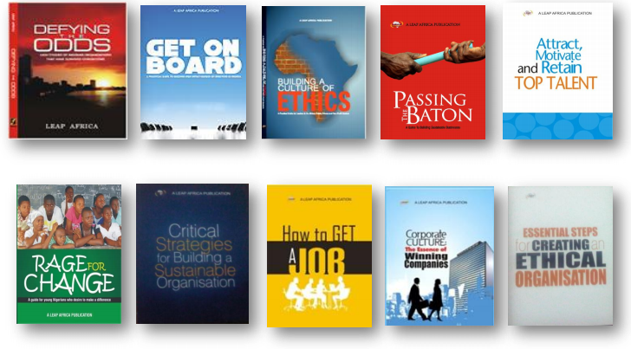
LEAP Africa: Promoting Ethical & Effective Leadership
OUR MISSION: To inspire, empower and equip a new cadre of African leaders by providing the skills and tools for personal, organizational and community transformation.
OUR VISION: To be recognized as the premier resource centre for developing dynamic, innovative and principled leaders, who will drive Africa's realization of its full potential.
OUR PROGRAMMES:
Youth LEAP - Changing the mindset of youth, equipping them to lead ethically and motivating them to deliver positive change in their communities.
Business LEAP - Supporting entrepreneurs in instituting systems and structures that are crucial for business sustainability.
eLEAP - Creating an online resource centre with technology enabled tools for developing innovative, dynamic and ethical leaders.
OUR IMPACT:
Trained 50,000 youth, entrepreneurs and teachers directly, with over 250,000 indirect beneficiaries
Direct beneficiaries have commenced over 1,000 change projects
Published 11 books used by trainers and key partners across Africa
Worked in 26 Nigerian states in partnership with key stakeholders
Pioneered training on succession and ethics in Nigeria

Slide 9

Prerequisites for Scaling
"Vision without action is just a dream, action without vision just passes the time, and vision with action can change the world."
Nelson Mandela
Building
Blocks
for
Scaling
Vision
Theory of Change
Talent & Leadership
Financing
Partner-ships
Business models that scale
Simple
Engages the Community
Leverages Technology
Low Cost
Demand Driven
Measurable Impact
Business Model
Pathways to Scale
Structure
Values
Mission

Slide 10

Reducing Food Waste and Malnutrition
AACE Foods
AACE Foods was created by Ndidi & Mezuo Nwuneli, propelled by passion and a sense of urgency rooted in three facts:
Over 90% of the processed food that is consumed in Nigeria is imported, even though 60% of the population is engaged in agriculture. Not unconnected, over 50% of household income is spent on food.
20-50% of grains, herbs, fruits, and vegetables are wasted due to poor post harvest practices, lack of appropriate packaging and storage facilities, inadequate distribution mechanisms and limited local processing.
37% of Nigerian children under 5 years old are classified as stunted, according to the 2013 Demographic and Health Survey
Our Mission: To provide nutritious and tasty food products made from the best of West Africa’s fruits, herbs, cereals and vegetables.
Our Vision: To be the preferred provider of food in West Africa, thereby contributing significantly to the improved nutritional status of our people, and better the livelihoods of our farmers.

Slide 11
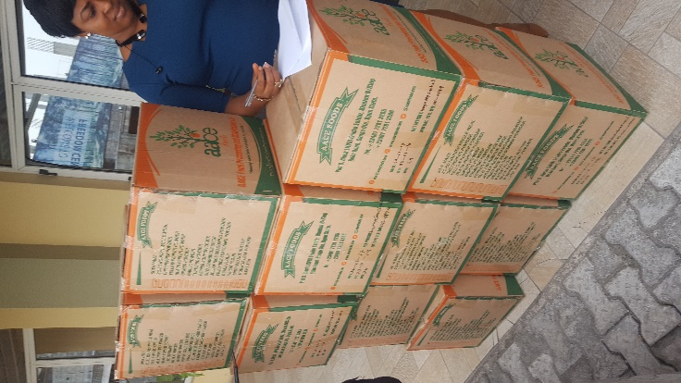
MISSION, VISION & VALUES
Our Mission: To provide nutritious and tasty food products made from the best of West Africa’s fruits, herbs, cereals and vegetables.
Our Vision: To be the preferred provider of food in West Africa, thereby contributing significantly to the improved nutritional status of our people, and better the livelihoods of our farmers.
Our Values: Proudly West African, Quality Products, Cost & Time Efficiency, Continuous Improvement and Accountability.
AACE Foods CSR strategy has four pillars: A commitment to:
Improving the livelihoods of smallholder farmers
Improving the nutritional status of West Africans
Promoting agribusiness education in Nigerian schools
Investing in a world-class, diverse and ethical team

Slide 12
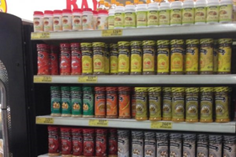
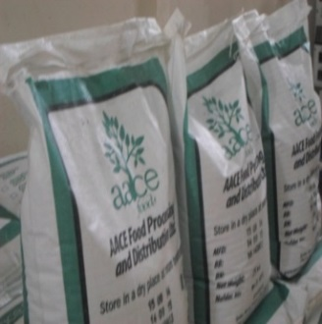
OUR PRODUCTS
AACE Foods’ provides a wide array of products to retail, wholesale, commercial and institutional buyers. Our products include:
Complimentary Food: Soya Maize, So-So Nourish (Sorghum-soya blend), Maize Flour, and Cowpea Flour directly focused on addressing moderate malnutrition in Nigeria
Spices: Black Pepper, Garlic, Ginger, Chili, and Yellow Pepper (Cameroun or Nsukka), Turmeric
Spread: Spicy Peanut Butter (Ose Oji)
Seasonings: Fried Rice Seasoning, Jollof Rice Seasoning. Pepper Soup, Suya/Barbeque (Yaji), Curry, Vegetable and Soup Seasoning, All purpose Seasonings and Ginger Garlic seasoning
Commodities: Soybeans, Ginger, Maize, Turmeric, Ginger, Coriander, Chilli, and Black Pepper.
3

Slide 13
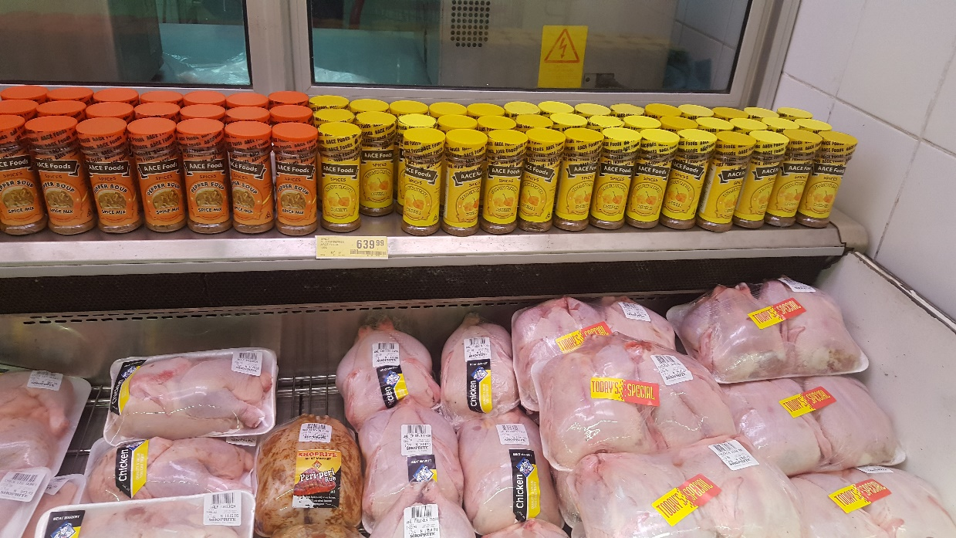

OUR REACH & IMPACT
Presence in 10 states in Nigeria and over 100 supermarkets and open air markets
Exports to Netherlands and the United States
Displaced imports of bulk spices and currently supply leading FMGCs
Engagement with over 10,000 farmers in Kaduna, Kano, Katsina, Taraba, Oyo and Ogun States
60 employees, over 50% are women, directly engage with over 100 distributors, SMEs and community organizations that benefit from AACE Foods
Serve as a catalyst and contributor in the “Made in Nigeria” Food movement, attracting other entrepreneurs. Recently recognized as the Made in Nigeria winner for 2016 by Ebonylife TV/WIMBIZ

Slide 14
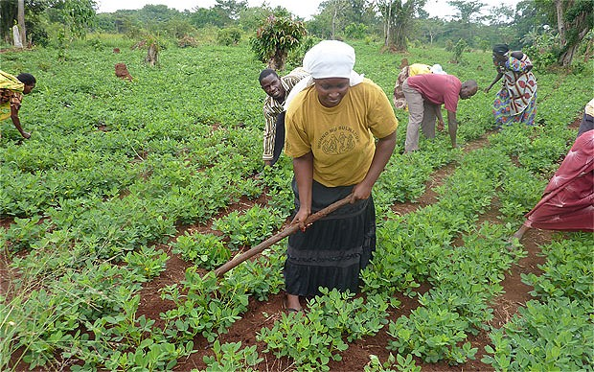
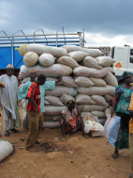
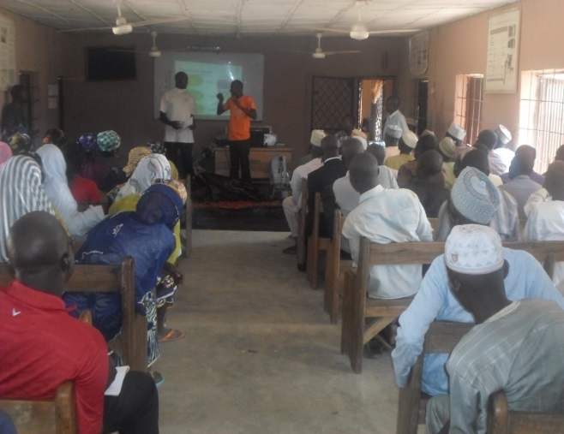
OUR PARTNERSHIP WITH FARMERS
AACE Foods has partnered with key international development agencies since 2010 to develop a local supply chain sourcing produce from over 10,000 farmers
We train, facilitate microfinance and provide farmer clusters with storage technology. This direct relationship has enabled us to build reliable sources of raw materials and to improve the lives of smallholder farmers.

Slide 15
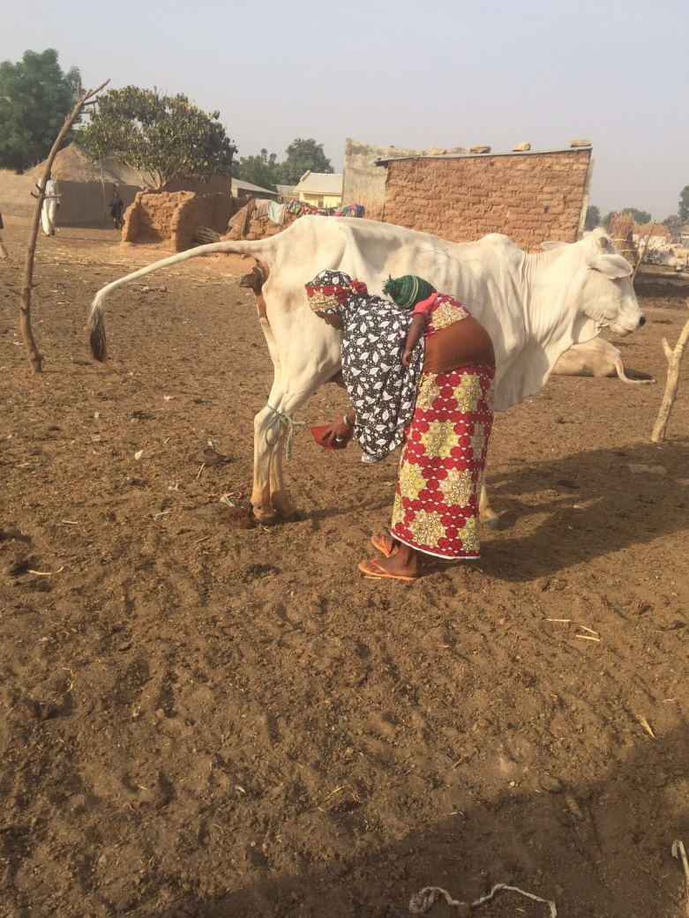
Nigerian Dairy Development Programme (NDDP)
The Nigeria Dairy Development Programme is a processor-led dairy programme implemented by Sahel Capital, in partnership with Friesland Campina in Oyo and L & Z in Kano
The programme aims to lay a strong foundation for the Government’s Dairy Transformation Agenda.
The programme is in the proof-of-concept phase, which aims to demonstrate the viability of the intervention and the desired gender and nutritional impacts that could be achieved.
Farmer Identification & Cluster Formation
Dairy cluster formation
Infrastructure for Dairy Development
Water resources/Boreholes
Milk collection infrastructure
Productivity Improvements
Gender Study (cultural norms, gender dynamics, etc.)
Baseline Study (including demographics, socioeconomics, milk production statistics, sources of livelihoods, etc.)
Baseline, Gender & Nutrition Studies
Genetics & Breeding
Farmer Extension & Animal Health
Feed & Fodder
Milk evacuation infrastructure
New milk suppliers identification (equitable women representation)
Nutrition Study (eating habits, nutritional status etc.)
Notes:
Project overview
Mention Fulani conflict

Slide 16
Addressing Regional Causes -Initiating and/or Supporting Causes
Ndu Ike Akunuba (NIA) – enabling female universities students in Southeastern Nigeria to achieve their highest potential. From leadership and mentoring programmes, to Big Sister programmes for secondary school students
Okonkwo-Iweala STEAM Center Awka – equipping and empowering girls to engage in science, technology, engineering, arts and mathematics.
Ola Ndi Igbo – Celebrating our Global Best – and engaging them to give back to Southeast by leading social change projects. Now managed by South Saharan Foundation

Slide 17
Project Alert – Revolving Survivors Fund
Project Alert is a non-governmental women’s rights organization set up in January 1999 by Josephine Effa-Chukwuma, to promote and protect the rights of women. It does this by providing information on all forms of violence against women/young girls; advocating for zero tolerance to all forms of violence against women/young girls; and providing practical support services to female victims of violence. These support services include: counseling, legal aid, and shelter. The shelter, known as Sophia’s Place is located in Lagos, and was set up in May 2001. It is the first battered women’s shelter in Nigeria.
Overview of the Project Alert Survivors Fund
Provide loans to abused working women (with verifiable income) in need of financial support to escape from their abusers and rent a place of their own.
Provide loans to abused women wishing to start off small scale businesses (with a clearly developed business plan)
Please visit our website on www.projectalertnig.org

Slide 18
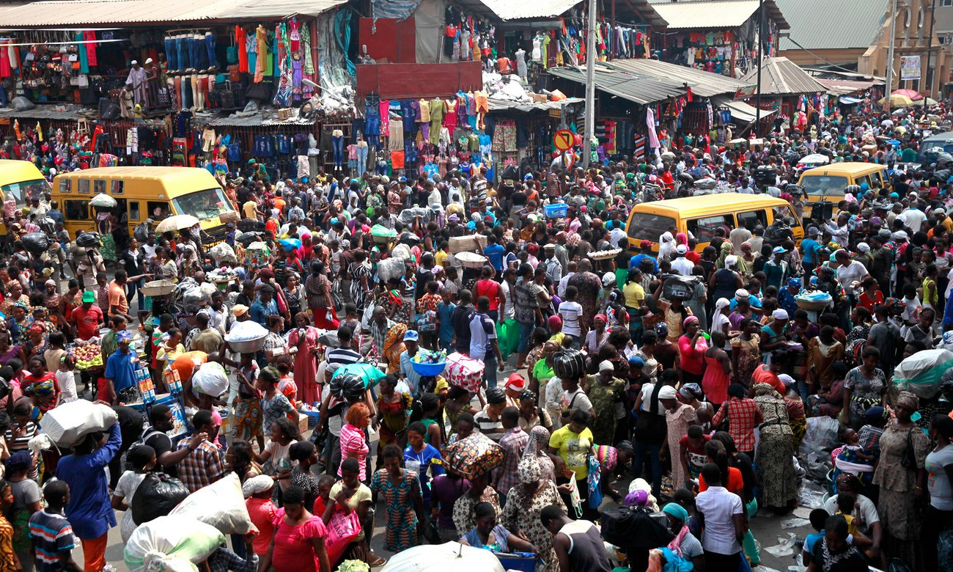
Sense of Urgency
Population trends:
1980 – 477 Million
2016 – 1.2 Billion
2050 – 2.4 Billion

Slide 19
QUESTIONS THAT WE MUST ASK OURSELVES
What legacy are we living and are we leaving?
Our children?
Our businesses?
Our companies?
Our community?
Our country?
The world?
Our art – books, songs, paintings, buildings?
We will be remembered when we are gone? If so, how?

Slide 20
TAKE PERSONAL RESPONSIBILITY – IN YOUR ROLES AS WIVES, MOTHERS, SISTERS, DAUGHTERS, BOSSES, MANAGERS, CITIZENS
Integrity – values based on honesty, a strong work ethic, accountability – commit to pay for service! Hard work still pays in Nigeria! Stop rewarding mediocrity!3
Discipline – manage your time, and your resources effectively. Resist the temptation to keep up with others. Run your own race!
Learning – read everyday, learn, grow, find mentors, critics, role models, champions and accountability partners. Leverage resources available in your community to grow and start your business!
Excellence – According to Saint Francis of Assisi said, “It’s no use walking anywhere to preach unless your preaching is your walking.” To leave a legacy of excellence, strive to be your best every day.
Service & Encouragement - You have a choice. You can lift others up or bring them down.
Purpose –A legacy of purpose, make your life about something bigger than you.

Slide 21
PARTING THOUGHTS
Be the first, but never the last – leave a door open for others to enter
Mentor at least one other person
Educate at least one other person
Groom a woman to succeed you in your current position
Write a will, and leave something to your daughter
If I have seen further, it is by standing on the shoulders of giants

Slide 22
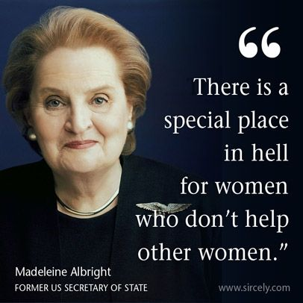

Slide 23
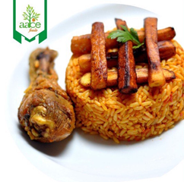
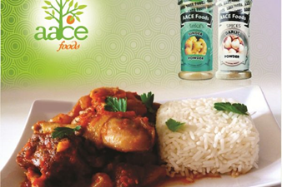
THANK YOU!!!
If you want to go fast, go alone
If you want to go far, go with others!!!
Ndidi Nwuneli
nnwuneli@aacefoods.com
www.aacefoods.com
@aacefoods
@ndidinwuneli

