Slide 1

Development Cooperation
Delegation of the European Union to Pakistan
30 November 2019

Slide 2
Content
Why a development cooperation policy & who we are?
EU development policies & international context
How is aid delivered? (Overall, budget support, blending)
What we do in Pakistan?
External financing instruments and next programming period
Practical information

Slide 3
1
Why a development cooperation policy?
&
Who are we?

Slide 4

Regional and national conflicts
Climate change
Migration/
Refugees
What happens in the world
Corruption
Terrorism
Hunger/
Malnutrition
Inequality
Natural disasters

Slide 5
86% of citizens support development cooperation policies
Citizens think that tackling poverty in developing countries should be one of the main priorities of:
The EU 70%
National governments 58%

Slide 6
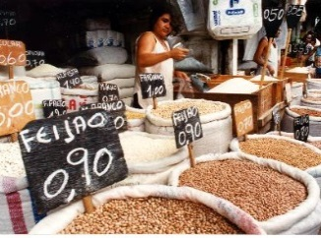
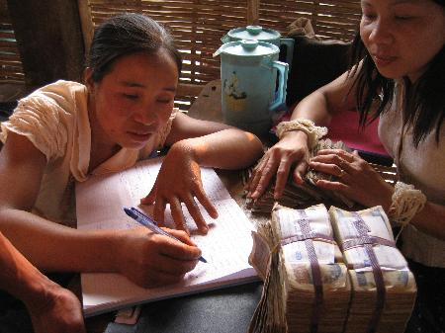
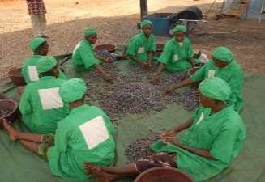
A win-win solution
Aid stimulates inclusive growth in developing countries and boosts trade with Europe;
Issues that affect us all can be tackled
in advance and can save money;
The EU has an added value: acting as one,
makes financial sense and can save money and increases leverage.

Slide 7
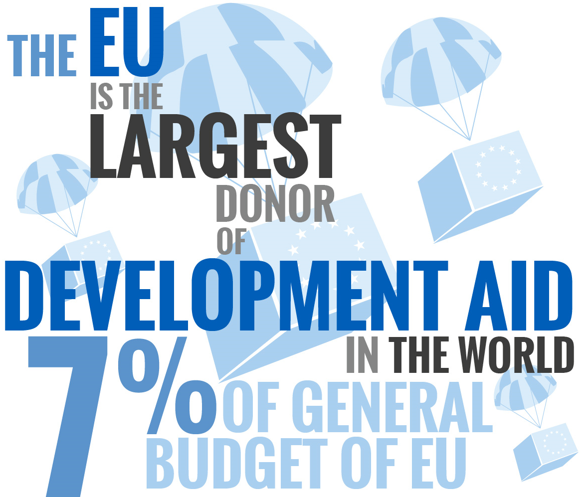
What happens in the world

Slide 8
ODA Commitments per Region in 2017
(commitments in €M)
Source Draft Annual Report 2017

Slide 9
Institutional Development Cooperation Actors
DEVCO designing development policy and delivering aid throughout the world
NEAR designing neighbourhood and enlargement policies
ECHO humanitarian aid civil protection
DG Trade trade policy, jobs and growth
FPI operational expenditures (along with EEAS) (CFSP, IcSP, PI, EOMs)
EEAS aims to make the EU's external action more coherent and efficient, thereby increasing the EU's influence
Notes:
Acronyms
DEVCO – European Commission Directorate-General for International Cooperation and Development
NEAR - European Commission Directorate-General for Euroepean Neighbourhood and Enlargement Negotiations
ECHO – European Civil Protection and Humanitarian Operations
DG Trade - European Commission Directorate-General for Trade
FPI – Foreign Policy Instruments
EEAS – European External Action Service
CFSP – Common Foreign and Security Policy
IcSP – Instrument for Stability and Peace
PI – Partnership Instrument
EOMs – Electoral Observation Missions

Slide 10
DG DEVCO tasks
Defining development policy in an international cooperation context;
Implementing external aid programmes across the world;
Translating policies into practical cooperation/aid actions and developing new methods of aid delivery;
Steps of aid delivery: programming (together with the EEAS), identification, feasibility, financial decisions and controls, tendering, contracting, monitoring and evaluation.

Slide 11
2
EU development policies & international context

Slide 12
Development cooperation under the
Treaty on the Functioning of the EU (TFEU)
“Union development cooperation policy shall have as its primary objective the reduction and, in the long term, the eradication of poverty” (TFEU Art. 208)
“The Union shall take account of the objectives of development cooperation in the policies that it implements which are likely to affect developing countries.” (TFEU Art. 208)

Slide 13
EU cooperation policy & history (1)
1958 The European Communities Development policy is part of foreign policy
1950s - 1990s
EU expansion of aid to ACP, Eastern Europe, Mediterranean, Asia, Latin America, Balkans and birth of thematic programmes like human rights. From association to partnership agreements
1992 UN Earth Summit, Rio de Janeiro - Climate Change Convention
2000
UN 8 Millennium Development Goals: fixing poverty reduction objectives for 2015
2002 Monterrey: more resources, EU countries commit to 0.7 % GNI for ODA
2005 Paris Declaration on Aid Effectiveness
2005 European Consensus on Development

Slide 14
2002 Monterrey: more resources, EU countries commit to 0.7 % GNI for ODA
2005 Paris Declaration on Aid Effectiveness
2005 European Consensus on Development
2011 A new development policy: Agenda for Change
2012 Rio+20 on Sustainable Development
2013 Multiannual Financial Framework 2014-2020
EU cooperation policy & history (2)
2011 A new development policy: Agenda for Change
2012 Rio+20 on Sustainable Development
2013 Multiannual Financial Framework 2014-2020
2015 Deadline to achieve the targets under the UN 8 Millennium Development Goals!
2015 New Sustainable Development Goals, 17 SDGs
2015 Addis Ababa Conference and Action Agenda
2015 December: Paris Climate Conference, COP21
2017: new European Consensus on Development
2017 European Investment Plan

Slide 15
2030 Agenda for Sustainable Development
Its main aims are to eradicate poverty and achieve sustainable development: It integrates and balances the economic, social and environmental dimensions of sustainable development, along with poverty eradication;
It is based on human rights for all and the commitment to "leave no one behind“: It addresses peaceful and inclusive societies and the fight against inequality in all of its dimensions;
Major difference: MDGs were supposed to be reached by developped countries; SDGs are to be reached by all countries (developped and developing) together;
5P = People
= Planet
= Prosperity
= Peace
= Partnerships

Slide 16


Slide 17
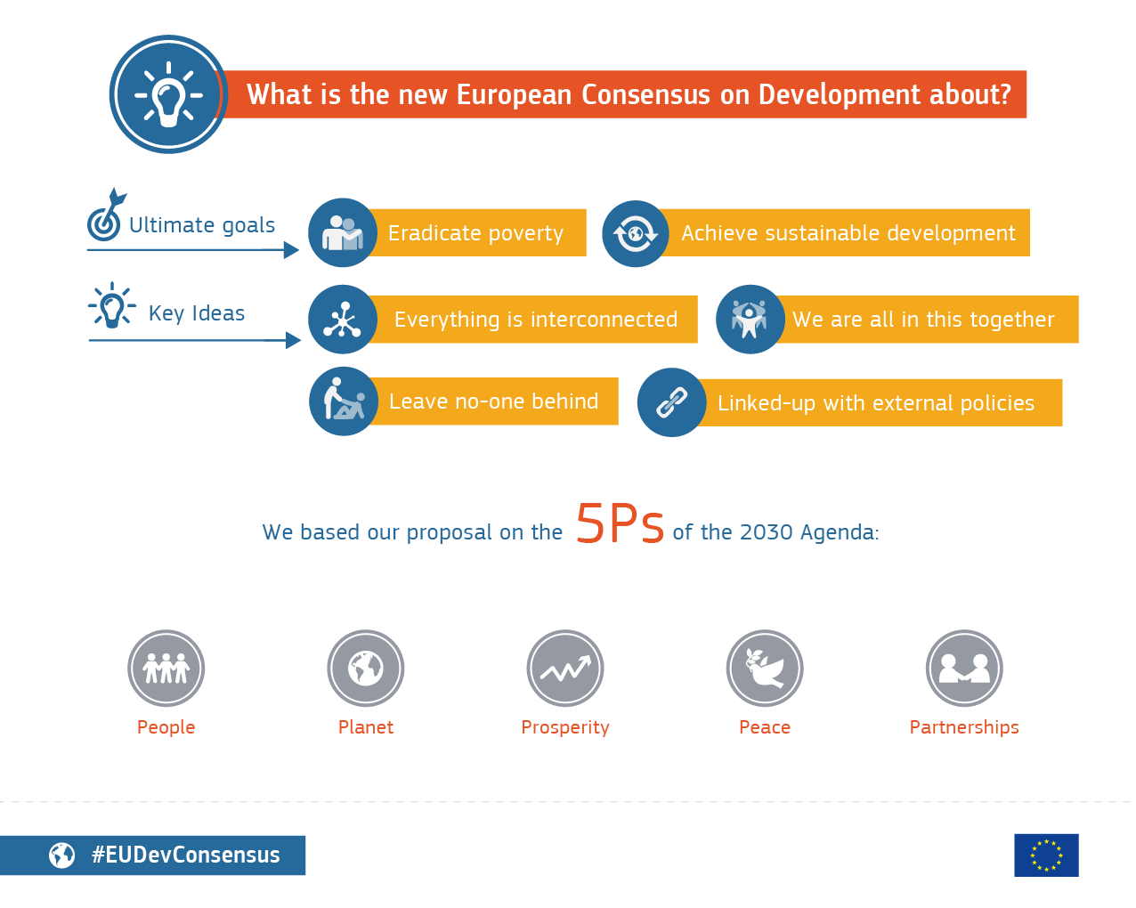

Slide 18
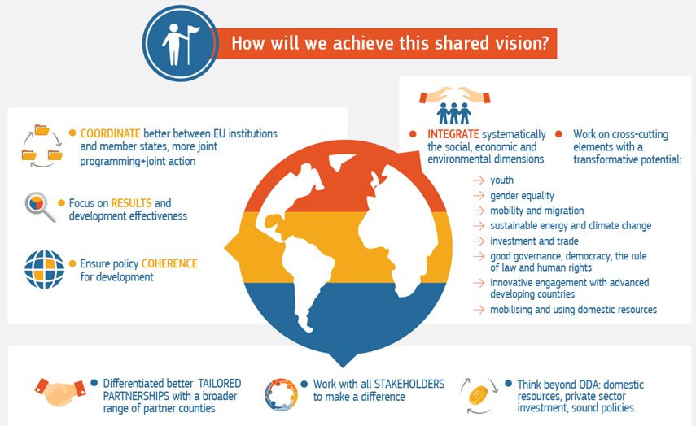

Slide 19
3
How is aid delivered?

Slide 20
3.1
Overall aid delivery

Slide 21
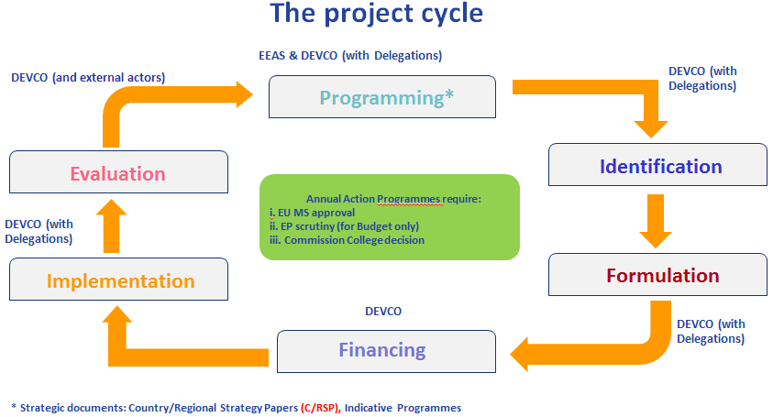

Slide 22
3.1.1 State of play – Key figures
3.1.2 Financing agreement – Concept and important provisions
3.1.3 Management mode and Implementing modalities - Which type of aid modalities used in Pakistan?

Slide 23
3.1.1 Devco in Pakistan
State of play Key figures

Slide 24
Development cooperation EU in Pakistan
mostly funded MFF 2014- 2020
ONGOING – see List of Financing agreements
Number of Financing agreements
14 FA with an ongoing implementation period (+ 8 FA closure)
4 FA currently to be signed
Number of ongoing contracts under ongoing FA :
41 implementing contracts
(531 M EUR – average size 13M EUR)
+ 19 support measure contracts (evaluation/audit CTR)
In addition, without FA, thematic contracts
(thematic budget lines targeting mostly CSOs) :
+/-22 contracts (17 M EUR – average size 800K EUR) .

Slide 26
3.1.2
Financing agreement
Important provisions

Slide 27
MFF (7 y cycle) partner country envelop and
Financing instruments defined
Joint Programming :
(partner country priorities, EU MS, donors coordination)
Priority sectors of intervention
Formulation Actions :
objectives and results & financial envelop
Commission decision adopted
Geo DEVCO Director : budgetary commitment (N+1), compliance legal basis, sound financial management
FA signature
(within N+1 from budgetary commitment)

Slide 28
Why signing a FA?
  principle of ownership by the partner country
  Agreement on the implementation of a Programme, its allocation and its implementing modality
Who signs the FA?
  signature of the financing agreement between the partner country representative (EAD) and the EU represented by the Commission (Geo Director Devco)
  Only in the case of budget support : Based on the financing agreement, the partner country may also become a direct recipient of funds

Slide 29
N+1 : Deadline to sign a Financing agreement with the partner country
After adoption of the financing decision, the global budgetary commitment is authorised
Year N = year in which the budgetary commitment was made
(ex. October 2019)
FA to be concluded by 31 December of year N+1
(ex. 31 Dec 2020)
Beyond N+1 funds are lost!
The FA signature sets the entry into force of the FA.
(ex. 12 Dec 2019)
D+3 to conclude all other contracts
(12 Dec 2019 D+ 3=> 11 Dec 2022)

Slide 30
FA content
0. Special conditions defines the action, the budget, the timing, the provisions added and/or the derogations.
Annex I containing the TAPs for the implementation of the action include the activities to be implemented and the budget
Annex II the general conditions which are fixed and cannot be changed
Annex III and IV not applicable (mostly EDF countries – Indirect management)
FA Example : Development through Enhanced Education Programme (DEEP) ACA/2017/39288 – (allocation 50 M EUR)

Slide 31
    FA SPECIAL CONDITIONS
    Article 1 - Nature of the action
    - Programme Title, CRIS ref (EU accounting system)
    - Legal Basis (DCI)
    - Financial allocation and co-financing
    Supplementary provision for Pakistan
Article 1.4
The activities envisaged under this programme will be overseen by the Project Steering Committee with a leading role for the Balochistan Water Authority as set out in Annex I TAPS.

Slide 32
Article 2 – Execution period
FA enters into force at the signature date by both parties (last of the two).
Operational implementation (OI):
    Contracting of implementing contracts (D+3 from entry into force unless multi donor action/co-financing
    All activities must be carried out under the implementing contracts
Closure period (CP) : max 24 months (exceptionnally 30 M)
    Audits and final evaluation
OI + CP => Execution period FA

Slide 33
Financing agreement timeline
Ex. PFM II (ACA/2019/41482 )
Suspensive clause : Launch of the tender before FA signature
Closure phase
Operational implementation period
FA execution period
D+3 :
contracting period
Audit evaluation
Implementation of activities
Notes:
SUSPENSION CLAUSE : possibility to launch contract procedures under suspension clause:
prior approval n° 11 - actual signature of contract will depend on the conclusion of the FA - award procedure will be cancelled if FA is not signed
FR imposes deadlines for signature of all contracts (including delegation/contribution agreements) implementing the FA.
General rule:
D+3 for not co-financed actions
D+X (to be specified in FA SC) for multidonor actions
EDF:
possibility to extend D+3 when IM w PC (if so, stipulated in FA SC)
Exceptions:
amendments to procurement & grant contracts
contracts concluded after early termination of procurement contracts
changes of implementing entity
blending
contracts for audit and evaluation (also during closure phase)
PE operating costs
Decommitment after deadline.

Slide 34
Derogations to FA for Pakistan
In principle, the following provisions are supplementing the General conditions
SC Art 6.2 – DISPUTE SETTLEMENT
Without prejudice to the provisions of the General Conditions including article 26 thereof, every effort will be made to settle differences/disputes with respect to the implementation of this project before resorting to the suspension of the agreement.
SC Art 6.3- CONSTITUTION & NATIONAL LAW
The project activities will be carried out in accordance with the Constitution of Pakistan and relevant national laws and policies
Disclaimer: for the AAP 2019 1-2 (PFM II -TL- Balochistan Education and water), the derogations are currently under the process of endorsement with Devco Geo Director

Slide 35
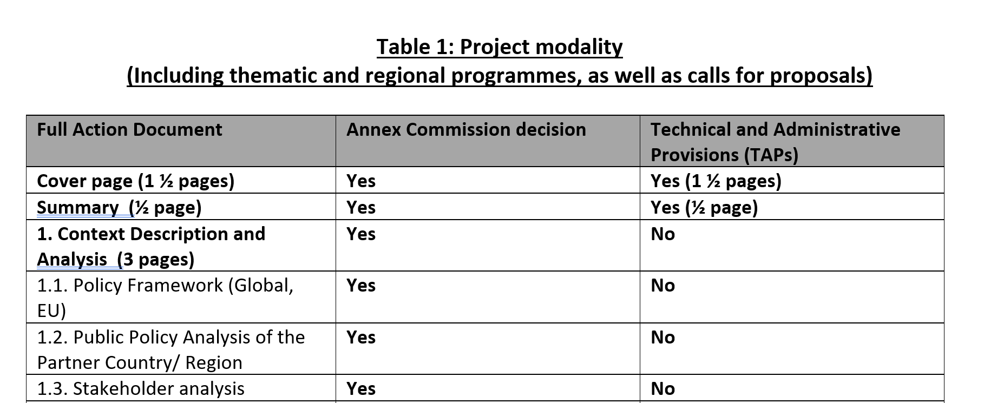
Annex I to FA : TAPS - Technical and Administrative Provisions
TAPS : Description of the action and the implementing modality
The AD from the Commission Decision is the basis to create the Technical and Administrative Provisions (TAPs) in the Financing Agreement
See table with the instruction to create the TAPs from the AD

Slide 36
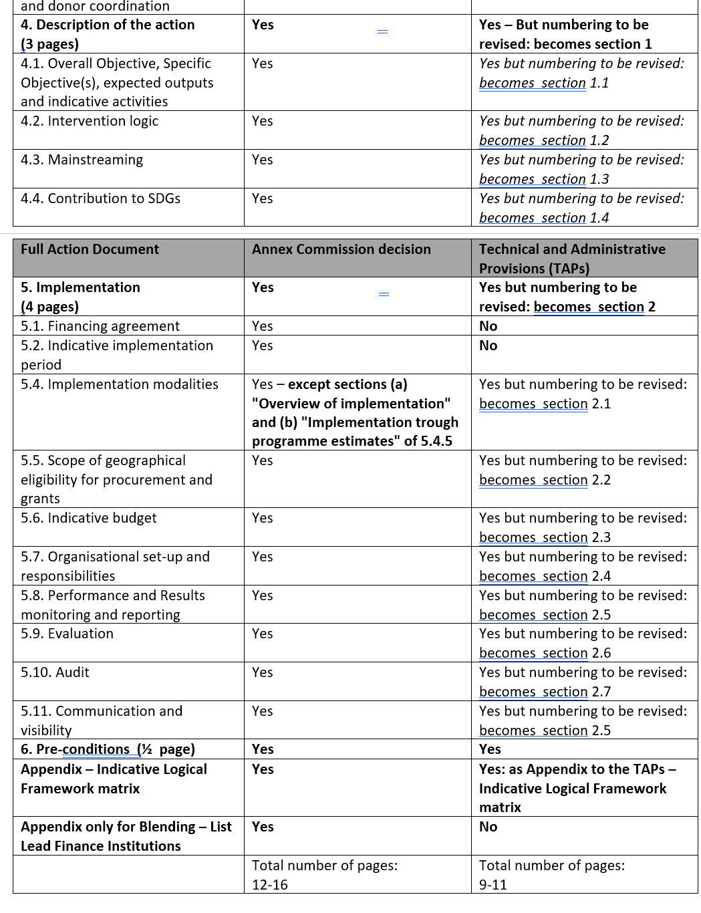
Annex I to FA : TAPS - Technical and Administrative Provisions

Slide 37
Annex I to FA : TAPS - Technical and Administrative Provisions

Slide 38
Section 2.4 of the TAPS
Estimated Budget

Slide 39
Annex II to the FA
see table of content of GC
Part One: Provisions applicable to activities for which the Partner Country is the Contracting Authority (e.g. contracting deadline, exclusion criteria, recovery etc.)
=> Not applicable in the case of Pakistan as implementing modality .
Part Two: Provisions applicable to Budget Support (e.g. policy dialogue, verification of conditions for disbursement)
=> Applicable for the Budget support operations (ie. AAP 2020 should BS be confirmed)
Part Three: Provisions applicable to this action as a whole, irrespective of the management mode (e.g. right of establishment, tax and customs provisions)
=> Always applicable

Slide 40
Amendments to FA
See Table Chapter 7 of the Devco companion
Substantial or not substantial
ie. change of management mode
Frequent riders requiring EAD intervention
  Budget reallocation / mobilisation of contingencies
  Extension of the Operational implementation period

Slide 41
3.1.3 Management mode and implementing modalities

Slide 42
AAP/
Financing
decision
Global/Individual Budgetary/Financial Commitments
Signature Financing agreement
Awarding of contracts /Tendering CFP CFT
Registration of individual commitments
CTR signed Implementation of projects
Payments
Recoveries
De-commitments

Slide 43
Management mode
Direct versus Indirect
Who manages the EU funds / the action?
EU directly (centralisation of CTR)
or EU indirectly (delegation) through entrusted entities (who becomes the contracting authority)
=> Budget implementation tasks delegated: tendering procedure, contracting, verification and acceptance of reports, payment, audit, recovery of funds unduly paid.

Slide 44
Direct management By the EU (delegation) | Indirect management Entrusted entities
Budget Support Grants Procurement Services = technical assistance, studies, training,... Supplies = goods and equipment Works = buildings, infrastructures, etc. | Pillar assessed IO / Development agencies Blending/Financial Instruments

Slide 45
Direct versus indirect management mode – Who is the CA?

Slide 46
Indirect management
Contribution agreements

Slide 47
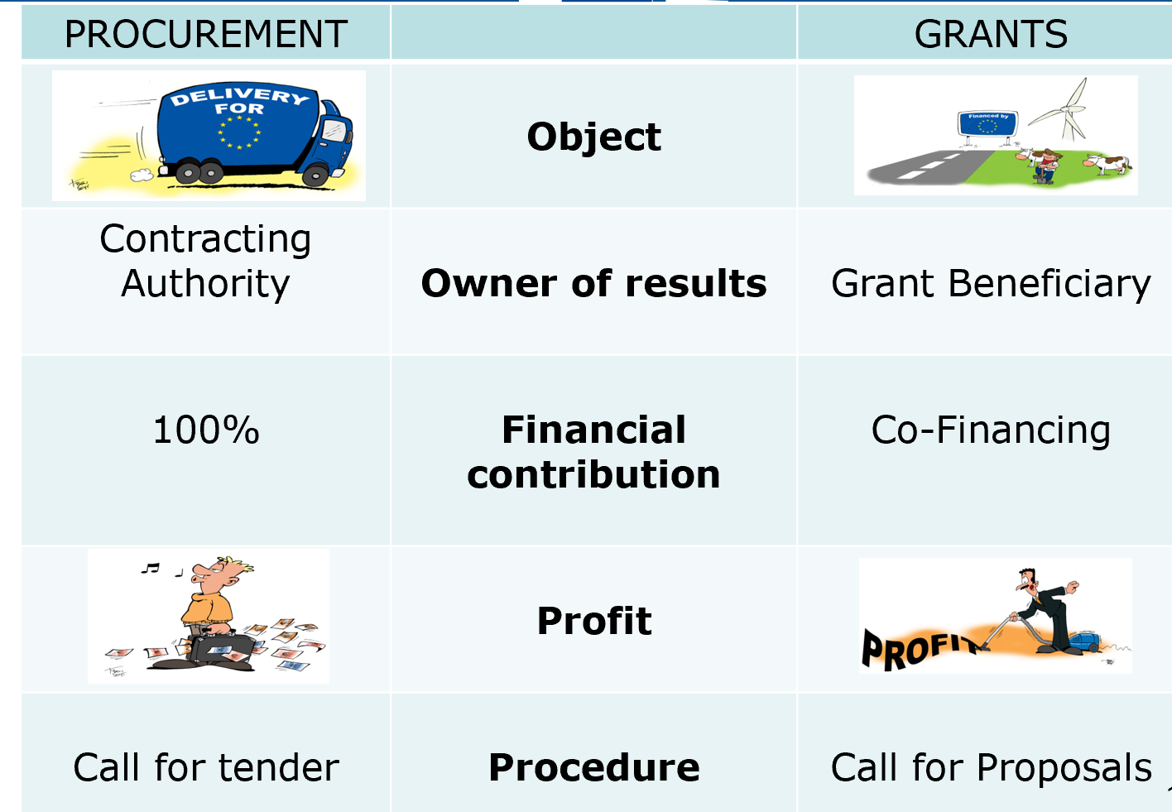
Grants versus Service contract

Slide 48
Call for proposals - Main steps
  Publication of the guidelines
  Submission of the concept note by the deadline (PROSPECT)
  Evaluation of the CN and shortlisting (ranking and twice the budget allocation)
  Submission of the Full proposals by the deadline (PROSPECT)
  Evaluation and final ranking
  Contract Signature and implementation

Slide 49
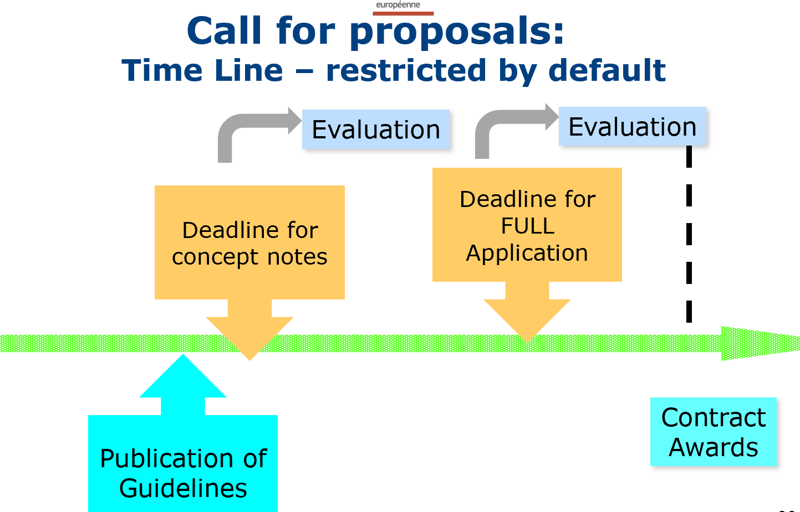

Slide 50
Call for tender - Main steps of the procedures
  Publication Prior info notice /Contract notice
  Shortlist: Candidate tenderer that complies with the selection criteria (Financial capacity/technical and professional capacity
  Tender launch – Invitation to tender & TORs
  Tenders received opening / admin check and Evaluation based on award criteria (technical offer and financial offer)
  Contract Award (Standstill Period)
  Contract Signature and implementation

Slide 51
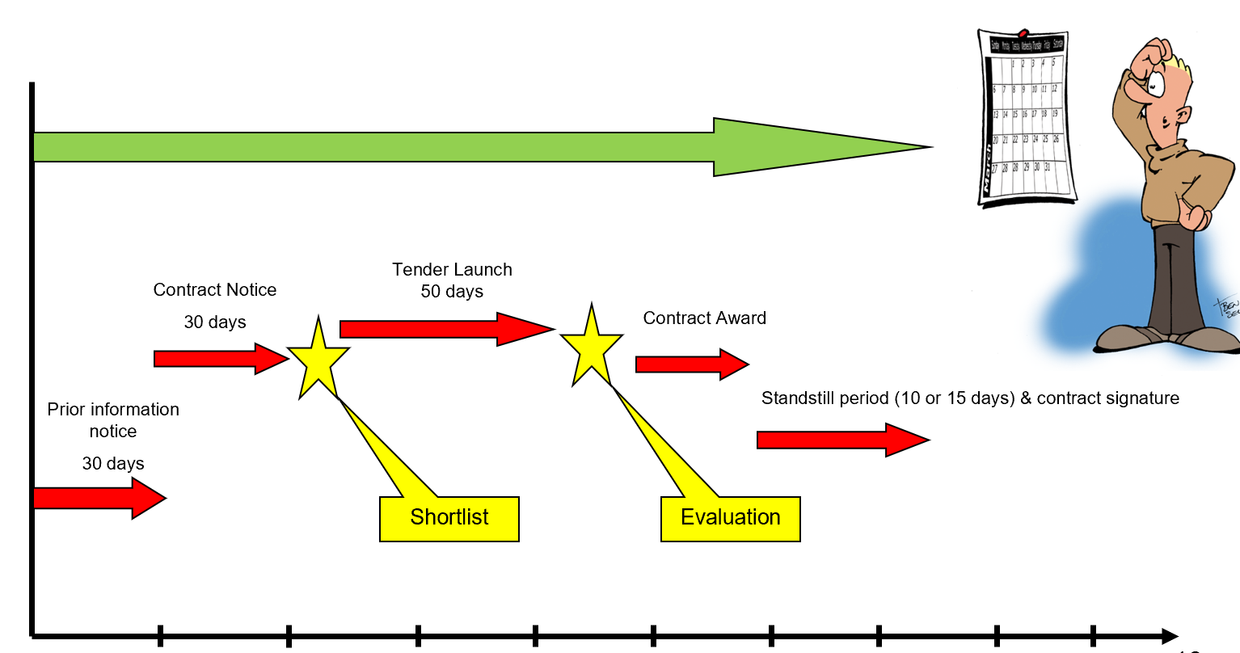
Call for tender – timeline for the procedure

Slide 52
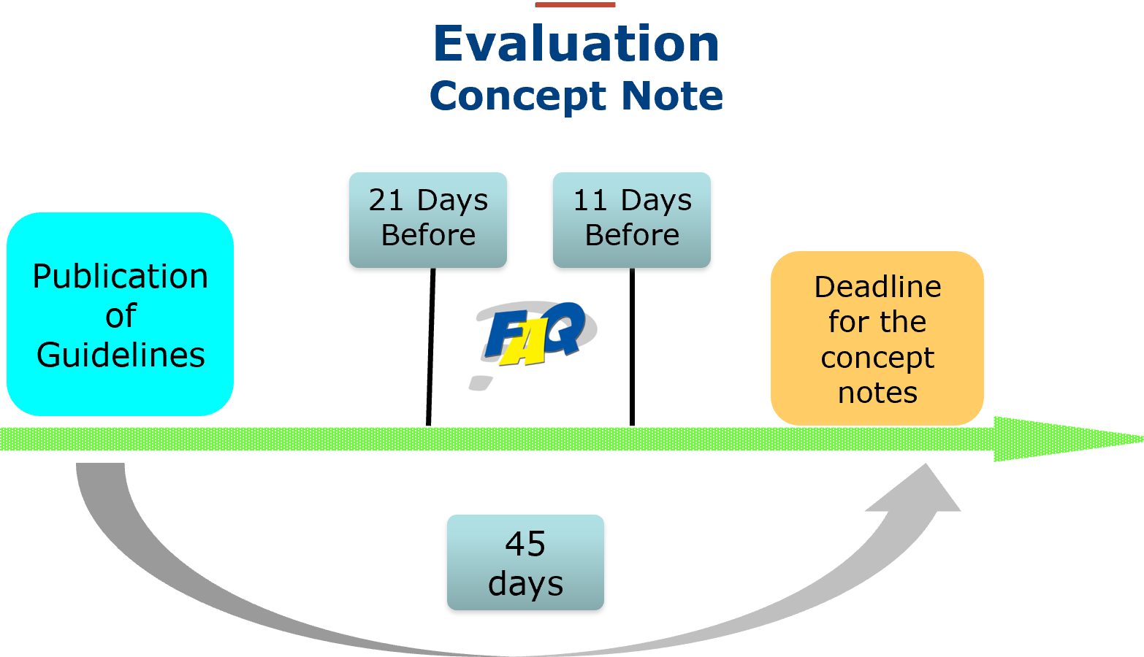
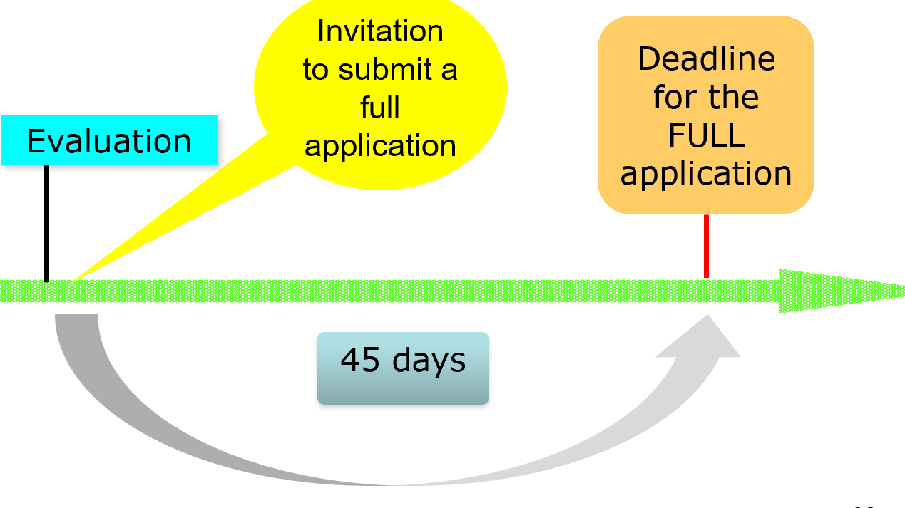
Grants
Call for proposals

Slide 53
Role of the partner country in the procedure
The terms of reference or technical specifications are drafted by the contracting authority. Where the European Commission is the contracting authority, the standard practice is to consult and obtain the approval of the partner country on the terms of reference or technical specifications, in order to strengthen both ownership and quality.
For procurement procedures, a representative of the partner country may participate as appropriate, either as an evaluator or as an observer.
In grant procedures, a representative of the partner country may participate as an observer only.
All members of the evaluation committee and any observers must sign a declaration of impartiality and confidentiality prior to carrying out any tasks related to the evaluation

Slide 54
What is Budget Support ?
An aid modality financing a partners development plan through:
"A transfer of resources to the partner government’s national treasury following the respect by the latter of agreed conditions for payment."
Notes:
The funds thus transferred are managed in accordance with the recipient’s budgetary procedures. Use of country systems and aid effectiveness
characterises budget support as a particular type of Programme Aid.
The definition distinguishes Budget Support from Balance of Payments support, where the transfer of foreign exchange would be to the Central Bank, and also from Debt Relief, where the transfer of foreign exchange would be directly to the country’s creditors.
The features distinguishing budget support are the nature of its objectives, the nature of the corresponding disbursement conditions, and the fact that it is perceived as a package of inputs, including policy dialogue and technical assistance or capacity-building measures, as well as financial transfers. Whereas the primary purpose of programme aid (structural adjustment
programmes, balance of payments support and debt relief) was to support macroeconomic stabilisation, the principal objective of budget support is to contribute to the implementation of a development strategy.

Slide 55
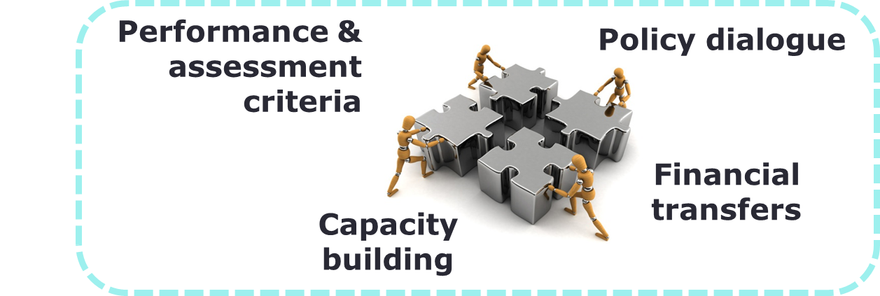
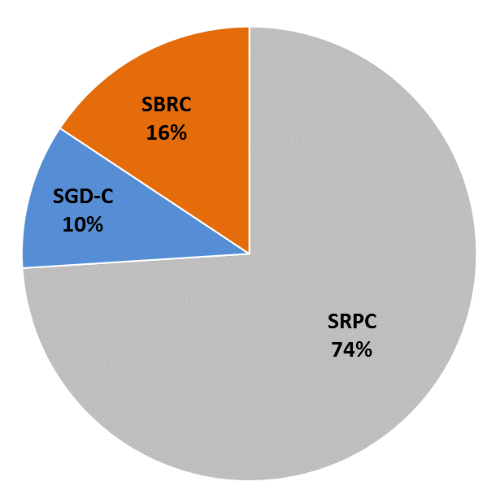
Budget support = development effectiveness
Dialogue on reforms, focus on results
Alignment with countries’ policies
Using countries’ systems
Ownership = sustainable results
3 types of contracts:
  Sustainable Development Goals Contract (SDG-C)
  Sector Reform Performance Contract (SRPC)
  State and Resilience Building Contract (SRBC)

Slide 56
Four general eligibility criteria for design and each disbursement:
Stable macroeconomic framework
  Focus on fiscal and debt sustainability, domestic revenue mobilisation, coping with shocks etc.
National/sector policy and reform
  National development policy or sector policy (sector budget support)
Public financial management (PFM)
  Assessment of PFM system, including Domestic Revenue Mobilization
  Partner countries to be actively engaged in fight against fraud and corruption
Transparency and oversight of budget
  Public availability of budgetary information and effective oversight institutions
  Assessed using a "dynamic approach" and the concept of "sufficient progress" in implementing reforms
  + Meeting specific criteria (form of variable indicators) during implementation
Notes:
Stable macroeconomic framework
More focus on fiscal and debt sustainability, domestic revenue mobilisation, prospect for reducing aid dependency, resilience
National/sector policy and reform
National ownership
Focus on inclusive/sustainable growth and poverty reduction (“Agenda for Change”)
Public financial management
Assessment of PFM system to establish a baseline for dynamic approach
May require short-term measures from PFM reform strategy before starting BS
Partner countries to be actively engaged in fight against fraud and corruption
Transparency and oversight of budget
Public availability of budgetary information (entry point)
Progress in the oversight : audit, (SAI), Parliament, civil society
They have to be respected before approval of an operation and during : they condition each payment

Slide 57
Budget Support is based on agreed planned results
The Financing Agreement (« Contract ») spells out what we agree to support (objectives) and, based on the national policy + planning also the milestones / indicator level etc to be achieved.
The country is eligible for the payment if there is satisfactory progress in each of the eligibility criteria .
Usually there is one payment each year. It can be split in a fixed and a variable tranche. The variable (or performance) tranche is conditioned (in addition) by the achievement of agreed indicators .

Slide 58
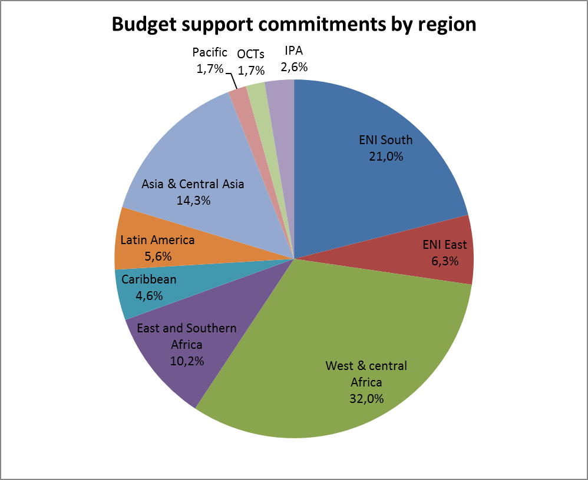
EU budget support > a global modality
90 countries & OCTs
270 contracts total
€ 1.6 bn committed in 2017
€ 1.8 bn paid in 2017
EU largest grant budget support provider globally (70% of total)
Notes:
OCT – Overseas Countries and Territories
SSA –
ENI – European Neighbourhood Instrument
IPA – Instrument for Pre-Accession Assistance
SSA -

Slide 59
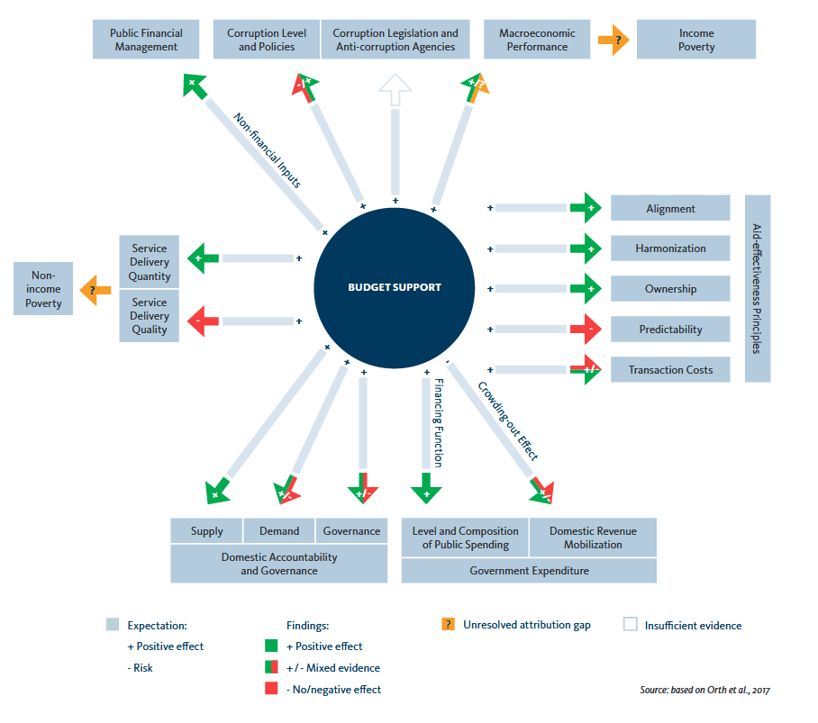
Effectiveness recognised
German Institute for Development Evaluation (DEVAL): synthesis of 95 evaluations over 1994-2015
(link)

Slide 60
3.3
Blending

Slide 61
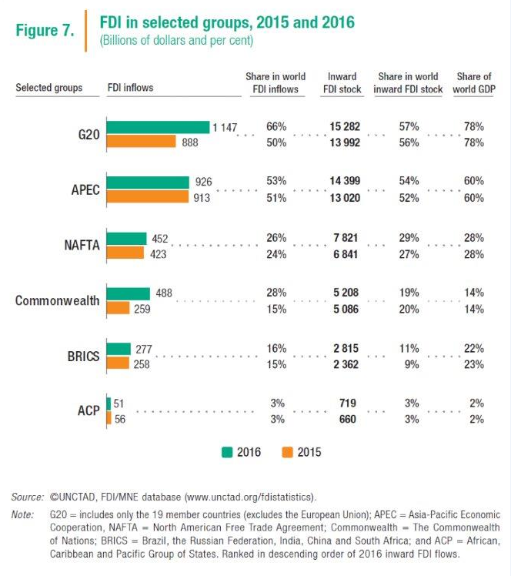
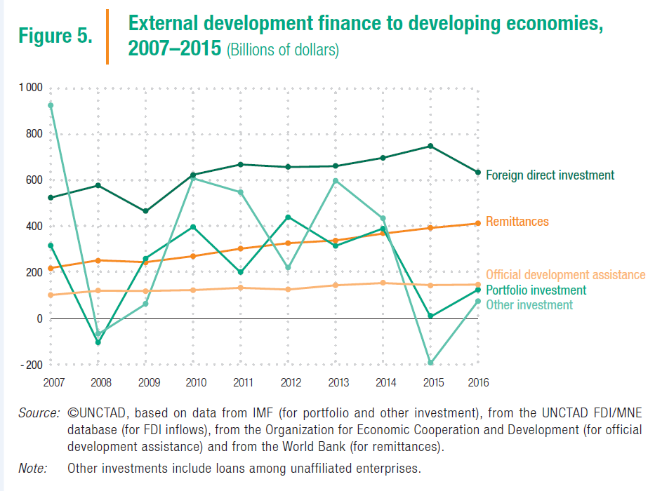
The case for Investment

Slide 62
Estimated global investment gap in key SDG sectors, 2015-30
Trillions of USD, annual average (WEF, 2015)

Slide 63
New European Consensus for Development:
Alignment with 2030 Agenda for Sustainable Development and Addis Ababa Action Agenda on Financing for Development
From billions to trillions !
Ultimate goal: job creation and inclusive sustainable growth

Slide 64
Blending is defined as …
THE STRATEGIC USE OF A LIMITED AMOUNT OF EU FINANCIAL SUPPORT TO MOBILISE FINANCING FROM PARTNER FIs AND OTHER SOURCES (Incl. THE PRIVATE SECTOR) TO ENHANCE THE DEVELOPMENT IMPACT OF INVESTMENT PROJECTS

Slide 65
Forms of blending
5 FORMS OF FINANCIAL SUPPORT… | …WHICH CAN ELIMINATE A KEY PROBLEM
Direct Investment Grant | Reduce cost to end users or beneficiary country by partly financing the total investment cost
Interest Rate Subsidy Grant | Reduce cost to end users or beneficiary country by reducing interest cost and/or avoiding IMF debt-ceilings (not a favoured tool for EU)
Technical Assistance Grant | To boost management, speed, project design, feasibility/preparation and quality i.e. address risks
Risk Capital | To address perceived high risk by providing funding which absorbs some of this risk and thereby lowers investors' risk perception (often with the objective of mobilising private capital)
Guarantee | To address perceived high risk by partly guaranteeing certain types of investments (often with the objective of mobilising private capital)
In Pakistan - mainly TA Grant

Slide 66
3 ‘types’ of partners, always a LEAD Financial Institution (FI)
Partners for blending
Multilateral European Finance Institutions (e.g. EIB,…).
European National development finance institutions from Member States (e.g. AFD, KfW, AECID, CDP, FMO…)
Regional and other multilateral banks: can act as lead (e.g. AfDB in AfIF; IaDB, CDB in CIF), as co-financiers in others.
‘Lead’ FI
(entrusted
with budget implementation tasks)

Slide 67
4
What we do in Pakistan?

Slide 68
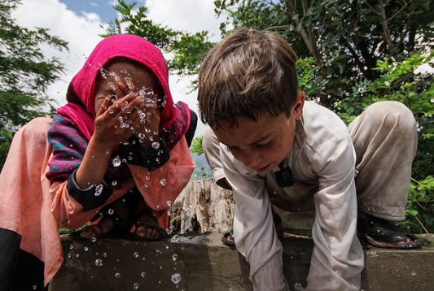
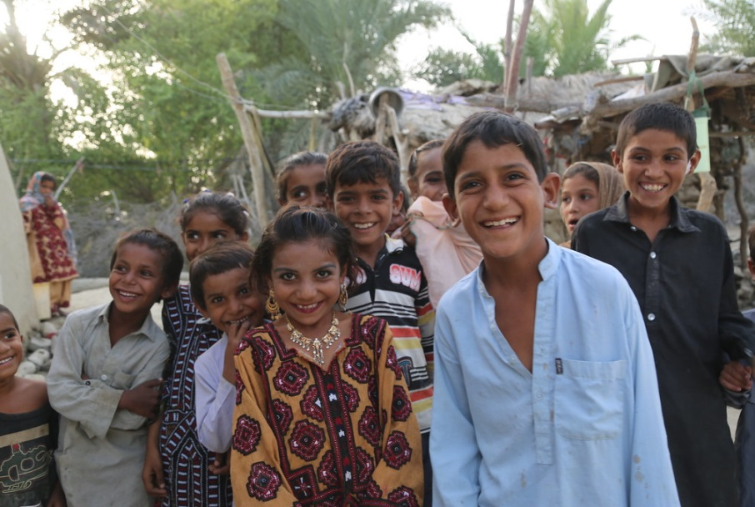


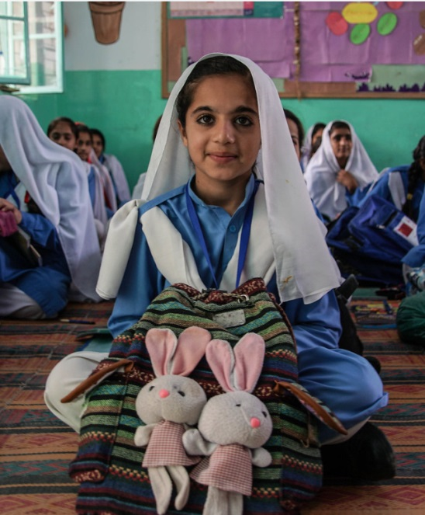
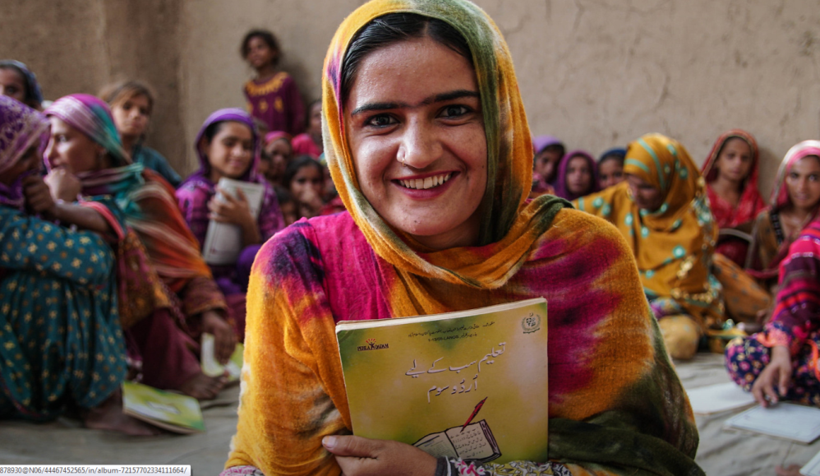
EU cooperation in Pakistan
EU cooperation
Total budget € 653 million

Slide 69
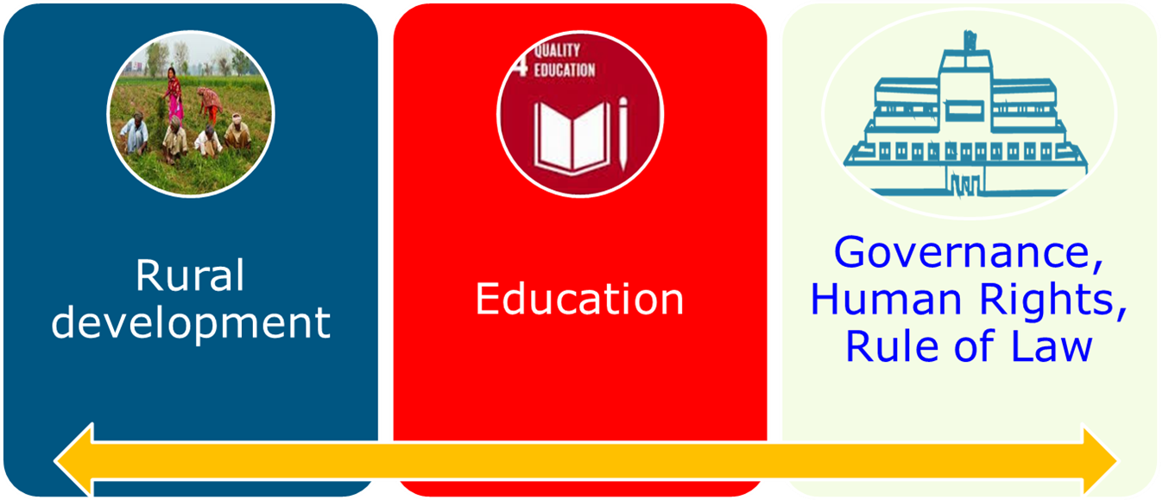

3 Thematic focal areas of cooperation
340 million
52%
210 million
32%
97 million
15%
Total budget € 653 million
Funded by Development & Cooperation Instrument
MIP 2007-2013 – EUR 398 Million
MIP 2014-2020 – EUR 605 Million
MIP 2021-2027 – Programming starts early 2020
regional indicative programmes

Slide 70
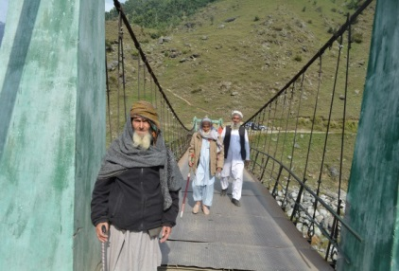
Focal sector 'Rural development and economic cooperation' 1
KP District Governance and Community Development Programme
(KP DGCD, 10/2014 – 06/2020, EUR 80 M)
Budget - EUR 80 M - of which budget support to KP Provincial Government EUR 57.125 M and complementary support of 22.875 M
Geographical coverage - 13 KP districts including 8 districts of Malakand Division and Haripur, Nowshera, Swabi, Torghar and Battagram
Main objective - To establish a financial and institutional mechanism and procedures for the implementation of Community Driven Local Development (CDLD) policy in KP Province
Achievements
4,599 community-based projects approved (worth of PKR 5.5 billion)
904 Women specific projects approved (0.7 million beneficiaries)
3.4 million total beneficiaries
PKR 4.5 billion disbursed to CBOs
1549 Village Council Development Plans prepared by all Village Councils / Neighbourhood Councils 13 Districts

Slide 71

Sindh Union Council and Community Economic Strengthening Support Programme (SUCCESS, 08/2015-08/2021, EUR 82 M)
Focal sector 'Rural development and economic cooperation' 2
Geographical coverage - 8 districts of Sindh
Main objective – Stimulate community-driven local development initiatives to reduce poverty and paying particular attention to empowering women.
Achievements
Sindh Poverty Reduction Strategy adopted and being implemented.
Community organizations: 556,356 households are organized into 28,518 Community Organizations (Cos), 3,327 Village Organizations (Vs) and 310 Local support Organizations (LSOs).
Community Investment Funds (CIF) sub grants have been transferred to 452 Community Institutions that invested mainly in livestock. 14,502 (25% of the target) women from the poorest households got income generating grants and invested in livestock.
736 Community Physical Infrastructures initiated.
128,063 poorest households were insured under the Micro Health Insurance.
10,297 people have been trained in various Technical and Vocational Skills Training.

Slide 72
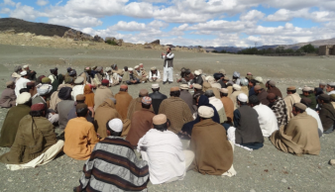
Balochistan Rural Development and Community Empowerment Programme (BRACE, 06/2016 – 06/2022, EUR 45M)
Focal sector 'Rural development and economic cooperation' 3
Geographical coverage – 9 districts of Balochistan (Turbat, Jhal Magsi, Washuk, Khuzdar, Loralai, Dukki, Kila Abdullah, Pishin, Zhob)
Main Objectives - To build and to empower resilient communities participating actively in identifying and implementing socio-economic development activities on a sustainable basis in partnership with local authorities.
Achievements
Poverty Profiling of 1.9 M beneficiaries;
3,816 Community Institutions established, trained on community
management, leadership, etc.
630 persons provided with TVET skills;
1,090 women provided with literacy and numeracy skills;
Financial instruments: PRK 78.4M community-based lending, Micro-investment plans - 117,589 Housholds (HHs);
PKR 8.7 M worth productive assets; 87 community infrastructure benefiting 8,268 HH
965 Village and 29 Union Council development planning completed;
Experts assist with the dev. of a Community-led Local Dev. Policy and PFM Reforms.

Slide 73
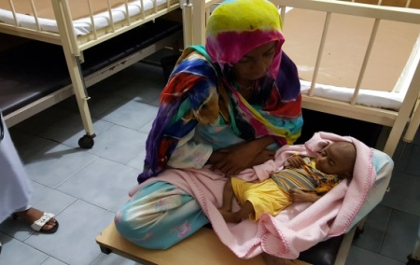
Programme for Improved Nutrition in Sindh (PINS)
(07/2017- 07/2021, EUR 60 M )
Focal sector 'Rural development and economic cooperation' 4
Geographical coverage - 10 districts of Sindh
Main objective – To sustainably improve the nutritional status of children under five and of pregnant and lactating women in Sindh.
Achievements
259 Outpatient Therapeutic Units are established and functional in 8 districts with staff and supplies;
3,852 women and men Agricultural Entrepreneurs trained;
82,230 men and women from poor households (0-23 PSC) have been trained on kitchen gardening;
96,626 received seed and manures and 65,976 have actually demonstrated kitchen gardening at their homes and are consuming vegetables at home;
2,139 poor HH with Pregnant and Lactating Women and children under 5 have been provided with goats and they are using milk for women and children;
9,124 poultry entrepreneurs trained and provided with poultry inputs (cockerels, drinkers, feeders and poultry feeds);
236 individual fisher farmers have been trained to improve fish pound management practices and implementation of Community Fish Pounds initiated;
3,919 women and men have been trained to work on community level WASH interventions,
19,776 households constructed latrines;
51,228 awareness sessions have been conducted on WASH and Food diversity.

Slide 74
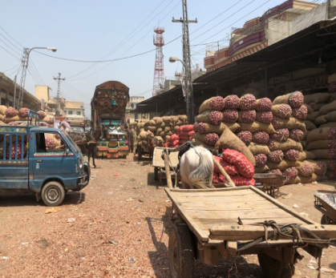
Growth for Rural Advancement and Sustainable Progress (GRASP)
(06/2019 – 12/2024, EUR 50 M)
Focal sector 'Rural development and economic cooperation' 5
Geographical coverage - Federal, Sindh, Balochistan
Main objective – To support income and employment generation, enhanced productivity and profitability of SMEs involved in primary production, service provision and value addition in and around selected clusters of production
Outputs –
1. Institutional capacity strengthened and business environment
improved for rural SME development.
2. Enhanced productivity and quality of production (SMEs and Business Intermediaries)
3. Value addition, technology upgradation and enhanced marketed volumes
Achievements
Inception phase ongoing July 2019 - April 2020: Multi-stakeholders consultations; preliminary assessments; baseline surveys; products & districts identification & selection; value chain mapping and refining workplan etc.

Slide 75
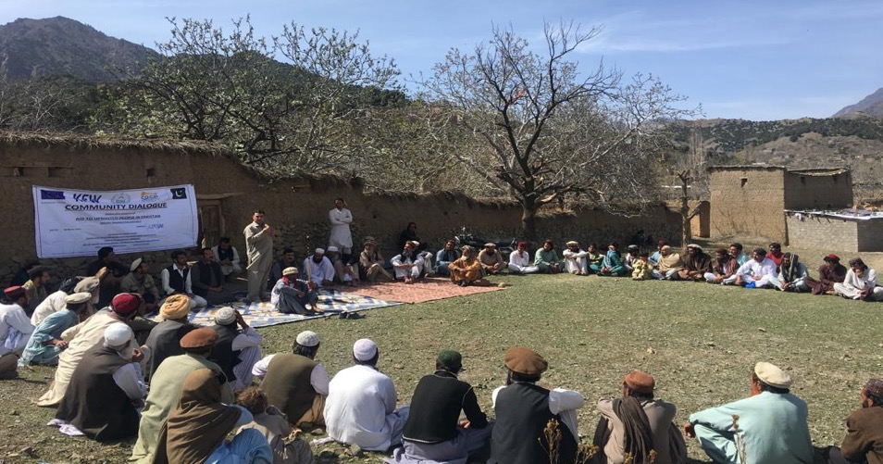
Focal sector 'Rural development and economic cooperation' 6
Aid to Uprooted People in Pakistan (08/2016 – 08/2021, EUR 22 M [RIP]
Budget – Total EUR 34 M, Co-financed by German Govt (EUR 12 M) with implementing partners – GIZ, KfW component implemented by SRSP
Geographical coverage - 5 Merged Districts of KP (ex-FATA)
Main objective - To facilitate the reintegration of KP’s merged districts Temporarily Displaced Persons by creating a favorable environment for their return.
Achievements
CO formation: 180 CBOs formed (target 340)
Infrastructure schemes: 111 initiated (target 312)
Trainings: 640 male/female trained (target 3400)
Governance: Local governance baseline completed
Health: Quality Assurance Plan for Health Centers
Education: EMIS developed

Slide 76
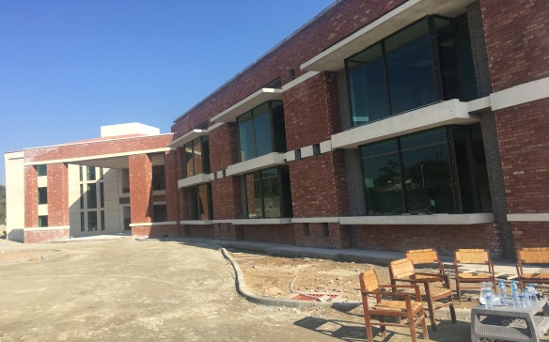
Hydropower Training Institute (HPTI), Mangla
(2013-2018, EUR 2.7 M, [RIP, Asia Investment Facility])
Focal sector 'Rural development and economic cooperation' 7
Geographical coverage - Mangla, District Jhelum, Punjab
Total budget – EUR 4.315 M, (EU - EUR 2.67 M, AFD - EUR 1.65 M)
Main objective - To promote and facilitate hydropower in Pakistan, in order to address the energy crisis and climate change issues through renewable and environmental friendly energy, along the line of EU policy in the country.
Achievements
Building completed with a covered area of 55,000 sq ft consisting of:
8 Class Rooms; 4 Laboratories;
1 Comp Room; 1 Auditorium for 150 people;
Administration Block; Library;
and a Committee Room.

Slide 77
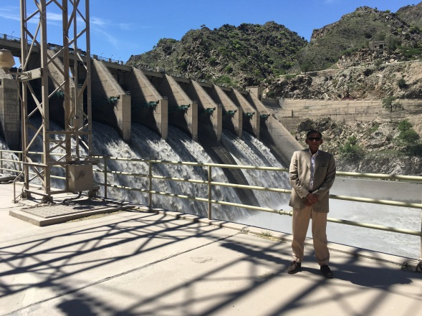
Warsak Hydropower Plant Rehabilitation
(2015-2021, EUR 4.7 M, [RIP, Asia Investment Facility])
Focal sector 'Rural development and economic cooperation' 8
Geographical coverage - Khyber District (ex-FATA)
Total budget – EUR 162 M, (EU – EUR 4.7 M, EIB – EUR 50 M, KfW –EUR 40 M, AFD – EUR 40 M)
Main objective - To contribute in the reduction of country energy crisis through increasing the longevity of low cost renewable energy 240 MW power source for another 40 years.
Achievements
Sedimentation management: Tender in process
Flood management: Tender in process
Community development: Partner selected
Workshop equipment: Re-tendered

Slide 78
Punjab urban water services improvement programme
(foreseen duration 2021 to 2024, EUR 12 M, [RIP, Asia Investment Facility])
Focal sector 'Rural development and economic cooperation' 9
Geographical coverage - Punjab (Faisalabad and Lahore)
Total budget – EUR 179 M (EU – EUR 12 M for TA, AFD – EUR 94 M for loan, GoPunjab – EUR 73 M)
Main objective - improvement of the living conditions of the population of the cities of Lahore and Faisalabad and economic development of these two cities through:
    improved access to water service for the inhabitants of the city of Faisalabad,
    improved water and sanitation service performances,
    Reinforced capacities of the Water and Sanitation Authorities;
    Creation of a regulatory framework in the water sector to improve sector governance and financial sustainability.
Achievements
Memorandum of Understanding signed between AFD and Government
Pre-feasibility studies completed
Complementary analysis and feasibility studies in tendering process

Slide 79
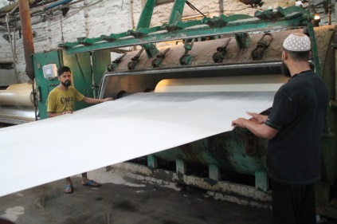
International Labour and Environmental Standards Application in Pakistan’s SMEs (ILES, 10/2016 - 9/2021, EUR 11 M, [RIP])
Focal sector 'Rural development and economic cooperation' 10
Geographical coverage - Legislative goals are nationwide with enterprise level activities focussing on Sindh, KP, and Balochistan.
Total budget – EUR 11.6 M (EU – EUR 11 M, Co-financed by partners ILO and WWF - EUR 0.6 M)
Main objective – Improving compliance with labour and environmental standards, thereby supporting the economic integration of Pakistan into the global and regional economy (see GSP+) and increasing competitiveness.
Achievements
Meeting international obligations regarding the 39 labour related international
instruments agreed by Gov. to be considered by the federal parliament.
ILO’s 4 month course "Sustaining Competitive and Responsible Enterprises programme" in Karachi with participating 8 enterprises and 12 trainers completed, 2 enterprises and 11 additional trainers ongoing
Tailored trainings on occupational safety and health in 101 enterprises Signing of a memorandum of understanding with the Sindh Environmental Protection Agency and active engagement with the government of AJK on environmental policy reform.
55 environmental audits of enterprises in the textile and leather sectors.
Establishment of 2 pilot waste water treatment plants.
Continued support to the Pakistan Buyers’ Forum.

Slide 80
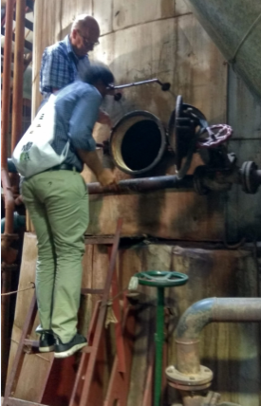
Implementation of Resource and Energy Efficient Technologies in the Sugar Sector of Pakistan (IREET, 03/2018 - 03/2022, EUR 1.4 M, [RIP – Switch Asia II])
Focal sector 'Rural development and economic cooperation' 11
Geographical coverage – Nationwide, with particular focus on Sindh and Punjab
Total budget – EUR 1.8 M, Co-financed by partners Iqbal Hamid Trust (IHT) pakistan, Lead Partner, Collaborating Center for Sustainable Consumption & Production (CSCP), Germany - (EUR 0.4 M)
Main objective – Enhancing resource efficiency of the sugar
sector through adoption of Resource and Energy Efficiency technologies.
Achievements
Energy audits completed at 9 sugar mills;
Establishment of a Conducive Regulatory Framework including a
multi stakeholder platform for promotion of Resource and Energy Efficiency
State Bank of Pakistan is being advised on expansion of its Renewable Energy refinance facility
Enhanced Awareness & Capacity of Sugar Sector, Solution/Service Providers & Farmers: awareness campaign started.

Slide 81
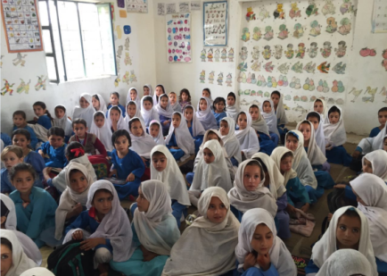
Development through Enhanced Education Programme – DEEP (2018-2022, EUR 50 M)
Focal sector 'Education and skills development' 1
Geographical coverage - Sindh Province
Main objective - to contribute towards universal access to quality education in Sindh, enabling young people to progress and engage in productive employment or higher/ vocational education.
Specific Objectives
Education planning, financial management and administration improved
More children enrolled and retained in government and low cost private schools (gender and rural-urban disaggregated) from early childhood to secondary education.
Children receiving better quality education
Achievements
The programme started first activities in the second half of 2019

Slide 82
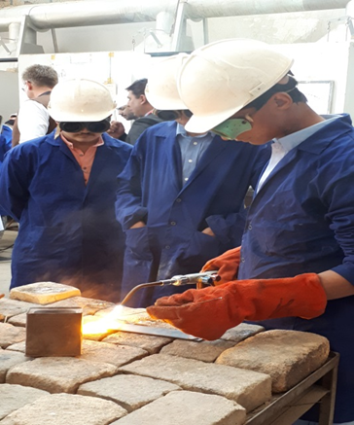
Support to the Technical and Vocational Education and Training Sector in Pakistan - TVET III (01/2017-12/2021, EUR 64 M)
Focal sector 'Education and skills development' 2
Budget - EUR 64 M (EU contribution EUR 45 M)
Geographical coverage - National
Main objective - To improve governance and private sector participation in the TVET sector to enhance access to quality skills development that meets demand of the labour market.
Achievements
900 agreements signed to involve the private sector in training
4 sector skill councils created (textile, construction, hospitality, energy)
310 training institutes accredited
9000 plus people enrolled in trainings
158 master trainers and 2173 teachers (800 females) trained
509 principals (112 females) and 896 assessors (211 females) are trained
14,754 (4,982 females) people are certified based on learning and skills
5500 trainees are assessed and certified

Slide 83
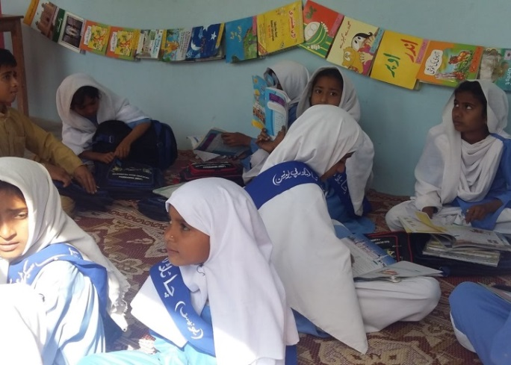
Balochistan Basic Education Programme (05/2014-11/2022, EUR 18.4 M)
Focal sector 'Education and skills development' 3
Geographical coverage - Balochistan
Main objective - To accelerate and further increase the number of children (especially girls) enrolling and completing quality elementary education in Balochistan
Achievements
Balochistan Assessment and Examination Commission established and regularly supported for capacity building
67 master trainers capacitated on training modules, who trained 393 teachers (245 men; 148 women)
1002 Parent Teacher School Management Committees oriented for better school management
269 Local Education Councils developed and trained
1,002 school development plans developed benefiting 157,226 children
Orientations on menstrual hygiene management reaching 18,107 girls, 2,340 teachers and 2,903 mothers
Education Management Information System and Real Time School Monitoring system for increased accountability and evidence-based planning introduced

Slide 84
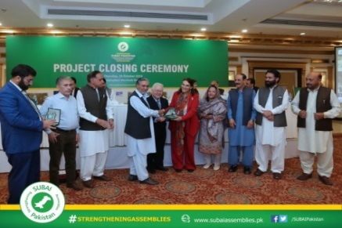

Focal sector 'Governance and Human Rights' 1
Support to democratic institutions – SUBAI (11/2016-10/2019, EUR 8.4 M)
Geographical scope – 4 Provinces (Punjab, KP, Sindh, Balochistan)
+ Gilgit Baltistan and Azad Jammu and Kashmir
Main objective : Improve the functioning of Pakistan's parliamentary institutions at Provincial level, through effective legislation, strengthened policy and budget oversight and enhanced representation
Achievements
Strengthened democratic process by standardizing legislative process, developing guides on role, functions and powers of the committees
Development of strategic plans for KP Assembly
Enhancement of the capacity and outreach of Members and Secretariat staff
Support to Women Parliamentary Caucuses and to the SDG Task Forces
Improved transparency by creating and revamping websites

Slide 85
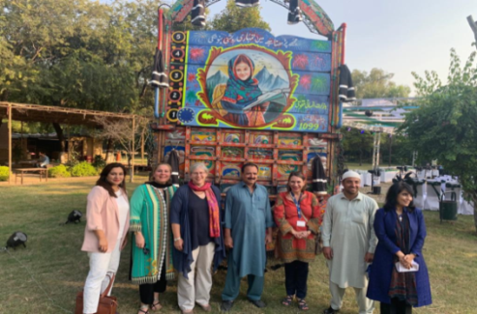
Promotion of Human Rightsin Pakistan
(2019-2021, EUR 7,9 M)
Focal sector 'Governance and Human Rights' 2
Geographical coverage - national
Main objective - To enhance the capacity of the federal
and provincial institutions and to promote and create
awareness of duty bearers and general public in the area of human rights
Achievements
Conducted needs assessment for Min. of Human Rights, Provincial Human Rights Depts. and Treaty Implementations cells; drafted training strategy and training
Developed communication material on Children's Rights to education, freedom from child marriage, domestic labour and child abuse
Organized the October 2019 event on Rights of the Girl Child through truck art

Slide 86
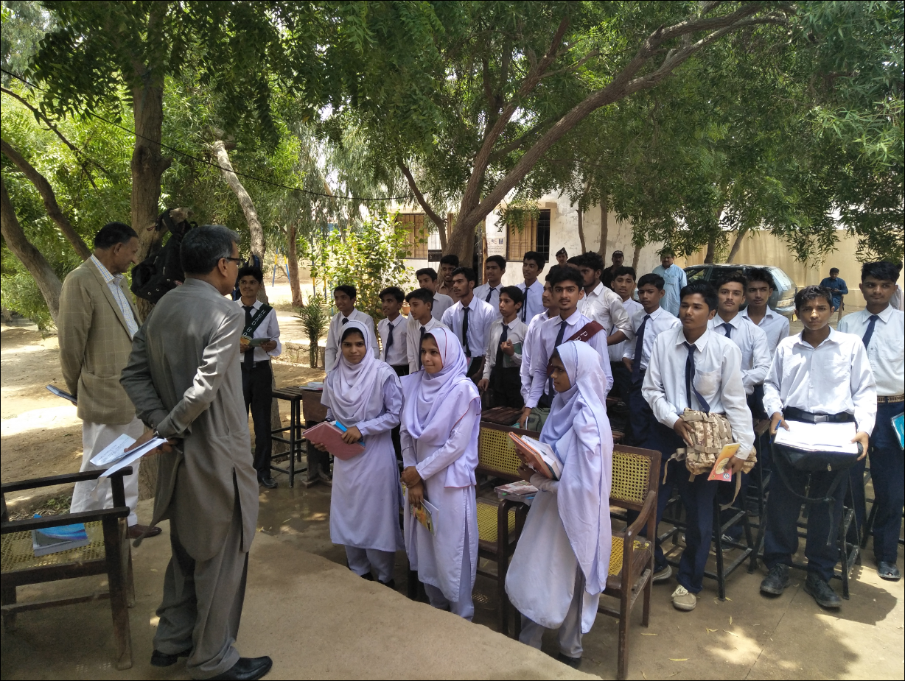
Public Financial Management Support Program for Pakistan PFM SPP (2014-2019, EUR 16,3 M)
Focal sector 'Governance and Human Rights' 3
Geographical coverage - Federal, Sindh, Balochistan
Main objective - to contribute to the improvement of public financial administration and to enhance the effectiveness and efficiency in the utilization of government budget resources in order to deliver better public services and to reduce the impact of poverty and social inequality
Achievements
Federal: Macro-economic and fiscal model transferred to macro unit in Min of Finance - Public Finance Administration Act (June 2019) - PFM reform strategy - Budget Manual - Results Based Management system (Green Book) – contribution to improvement in IFMIS system – training on budget processes
Sindh: PFM Reform Action Plan - Annual Budget Formulation strengthened - Sector plans in a number of departments – PFM Law adopted by Cabinet (April 2019) - training on budget processes
Balochistan: PFM reform strategy - Annual Budget Formulation strengthened - Sector plans in a number of departments – draft PFM Law - various training on budget processes including at district level

Slide 87
Additional funding instruments
Food Security thematic programme
ILTS
FIRST
Civil Society Local Authorities budget line
7 grants ongoing
5 with CSOs
2 with associations of local authorities

Slide 88
Additional funding instruments
Asia Investment Facility - Blending
3 projects
Instrument contributing to Peace & Stability (IcSP)
4 Projects ongoing on:
Risks of chemical, biological, radiological and nuclear materials
Countering terrorism and violent extremism; fighting against drugs and organised crime

Slide 89
European Civil Protection and
Humanitarian Aid Operations (ECHO) funding
2019 total financial envelope: EUR5m + EUR4m for Afghan refugees
ECHO budget 2020 still to be formally approved
Besides HIP other funding instruments in use in Pakistan are:
Small Scale
DREF: this is a fund only available to the IFRC which ECHO can replenish.

Slide 90
ECHO Pakistan focus for 2019/2020
Afghan refugees (protection, health and education)
Returnees to the newly merged tribal districts in (WASH, cash, health, education)
People affected by Natural Disasters (flash flood, flood, drought, earthquake)
Regarding drought ECHO’s involvement has to be linked to development projects funded by the European Commission and builds on ECHO-funded DRR / Resilience activities from the HIPs 2017 / 2018 / 2019 in Sindh
Education in Emergencies

Slide 91
5
External Financing Instruments

Slide 92
5.1
Financing Instruments
2014-2020
2021-2027

Slide 96
Geographic scope of the proposed Instruments
2014-2020
2021-2027

Slide 97
5.2
Financing Instruments
2021-2027

Slide 98
EU External Budget 2021-2027
The European Commission has proposed to increase the EU's overall external action budget from currently €96 billion to €123 billion, to significantly simplify its structure, and make it much more flexible and effective to address today's global challenges.
If confirmed, this would be a 30% increase allowing EU to be a reliable, predictable, cooperative global player.

Slide 99

External Heading Proposals
HEADING VI: Neighbourhood and the world | Amounts (billion euro)
Neighbourhood, Development and International Cooperation Instrument | 89.2
Instrument for Pre-accession assistance | 14.5
Humanitarian aid | 11
Common Foreign and Security Policy | 3
Overseas countries and territories including Greenland | 0.5
European Instrument for Nuclear Safety | 0.3
Other | 1.219
Margin | 3.283
Total | 123.002
European Peace Facility | 10.5

Slide 100
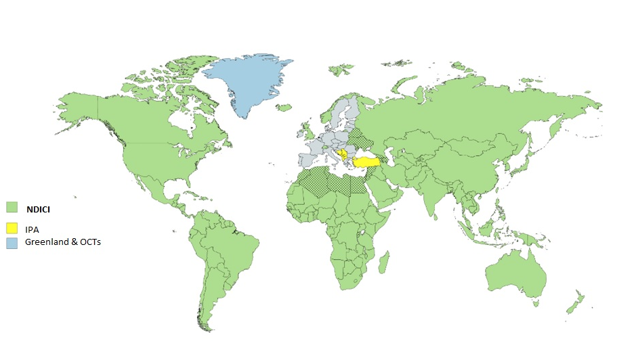
New External Instruments
Notes:
And this is the simplified set-up of geographic instruments.

Slide 101
EU External Budget 2021-2027
The main, simplified Instrument to deliver cooperation funding will be the Neighbourhood, Development and International Cooperation Instrument (NDICI)
It has three pillars:
1. geographic, to jointly address global challenges such as human development including gender equality, climate change, environmental protection, migration and food security
2. thematic, focussing on support for human rights and democracy, civil society, stability and peace
3. rapid response, to allow the EU to swiftly respond to crises, as well as to support conflict prevention, build resilience, link humanitarian aid and development action

Slide 102
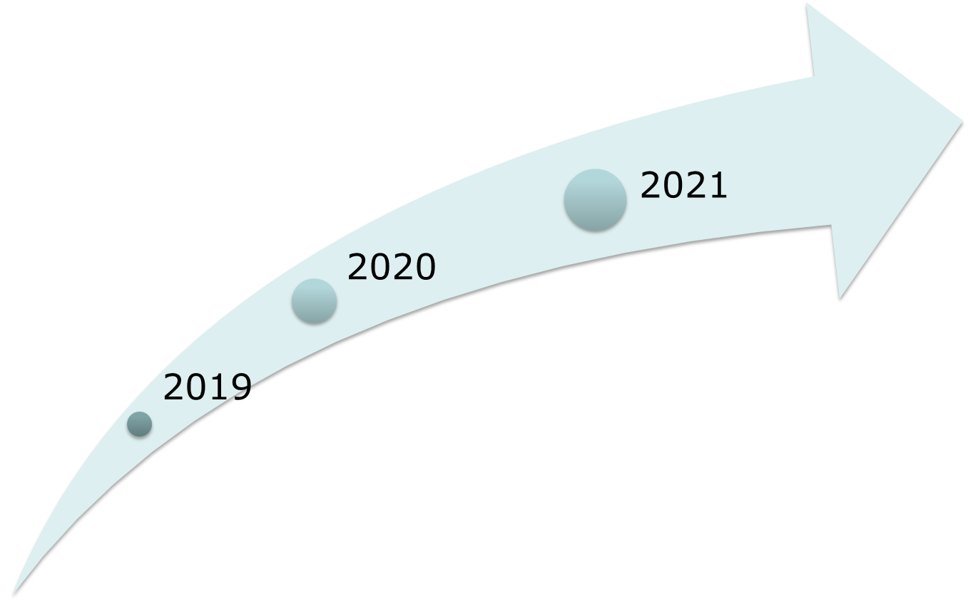
Timeline Programming
MPP 2021-2027
Early 2021: NDICI Committee approves programming documents followed by financing decisions which Commission subsequently adopts
Early 2020: Early indicative estimation per year and per geographic area
  of sovereign/private lending
  for ERASMUS+
  for budgeting process in
  2020 (EU Budget 2021)
Late 2020: Finish programming process
End 2019: Start programming process in order to develop programming documents

Slide 103

NDICI 2021-2027
Geographic
Thematic
Rapid Response
Neighbourhood
Sub-Sahara Africa
Asia and Pacific
The Americas and the Caribbean
Human Rights and Democracy
Civil Society Organisations
Stability and Peace
Global Challenges
Crisis Response and Conflict Prevention
Resilience and linking humanitarian and development actions
Foreign policy needs and priorities
Emerging challenges and priorities cushion
Geographic approach preferred; thematic programmes + rapid response complementary

Slide 104
Official Development Assistance and Aid Effectiveness
Official development assistance (ODA) is a term coined by the Development Assistance Committee (DAC) of the Organisation for Economic Co-operation and Development to measure aid; it forms a key pillar of aid accountability. Aid that qualifies as ODA is referred to as "DAC-able"
The EU subscribes to the five principles of development assistance of the Paris Declaration: Ownership, alignment, harmonisation, results, mutual accountability.

Slide 105
EU ODA Commitments
The EU and its Member States in 2018 spent more than €74.4 billion in ODA, almost 57% of the world's total.
The EU and its Member Stages have committed to spend 0.7% or more of Gross National Income in ODA. Currently the rate is 0.47%; four EU Member States have reached the target: Denmark, Luxembourg, Sweden, and the UK.
More information:
https://euaidexplorer.ec.europa.eu/

Slide 106
Joint Programming
Joint programming refers to a joint response from the EU and its member states to the national development plan of a partner country. It is one of the key commitments by EU countries that work together in development, to ensure that aid is effective, enshrined in the 2017 European Consensus for Development.

Slide 107
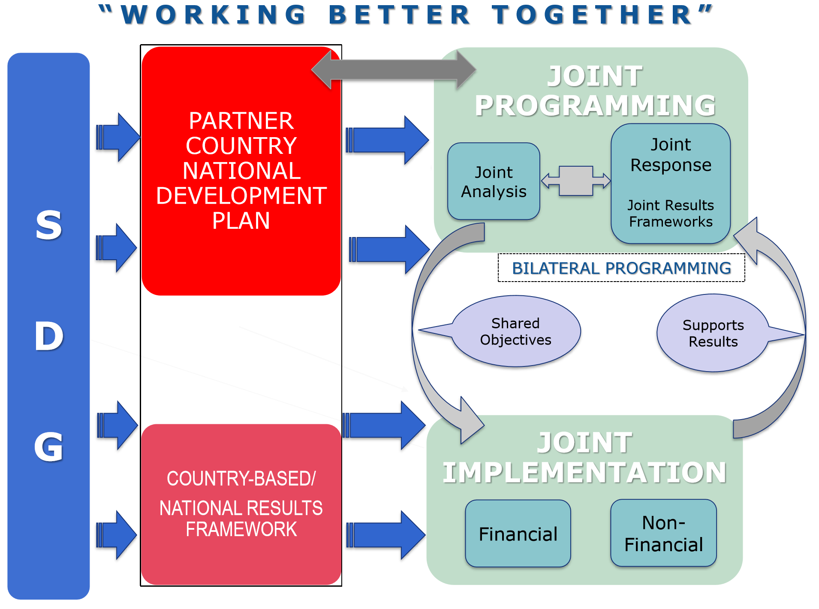

Slide 108
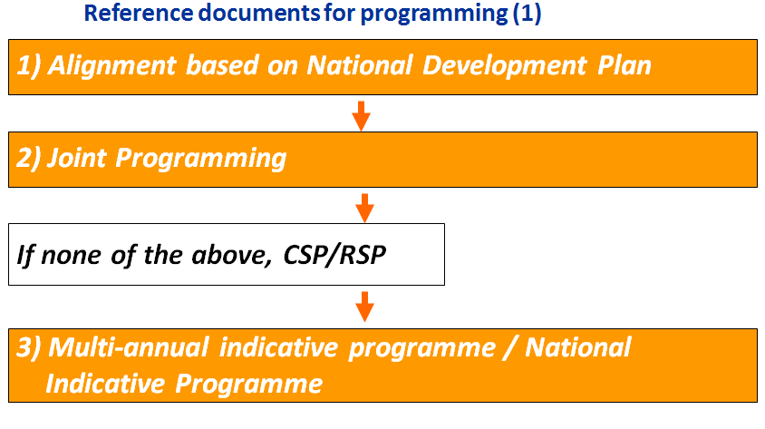
Notes:
Acronyms
CSP – Country Strategy Paper
RSP – Regional Strategy Paper

Slide 109
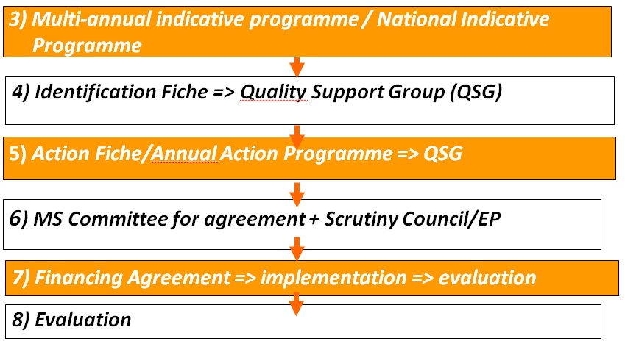
Reference documents for implementation (2)

Slide 110
NDICI’s Specific Targets
A level of at least 92% of DAC-ability has been set for the whole instrument (article 3) – NDICI should contribute to the collective Union objective of providing 0.7% GNI as ODA /0.2% for LDCs
Other targets
  25% for climate-related actions
  20% of ODA-eligible funds for social inclusion and human development, including gender equality and women empowerment
  10% for migration-related actions
Mainstreaming: climate change, environmental protection and gender equality (article 8)

Slide 111
6
Practical information

Slide 112




EU Delegation on social media
@EUinPakistan
@EUPakistan
Web https://eeas.europa.eu/delegations/pakistan_en
EU Delegation to Pakistan
@eudelegaitonpakistan

Slide 113
EU Financial Transparency System (FTS)
https://ec.europa.eu/budget/fts/index_en.htm
FTS lets you search through the beneficiaries of funding from the EU budget implemented directly at headquarters or in EU delegations.
FTS does not provide information on funding from the EU budget implemented indirectly by other international organisations or non-EU countries ('indirect management').

Slide 114


Thank you
FOR YOUR ATTENTION
بہت شکریہ

