Slide 1


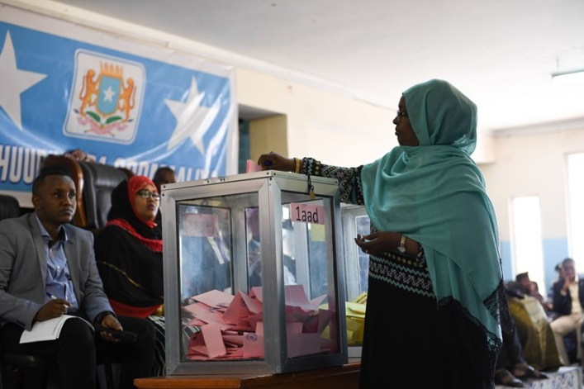
WORKING WITH SOMALI PEOPLE TO BUILD PEACE AND PROSPERITY
STATE AND PEACE BUILDING
Building state legitimacy and responsiveness, and democratic governance
THE CHALLENGES
After more than two decades of conflict, Somalia is showing signs of progress: regional administrations have been established as part of the federal architecture, State institutions – including new ones – have increased their legitimacy and capacity, democratic mechanisms have been gradually adhered to. However, Somalia’s governance structures remain structurally weak and insufficient, own revenue generation is still very low, the majority of the population cannot access justice mechanisms, the reach of the State beyond regional capitals is limited and under continuous threat. Only tangible progress in delivering security, justice, administrative and basic services can create and nurture the trust between the population and the State. At the same time, the persistence of conflict at various levels makes peace-building and reconciliation an essential component of state building in Somalia. Increasingly legitimate local authorities will need to address the needs of communities to ensure lasting stabilisation, while an inclusive debate – including on the relations between the centre and the Federal Member States and between key institutions – will have to guide a much needed Constitutional development.
OUR SUPPORT
EU interventions have focused towards the following areas of action:
Financial governance and institutions building
The EU has made substantial investments in strengthening the public administration and establishing robust public financial management (PFM) systems and processes, which are essential to enable the federal and state governments to increase revenues, manage resources and deliver basic services. The nascent dialogue on the federalism architecture, including the establishment of fiscal arrangements is being supported. The outcome of this dialogue should promote greater equity and resource distribution among federal and state governments. EU support is largely implemented through trust funds managed by the World Bank, IMF and the UN.
Democratic processes and accountability
The EU has been a leading actor in the field of democratisation through the UN as well as bilateral programmes. We have supported the National Federal Parliament (and recently the established State assemblies in terms of infrastructure and equipment, capacity building and technical assistance). The EU has also supported the conduct of the 2016/2017 electoral process alongside contributing to the establishment and capacity building of the National Independent Electoral Commission (NIEC) and other federal governance institutions such as the Boundaries and Federalism Commission (BFC). Further support has allowed to progress in the review of the Federal Provisional Constitution under the leadership of the Parliamentary Oversight Committee and the Independent Constitutional Review and Implementation Commission (ICRIC). In Somaliland, the EU has provided the bulk of support to the establishment of a credible and accepted voter register, which was decisive for an inclusive and credible electoral process in 2017.
In all these areas the EU has also promoted civic engagement and demand for accountability by supporting the Somali civil society, from well-established Somali NGOs to community-based organisations, to professional associations and the private sector. Support has focused on human rights organisations, cultural initiatives as a vehicle for peacebuilding, women’s groups and the promotion of free and independent media.

Slide 2
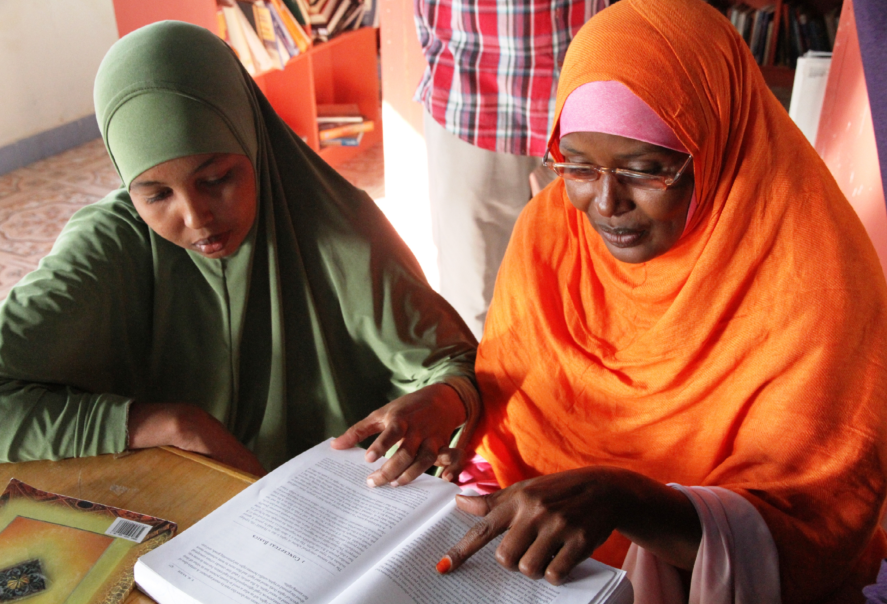
Reconciliation, stabilisation and local governance
The EU has accompanied the political reconciliation process which resulted in the formation of all the Federal Member States between 2014 and 2016 (Jubaland, South West, Galmudug and HirShabelle) in addition to the existing Puntland and Somaliland, and has provided support for the establishment of these new administrations. In support of the Government’s Wadajir Framework for Local Governance, the EU has also engaged in community reconciliation and the reestablishment of local administrations that can facilitate the delivery of basic services and tangible peace dividends in an accountable and responsive manner through the Somalia Stability Fund, the UN Joint Programme on Local Governance and bilateral assistance (Finn Church Aid led consortium).
Justice
The EU has been one of the major partners supporting the rebuilding of the judiciary – with the pace of actions picking-up in tandem with improved access across the country and an increased ownership of Somali judiciary stakeholders. Through the UN Joint Rule of Law Programme we have increased access to justice through the deployment of mobile courts, provision of legal aid, refurbishing of infrastructure, strengthening the human capital through the provision of academic law scholarships and training of justice actors, and improving the living conditions of detainees. The judiciary and corrections model currently being developed will form the basis of the EU's support for the years to come, which will also aim at reinforcing the connectivity between the formal justice and traditional dispute resolution mechanisms.
OUR RESULTS
Amongst most relevant results achieved by the EU support in this sector:
150 students graduated with law degrees through a scholarship programme and working with justice institutions.
6,700 civil and criminal cases heard and adjudicated through mobile courts, in addition to 40,000 cases through the permanent courts. 40,000 individuals accessed legal representation thanks to the provision of legal aid.
Rehabilitation of and procurement of furniture and equipment for courts, police stations, prisons, the National Federal Parliament, State Assemblies and other public administration structures of the new member states.
Increased number of laws, resolutions and other acts adopted by the National Federal Parliament thanks to technical assistance and strengthened organisational and human capacity
Community-driven development investments and key infrastructure built/rehabilitated in targeted locations recovered from Al-Shabaab.
Establishment of District Councils in South West and Jubaland in line with the Wadajir Framework.
EU support also strongly contributed to the following achievements:
• More than 5,000 civil servants and an increasing number of teachers regular and timely paid through country system and merit based recruitment and salary system for strategic government staff implemented.
• Increased number of voters in the 2016/2017 process (from 135 to 14,025) and vote in Federal Member States through the Establishment and operationalization of federal and state level ad hoc electoral bodies.
• Establishment of a 10th House of the People and an Upper House and increase women's representation in the Federal Parliament to 24,3 % through assertive action.
• About 20 Ministries at federal and state level with organizational structures and core mandates defined and established.
• Establishment of Jubbaland, South West, Galmudug, Hirshabelle administrations and the buy in of Puntland in the federal architecture.
• Continuous growth of revenue and new dialogue for the re-engagement of the IFIs (for debt relief and access to concessional lending) thanks to PFM strengthening reforms.
OUR CONTACTS
Luca Trinchieri – Head of Section Luca.trinchieri@eeas.europa.eu
Eva Atanassova – Programme Manager Democratisation Eva.Atanassova@eeas.europa.eu
Katarina Motoskova – Programme Manager Financial Governance Katarina.Motoskova@eeas.europa.eu
Safia Abdi – Programme Manager Public Sector Development Safia.Abdi@eeas.europa.eu
Timothy Baines – Programme Manager Rule of Law and Security Sector Reform Timothy.Baines@eeas.europa.eu
Jane Rama – Programme Manager Gender, Culture and Civil Society Jane.Rama@eeas.europa.eu

